Slide 1
Valve Preservation Challenges
CONFERENCE
ORGANIZERS

Slide 2
Valve Preservation Challenges
Salam Alsowaidan | Chief Representative Aramco Europe - Italy

Slide 3

Outline
Equipment Deficiencies Report (EDR) Process
Deficiencies Statistics
Preservation Deficiencies Cases
Recommendations

Slide 4
EDR Proceess
Definition:
Equipment Deficiency Report (EDR) is an SAP report established at the end of 2001, documenting purchased inspectable material received at site and found deficient due to manufacturing or transportation issues.
Objective:
To take effective corrective action & to ensure that reporting, investigation, and documentation of equipment deficiencies are handled consistently (SAEP-380 :Equipment Deficiency Report)

Slide 5
EDR Proceess
Scope:
Purchased Inspectable material:
  Arrived at site with deficiency(ies).
  Failed prematurely after deployment
Advantages:
  Report manufacturing deficiencies
  Identify root cause(s)
  Determine & implement corrective actions to avoid recurrence.
  Measure and evaluate quality management system effectiveness (manufacturers, inspection agency)
  Identify continual improvement of the quality management system

Slide 6
EDR Proceess
Equipment Deficiency Report
Defective Material/ Prematurely Failure
Initiation
Originator initiate EDR
EDR coordinator review / assign task to QME
Investigation & remedial actions
QME investigation
Corrective actions
Evaluate vendor/escalate issue
Feedback reviewed by EDR coordinator
Completion
EDR will be closed
Interested parties are notified

Slide 7
Deficiencies Statistics

Slide 8
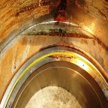
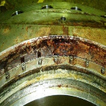
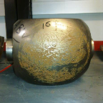
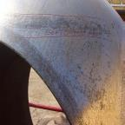
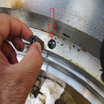
Preservation Cases
Water with high chloride content caused pitting corrosion
Residual Test Fluid Remaining in Valves
Corrosion of a 16” ball which was tested with untreated water

Slide 9
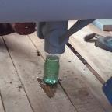
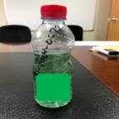
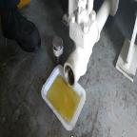
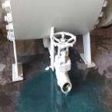
Preservation Cases
Valves Arriving at Site, Still Containing Hydrostatic Test Liquid

Slide 10
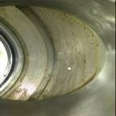
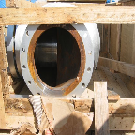
Preservation Cases
Covers & Straps not Complying with Spec.
Insufficient corrosion inhibitor on surface
Improper Packaging

Slide 11
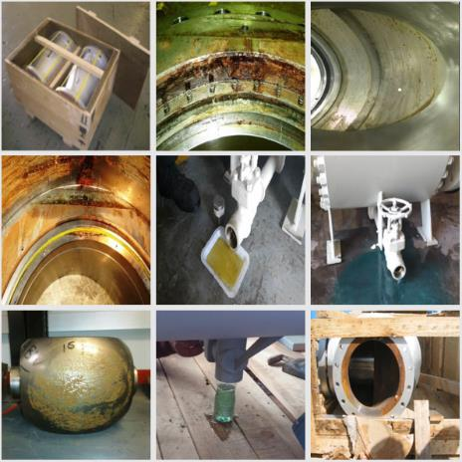
Root Causes
Procedure Factors
Poor draining and drying
Improper inspection after draining and drying
Lacking tilting / blowing / drying of valves
Valve’s ball is not in full open position
Poor water quality, high chlorine content
Poor procedure for shipment preparation
Inadequate packaging

Slide 12
Root Causes
Human Factors
Ignoring the importance of fully draining and drying valves
Lack of training and knowledge of specification requirements
Poor final inspection

Slide 13
Recomendations
Manufacturers to provide guidelines for valve preservation restoration procedure after receiving inspection at site (un-packaged condition)
Manufacturers to provide detailed procedure of maintaining the preservation during the stored condition to minimize the need to repeat test prior to site installation
Manufacturer encouraged to evaluate utilization of Volatile Corrosion Inhibitor (VCI) or equivalent for valve storage
Manufacturer to enhance the final inspection procedure to ensure valve preservation is done prior to packing

Slide 14
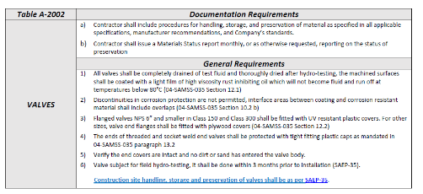
Recomendations
SAEP-385
Ensure valves are completely drained and dried after hydrotest
Utilize corrosion inhibitor in hydrotest fluid
Utilize dry air during valve drying after hydrotest
To include tilting and rotation of valve to drain the valve after hydrotest

Slide 15
Thank you
ORGANIZING SECRETARIAT
Ph. +39 035 3230904
e-mail info@industrialvalvesummit.com
CONFERENCE ORGANIZERS
Ph. +39 3474908420
e-mail segreteria@valvecampus.com
www.industrialvalvesummit.com
www.valvecampus.com

