Slide 1
Valves for Hydrogen Fluoride (HF) Alkylation Service
CONFERENCE
ORGANIZERS

Slide 2
Valves for Hydrogen Fluoride (HF) Alkylation Service MSS SP-160
MSS TC-410 Severe & Special Service Valves
Paul Heald | VP Product Engineering, Specialties & China Operations
BONNEY FORGE

Slide 3
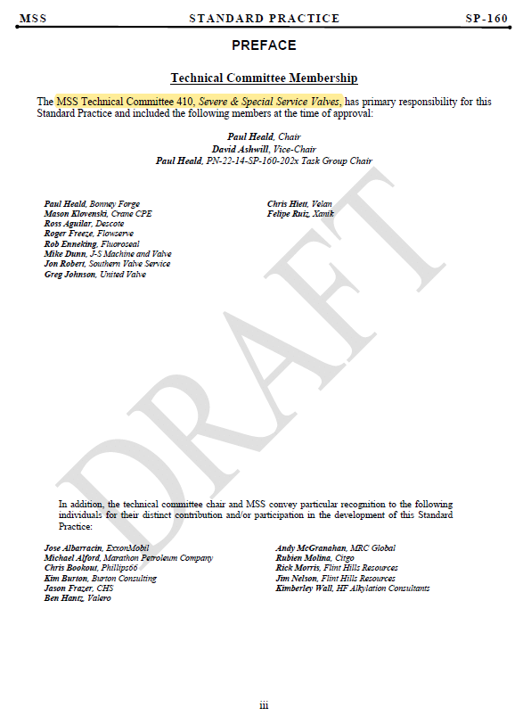
MSS SP-160 Valves for Hydrogen Fluoride (HF) Alkylation Service (Ballot DRAFT 1)
21 Members
12 “Subject Matter Experts – SME’s”

Slide 4
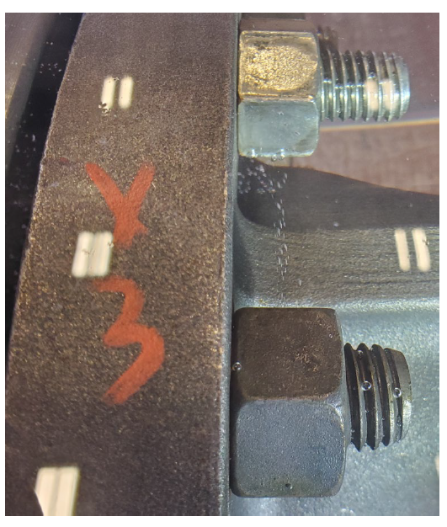
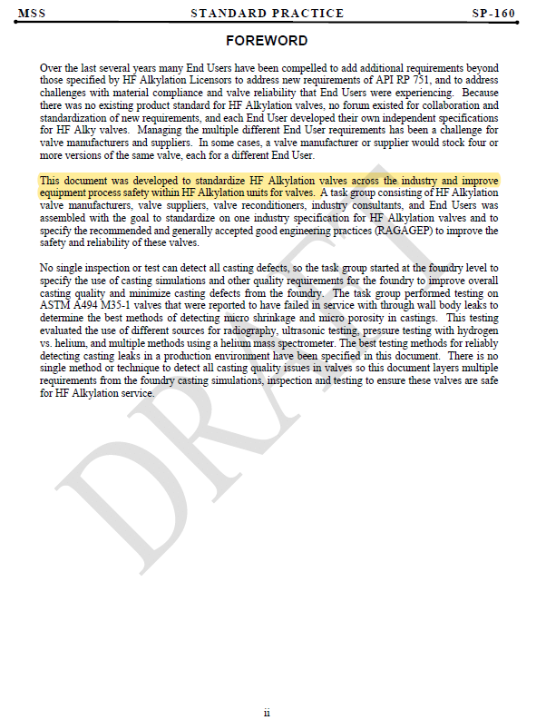
Valves for Hydrogen Fluoride (HF) Alkylation Service
UOP Stopped Acceptance to Pipe
Specifications

Slide 5
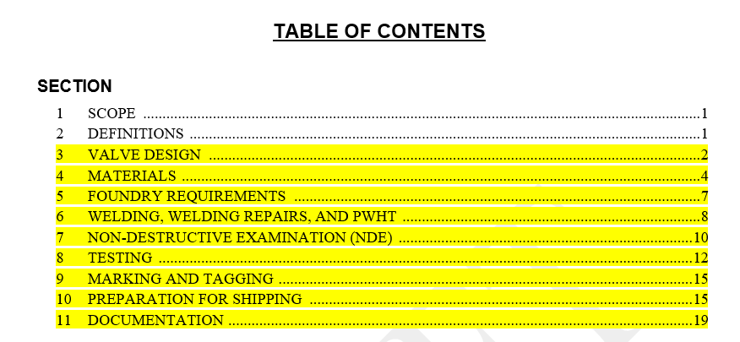
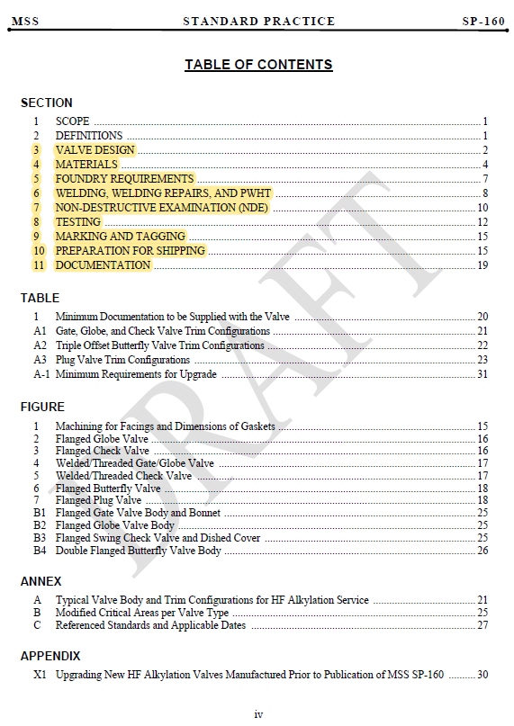
Valves for Hydrogen Fluoride (HF) Alkylation Service

Slide 6
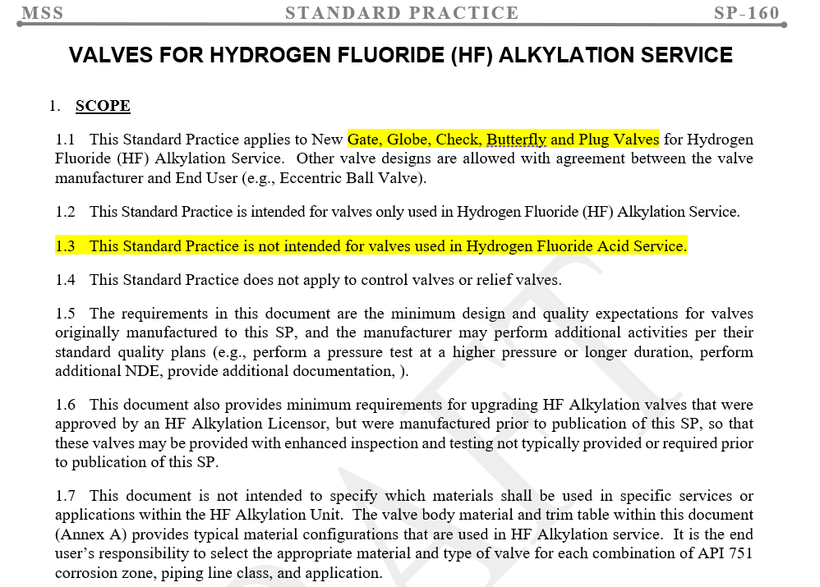
Valves for Hydrogen Fluoride (HF) Alkylation Service

Slide 7
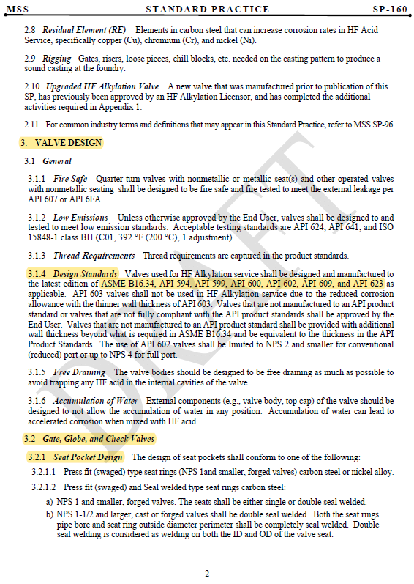
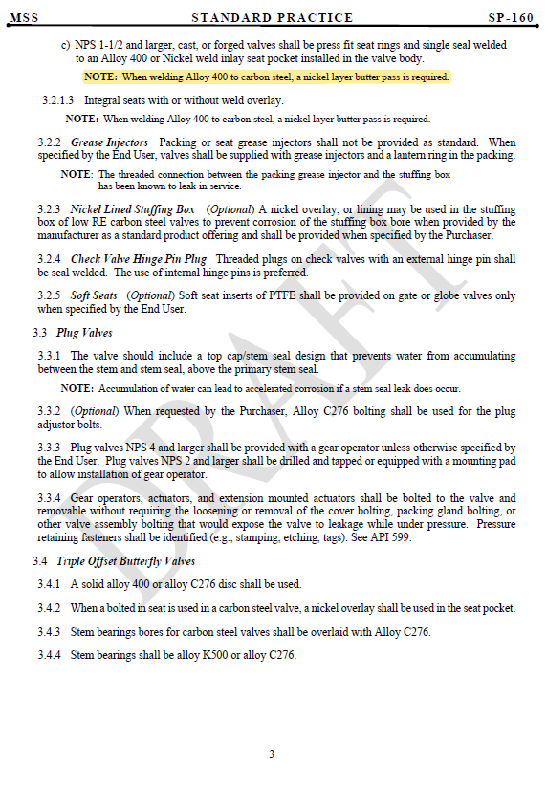
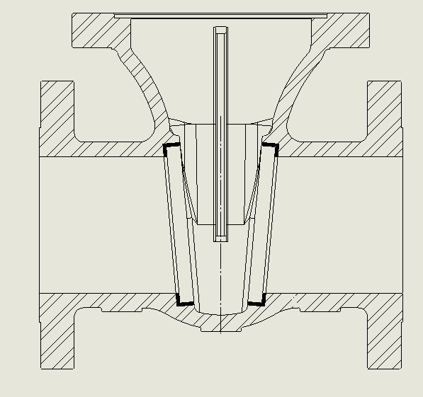
Valves for Hydrogen Fluoride (HF) Alkylation Service

Slide 8
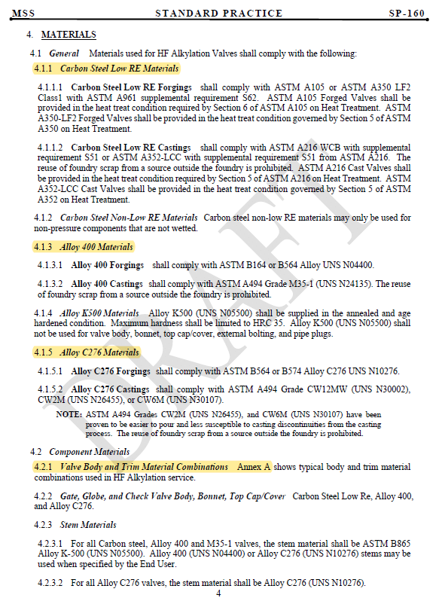
Valves for Hydrogen Fluoride (HF) Alkylation Service
Carbon Steel
Monel
C276
TRIM ANNEX A

Slide 9
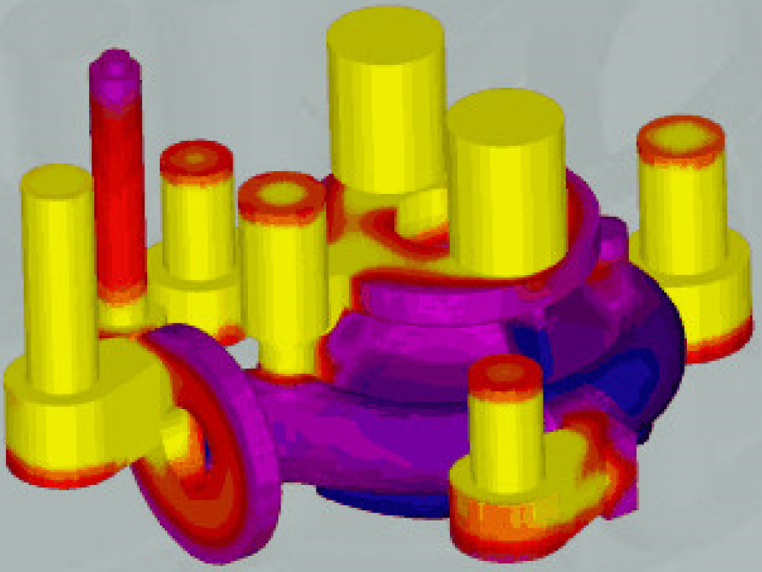
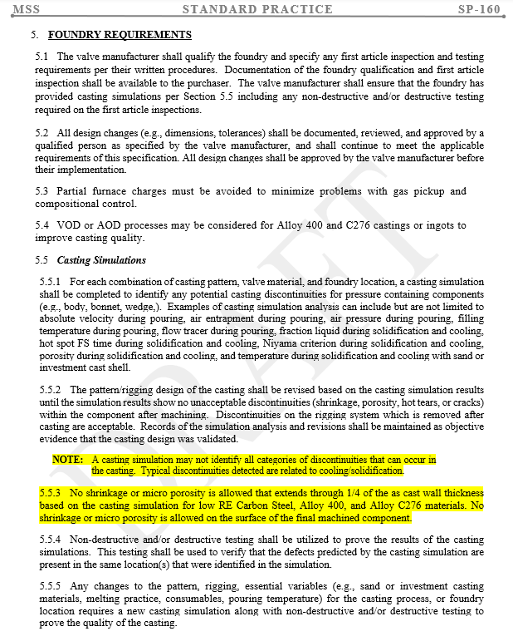
Valves for Hydrogen Fluoride (HF) Alkylation Service

Slide 10
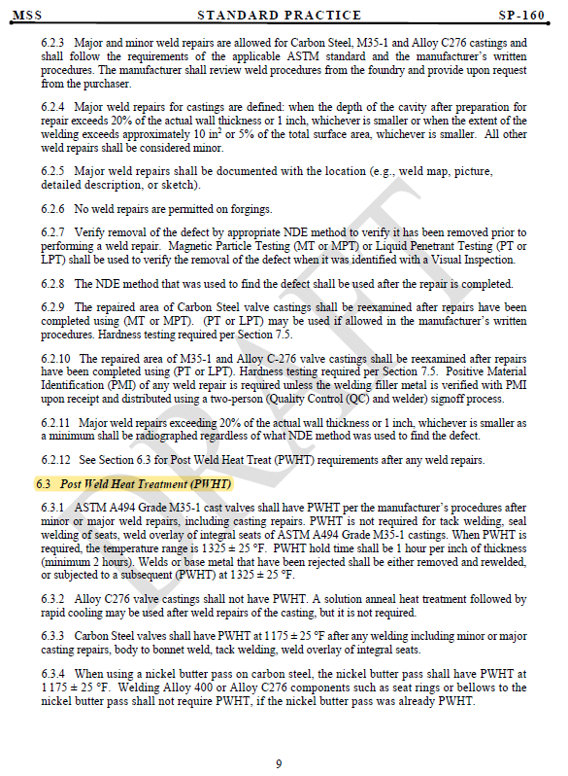
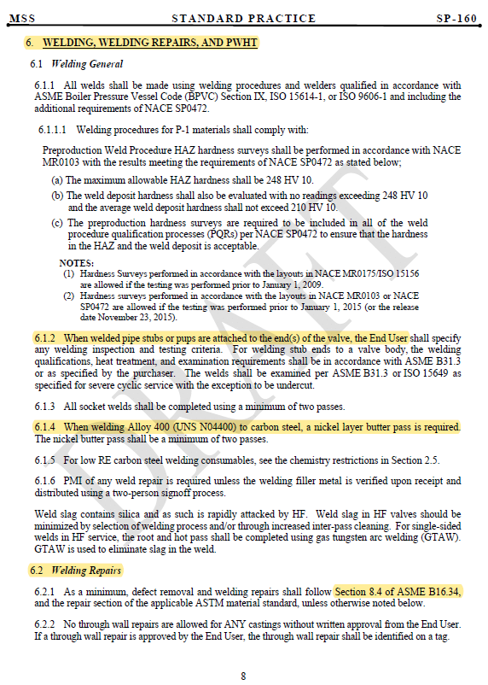
Valves for Hydrogen Fluoride (HF) Alkylation Service

Slide 11
Valves for Hydrogen Fluoride (HF) Alkylation Service

Slide 12
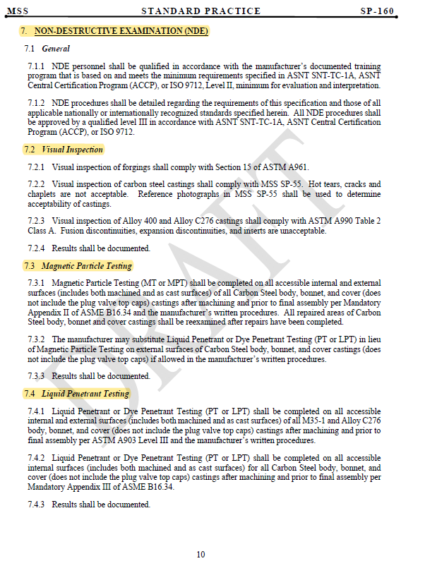
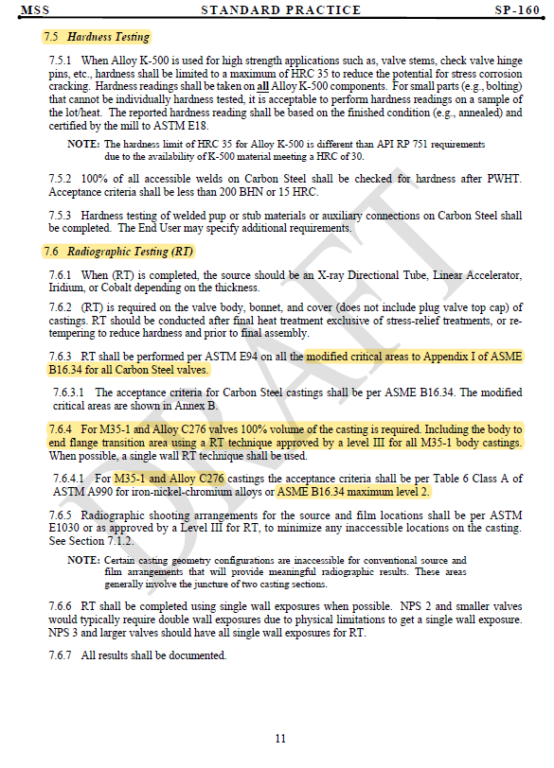
Valves for Hydrogen Fluoride (HF) Alkylation Service

Slide 13
Valves for Hydrogen Fluoride (HF) Alkylation Service

Slide 14
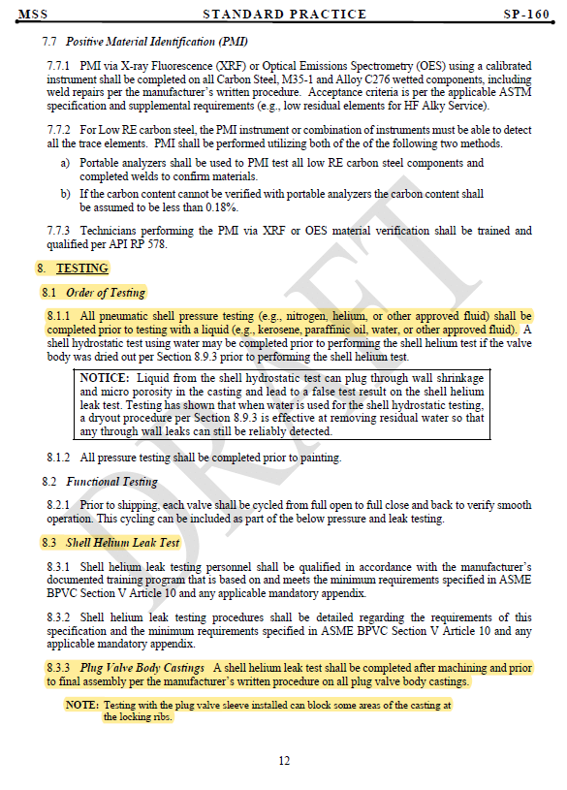
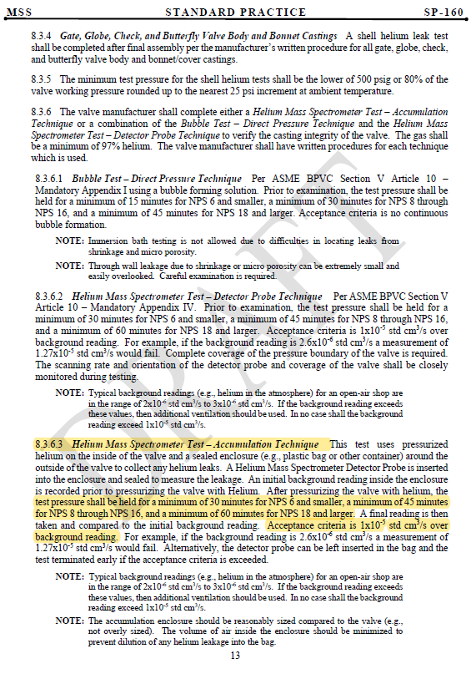
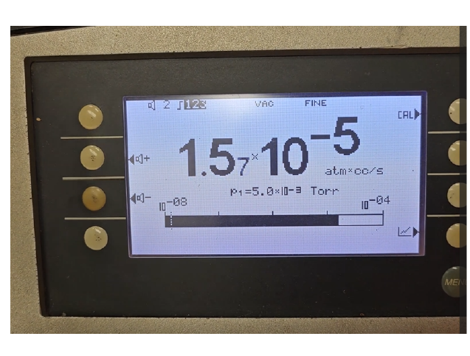
Valves for Hydrogen Fluoride (HF) Alkylation Service

Slide 15
Valves for Hydrogen Fluoride (HF) Alkylation Service

Slide 16
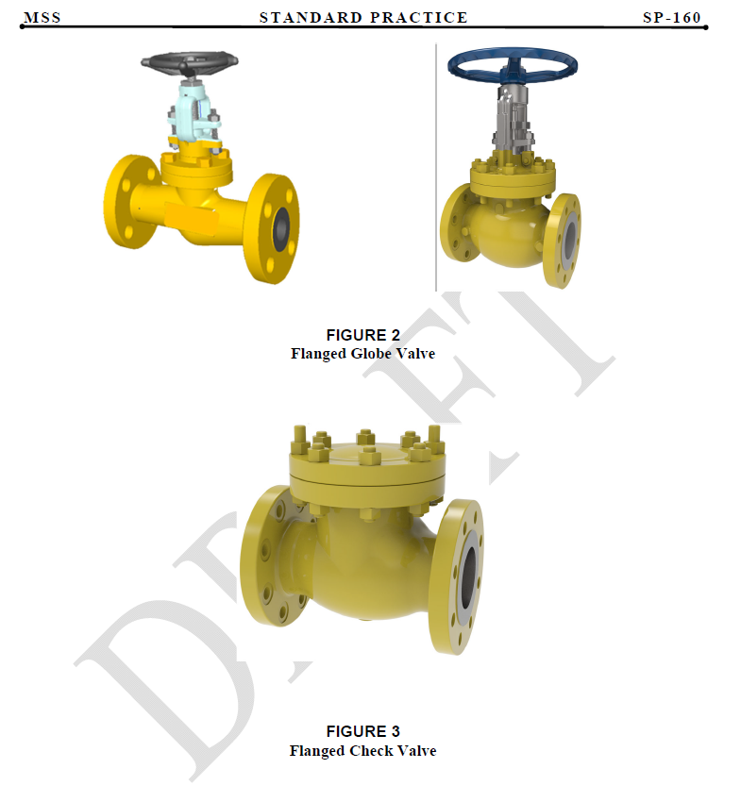
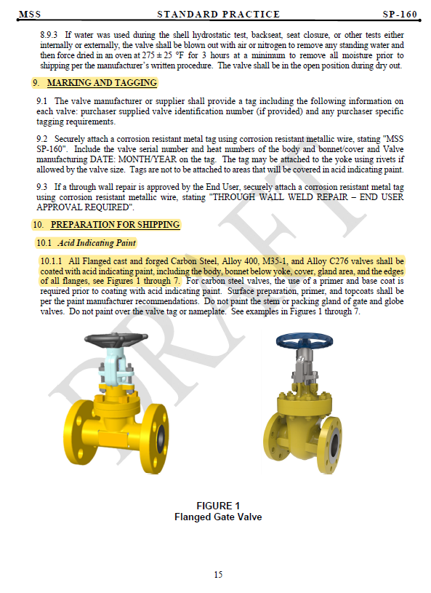
Valves for Hydrogen Fluoride (HF) Alkylation Service

Slide 17
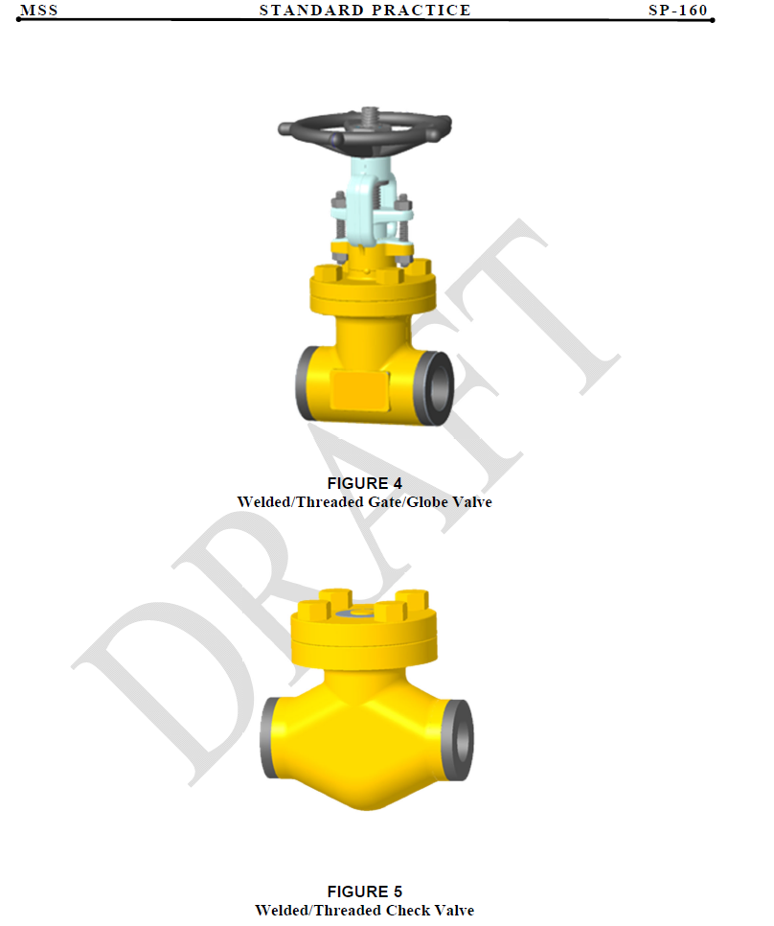
Valves for Hydrogen Fluoride (HF) Alkylation Service

Slide 18
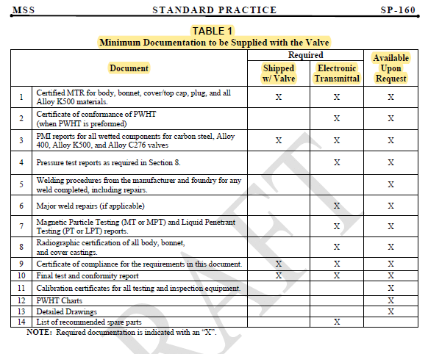
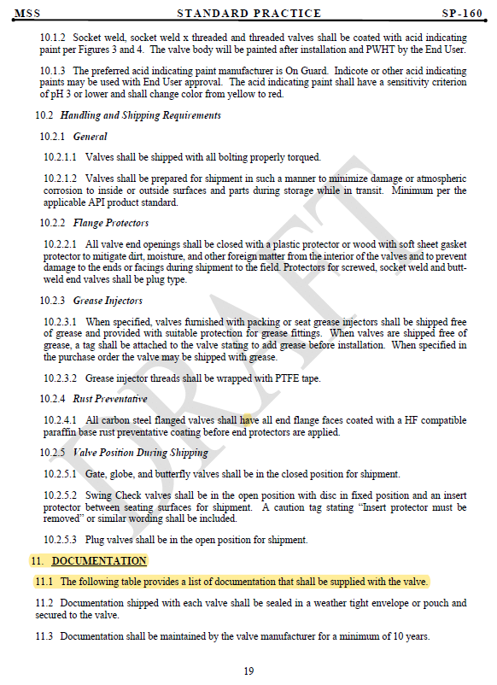
Valves for Hydrogen Fluoride (HF) Alkylation Service

Slide 19
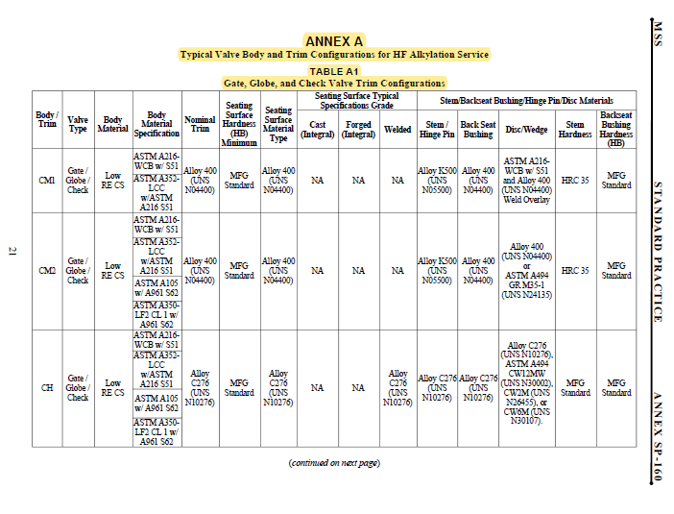
Valves for Hydrogen Fluoride (HF) Alkylation Service

Slide 20
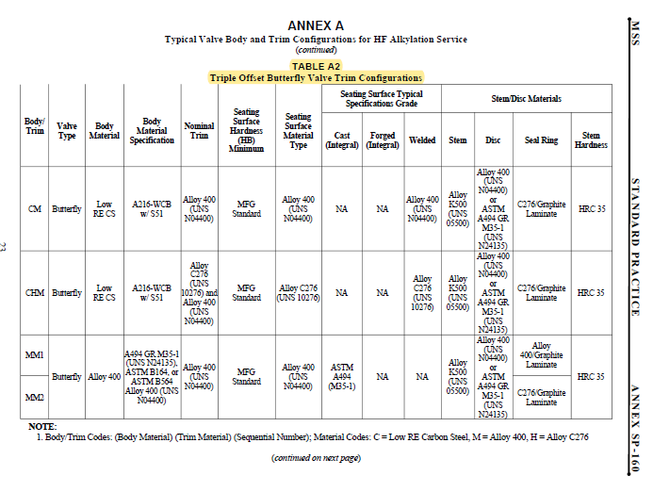
Valves for Hydrogen Fluoride (HF) Alkylation Service

Slide 21
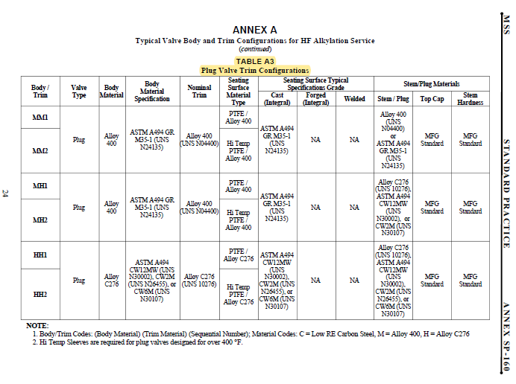
Valves for Hydrogen Fluoride (HF) Alkylation Service

Slide 22
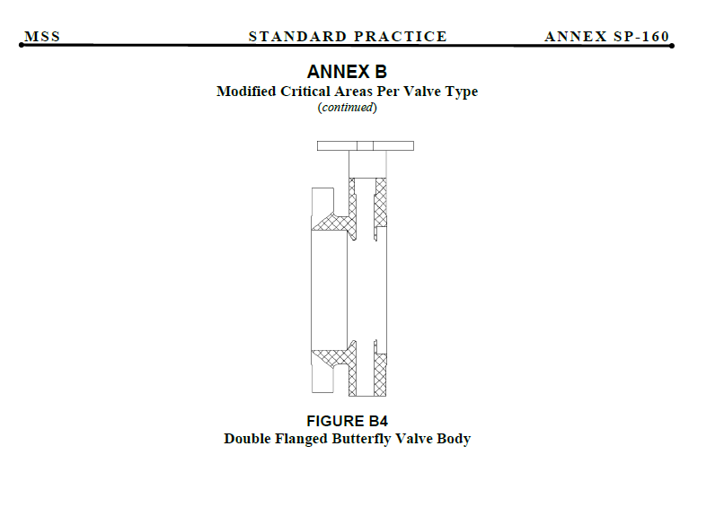
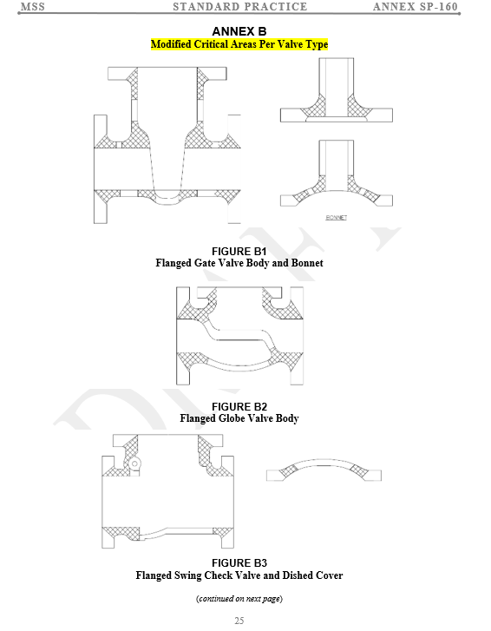
Valves for Hydrogen Fluoride (HF) Alkylation Service

Slide 23
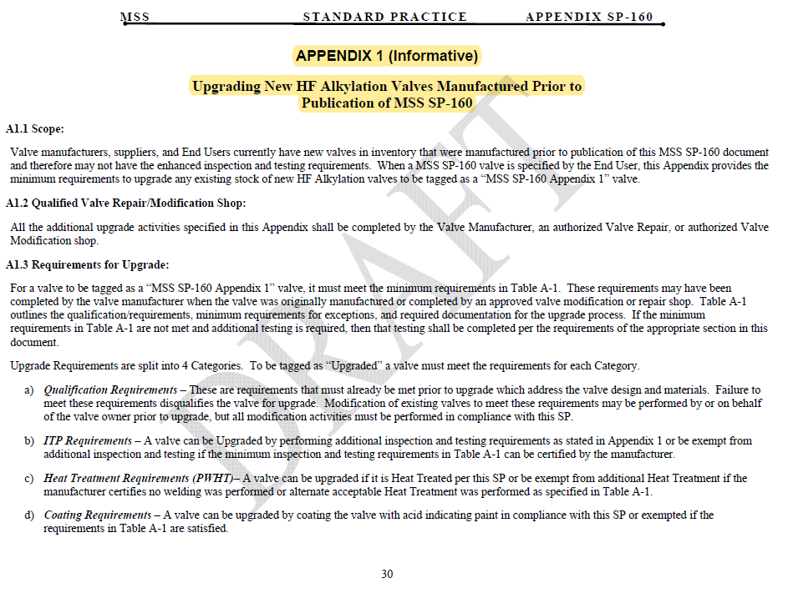
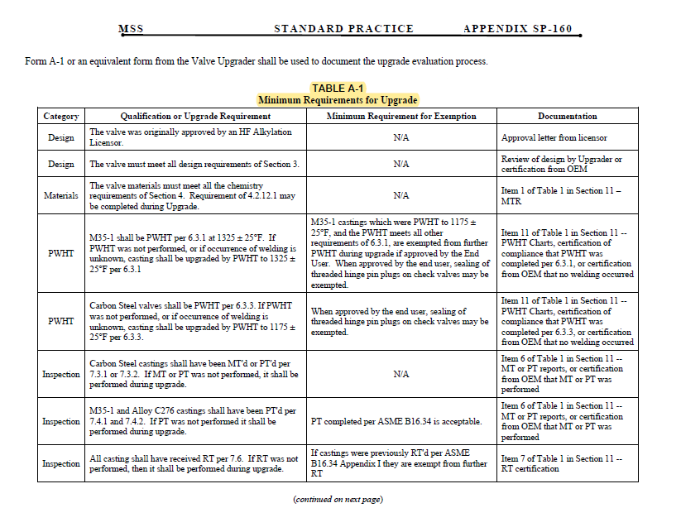
Valves for Hydrogen Fluoride (HF) Alkylation Service

Slide 24
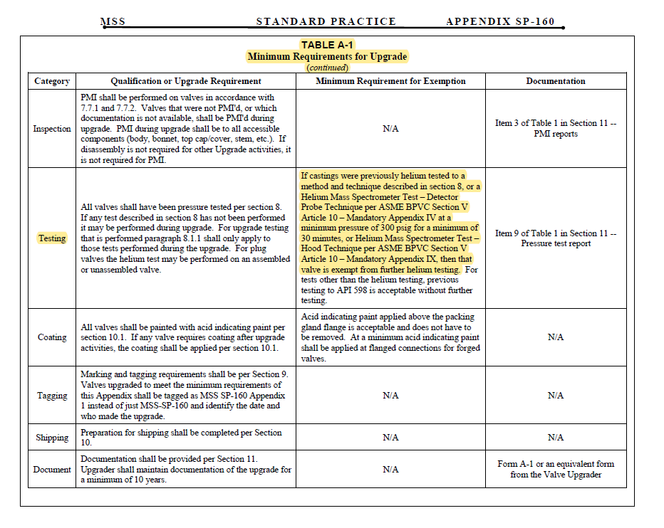
Valves for Hydrogen Fluoride (HF) Alkylation Service

Slide 25
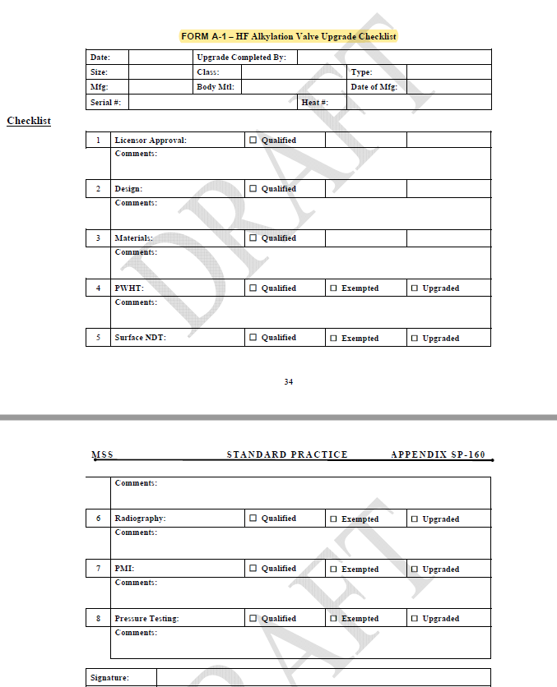
Valves for Hydrogen Fluoride (HF) Alkylation Service

Slide 26
Thanks
ORGANIZING SECRETARIAT
Ph. +39 035 3230904
e-mail info@industrialvalvesummit.com
CONFERENCE ORGANIZERS
Ph. +39 3474908420
e-mail segreteria@valvecampus.com
www.industrialvalvesummit.com
www.valvecampus.com

