Slide 1
Alternative rules for valve design in hydrogen application
CONFERENCE
ORGANIZERS

Slide 2
Alternative rules for valve design in hydrogen application
Applications of alternative Design-By-Analysis methodologies: design of valves for hydrogen service and validation of components affected by hydrogen induced effects
Ing. Diego Barcella | Senior Lead Engineer OMB Valves

Slide 3

Alternative rules for valve design in hydrogen application
Although the impressive amount of published studies on the subject, the hydrogen-metal interaction is still a main topic of research, especially in cutting edge engineering and safety related issues.
Due to their unpredictability, Hydrogen Induced Cracking (HIC) and Hydrogen Embrittlement (HE) are two of the most relevant problems for chemical and energetic plants and transportation pipes integrity.
With the exception of ASME B31.12, which addresses a limited list of materials, there are currently no design-by-formula standards available for engineers to design valves for hydrogen service, or at least to take into consideration the damages caused by the negative effects of hydrogen on metals.
The aim of this work is to show alternative Design-By-Analysis methodologies, useful in designing valves for hydrogen application or in validating components affected by hydrogen presence. Three different cases are used as examples.

Slide 4
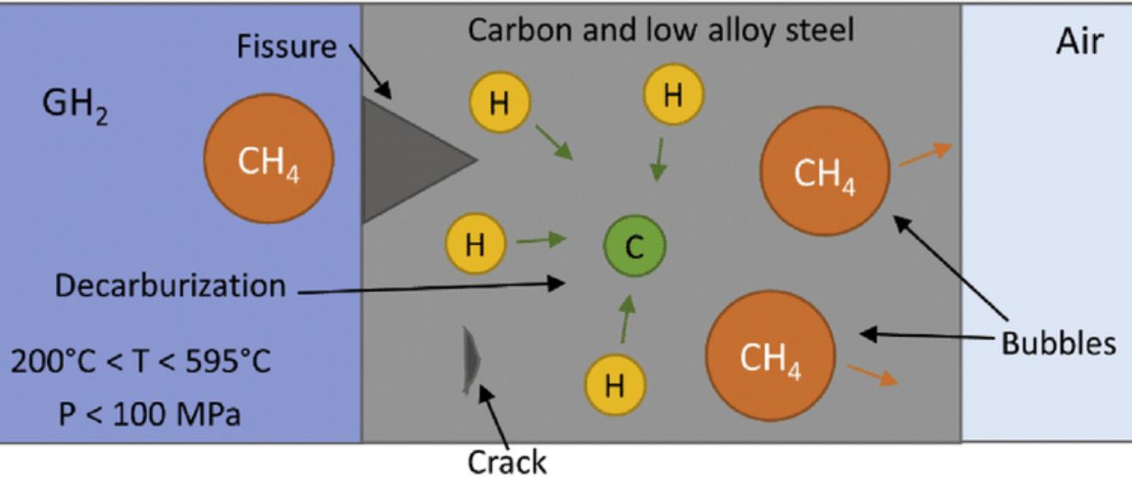
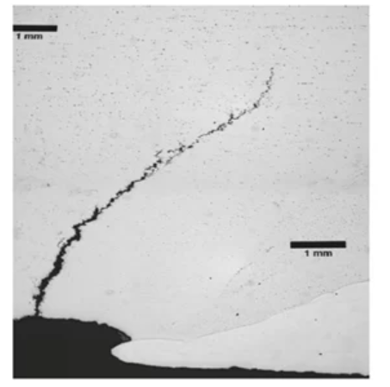
Types of damage caused by H2: hydrogen attack (HAC)
Typical for P > 50 bar and T > 200 °C
Formation of CH4 bubbles inside metal structure and decarburization of the alloy
Figure 1: HAC process
Figure 2: HAC example

Slide 5
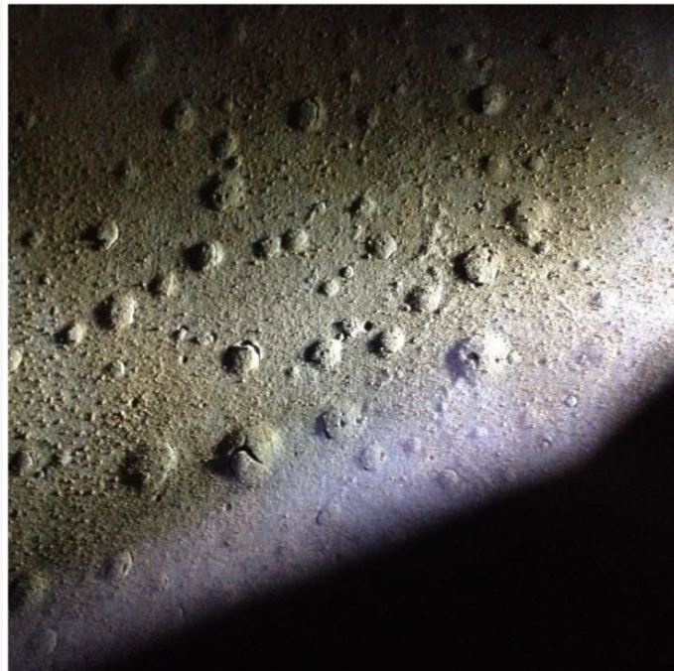
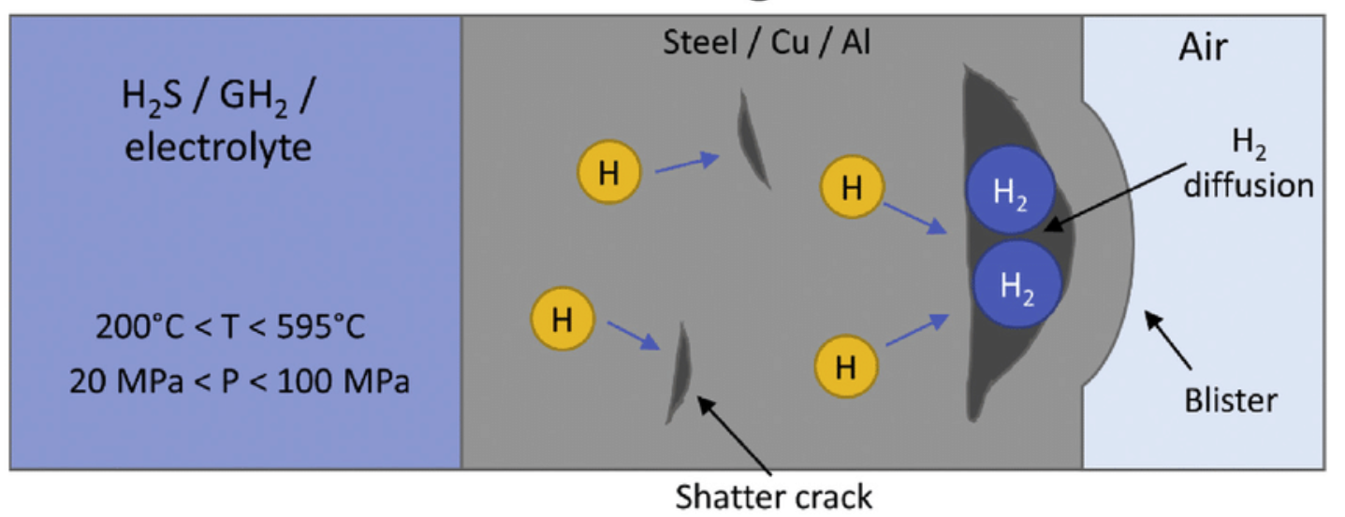
Types of damage caused by H2: blistering
Typical with presence of electrolytes (H2S)
Formation of H2 bubbles inside imperfection of metal structure
Even without the application of external loads
Figure 3: Blistering process
Figure 4: Blistering example

Slide 6
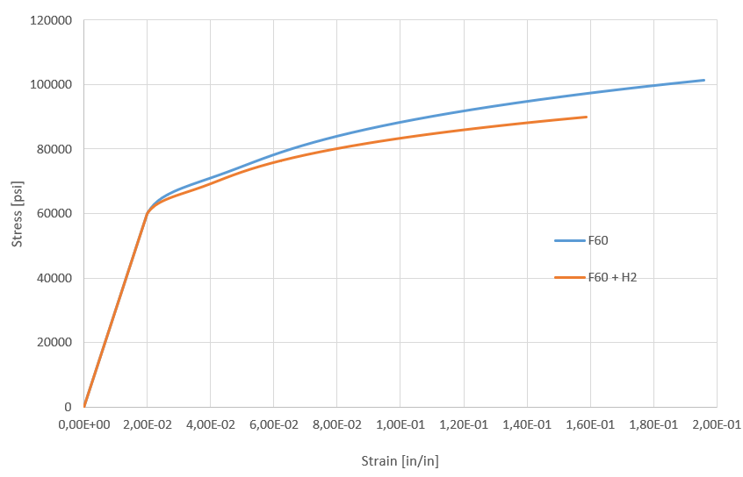
Types of damage caused by H2: embrittlement (HEE)
Decrease of mechanical properties and ductility in presence of hydrogen under applied load
High mechanical strength steels are more sensitive to embrittlement than resilient ones
Example for ASTM-A649-F60
Tensile stress: 92%
Elongation: 55%
Reduction area: 77%
Figure 5: HEE effect ok 60K CS stress-strain curve
Ref: NASA/TM-2016–218602

Slide 7
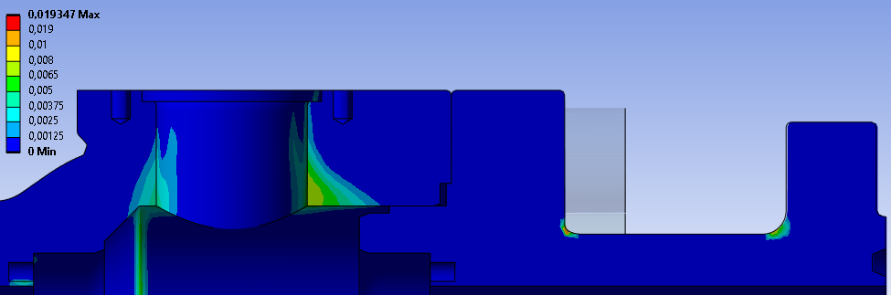
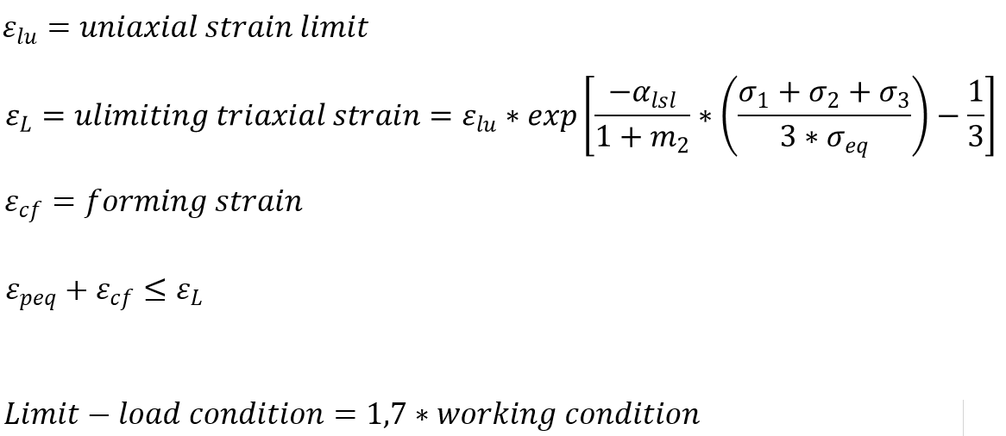

Example 1: API6A 10k ball valve
Effect of HEE on protection against local failure according ASME VIII Div.2
Figure 6: Triaxial strain limit in normal and embrittled steel: the second case is 33% higher

Slide 8
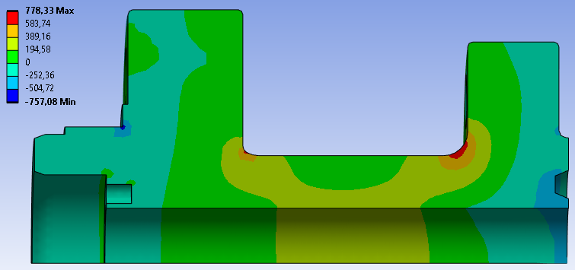
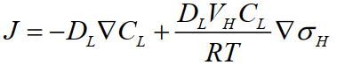
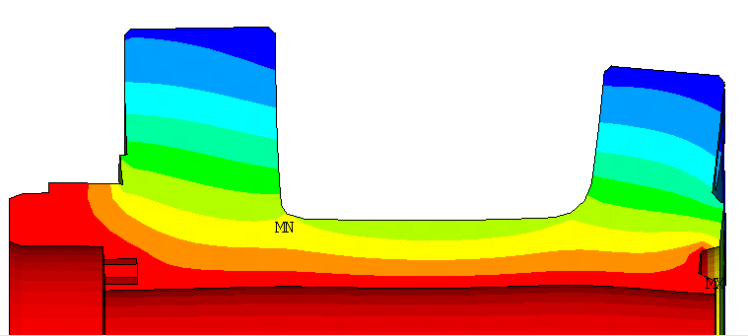
Example 1: API6A 10k ball valve
Hydrogen diffusion process
Fick’s law:
J = hydrogen flux
DL = diffusion coefficient
σH = hydrostatic component of stress
Concentration of stress causes an accumulation of H2 inside the most stressed areas.
Figure 7: example of H2 diffusion

Slide 9
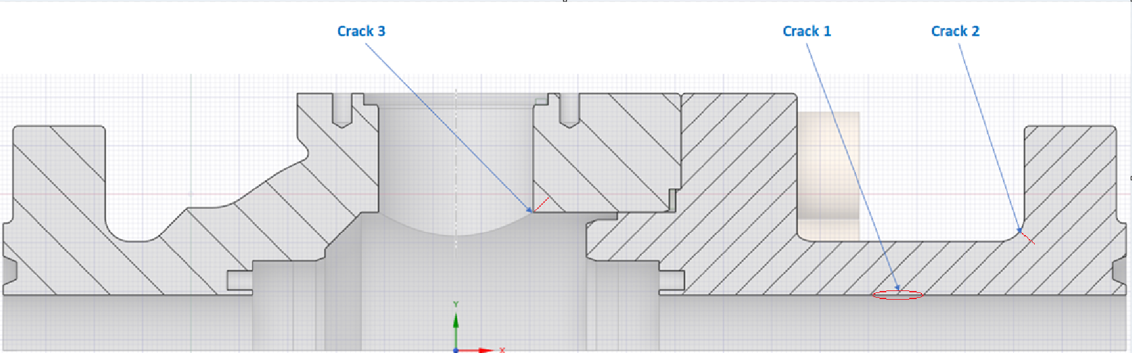
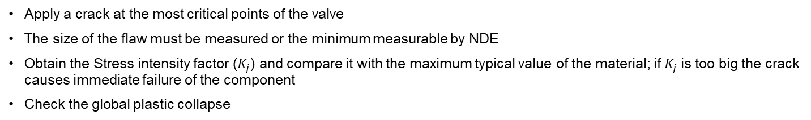
Example 1: API6A 10K ball valve
Design assessment according to API 579: elastic-plastic method
Apply a crack at the most critical points of the valve
The size of the flaw must be measured or the minimum measurable by NDE
Obtain the Stress intensity factor ($K_{j}$) and compare it with the maximum typical value of the material; if $K_{j}$is too big the crack causes immediate failure of the component
Check the global plastic collapse
Figure 8: position of crack in API6A 10K valve

Slide 10
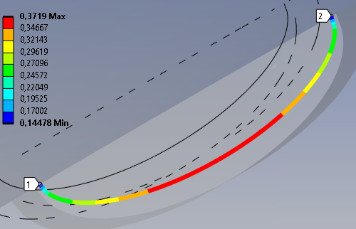
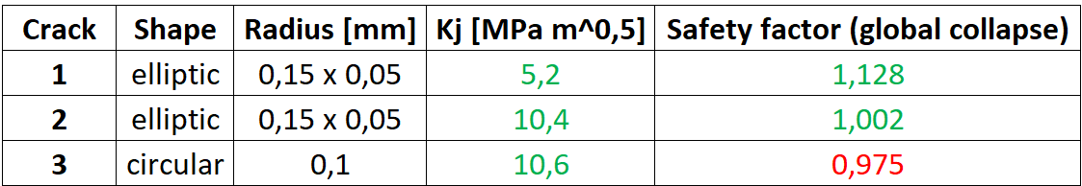
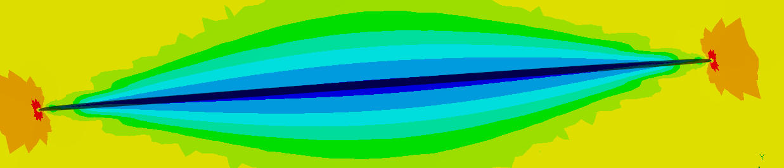
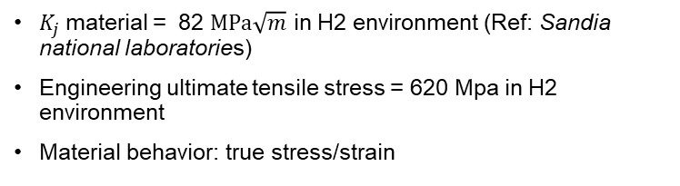
Example 1: API6A 10K ball valve
Design assessment according to API 579
$K_{j}$material = 82 $MPa\sqrt{m}$ in H2 environment (Ref: Sandia national laboratories)
Engineering ultimate tensile stress = 620 Mpa in H2 environment
Material behavior: true stress/strain
Figure 9: J integral / stress intensity factor for crack n°2
Cracked body is not verified for protection against plastic collapse
A small crack at body crossbore in H2 environment could be fatal
Figure 10: equivalent stress on crack n°2

Slide 11
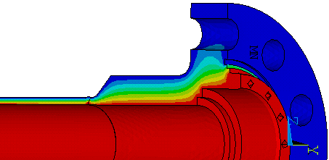
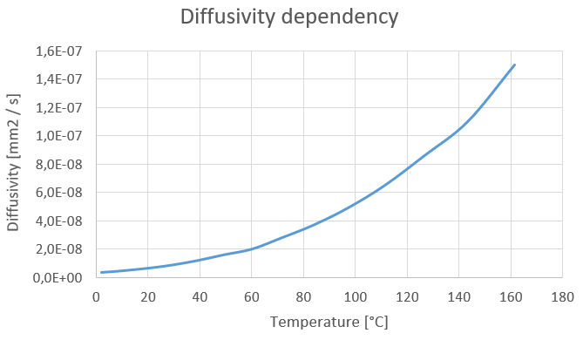
Example 2: duplex subsea valve
Verification according two different standards
For this valve, two different verifications are performed, according with two different regulations
DNVGL-RP-F112 - Category 2
ASME VIII Div.3 Crack grow
Hydrogen accumulates in the most stressed areas and in geometry discontinuities
Figure 11: H2 concentration in closure and pup

Slide 12
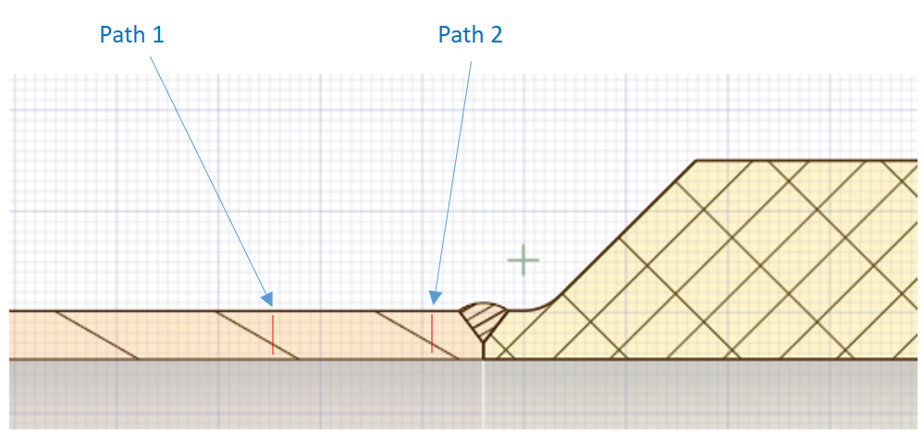
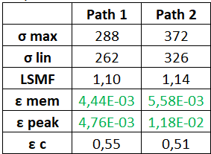
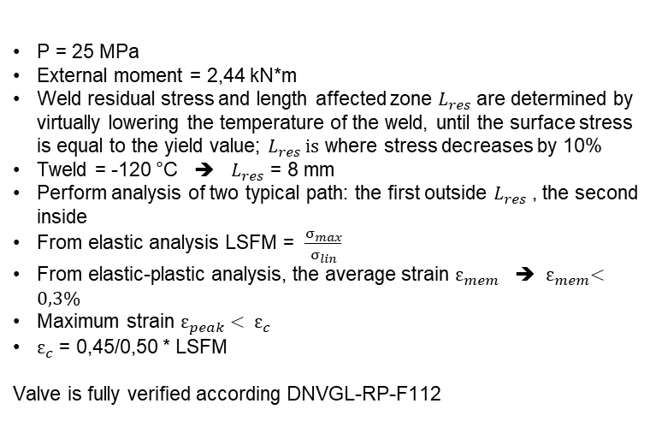
Example 2: duplex subsea valve
First verification: DNVGL-RP-F112
P = 25 MPa
External moment = 2,44 kN*m
Weld residual stress and length affected zone $L_{res}$are determined by virtually lowering the temperature of the weld, until the surface stress is equal to the yield value; $L_{res} is$ where stress decreases by 10%
Tweld = -120 °C ➔ $L_{res}$ = 8 mm
Perform analysis of two typical path: the first outside $L_{res}$, the second inside
From elastic analysis LSFM = $\frac{σ_{max}}{σ_{lin}}$
From elastic-plastic analysis, the average strain $ε_{mem}$ ➔ ${ ε}_{mem}<0,3\%$
Maximum strain $ε_{peak}< ε_{c}$
$ε_{c}$ = 0,45/0,50 * LSFM
Valve is fully verified according DNVGL-RP-F112
Figure 12: position of path in subsea valve

Slide 13
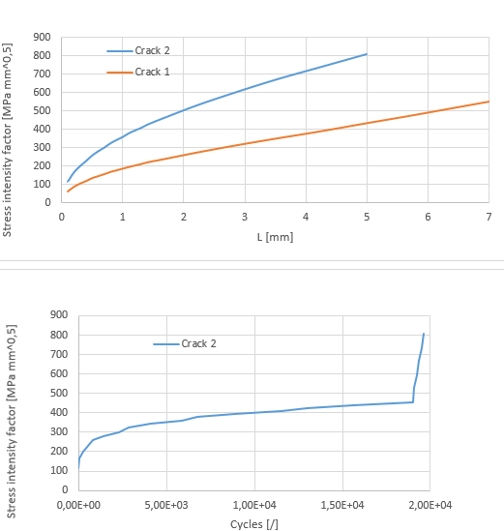

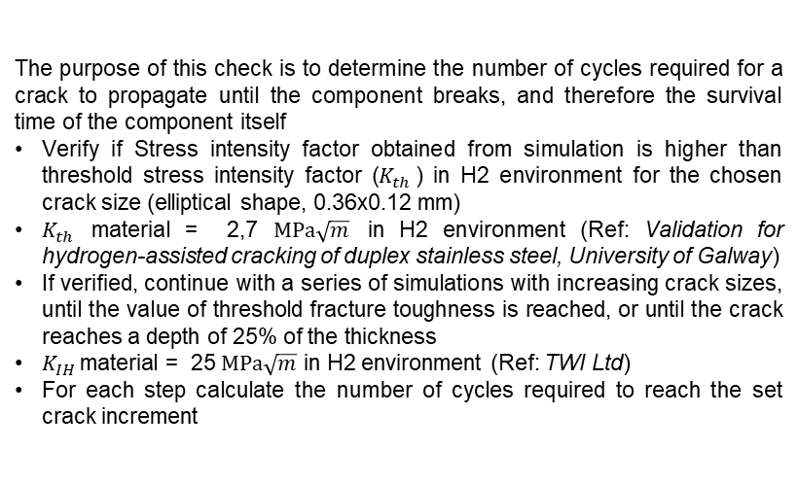
Example 2: duplex subsea valve
Second verification: ASME VIII Div.3 crack grow
The purpose of this check is to determine the number of cycles required for a crack to propagate until the component breaks, and therefore the survival time of the component itself
Verify if Stress intensity factor obtained from simulation is higher than threshold stress intensity factor ($K_{th}$) in H2 environment for the chosen crack size (elliptical shape, 0.36x0.12 mm)
$K_{th}$ material = 2,7 $MPa\sqrt{m}$ in H2 environment (Ref: Validation for hydrogen-assisted cracking of duplex stainless steel, University of Galway)
If verified, continue with a series of simulations with increasing crack sizes, until the value of threshold fracture toughness is reached, or until the crack reaches a depth of 25% of the thickness
$K_{IH}$material = 25 $MPa\sqrt{m}$ in H2 environment (Ref: TWI Ltd)
For each step calculate the number of cycles required to reach the set crack increment
Figure 14: crack n°2 grow, till 20000 cycles

Slide 14
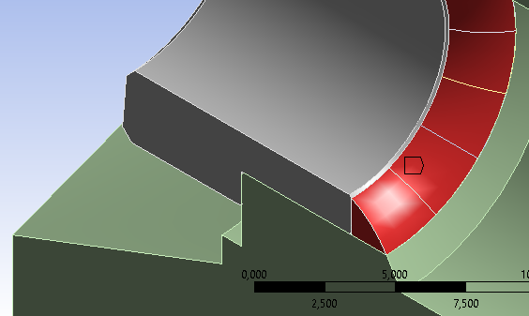
Example 3: welded seat and pup
First simulation: transient thermal analysis of welding deposit
Points close to the welds are the most sensitive, due to the inception of cracks and to the presence of residual (secondary) forces
In order to have a reliable evaluation of these stress we decided to simulate the entire welding process
The first step of this job was to evaluate the correct thermal behavior of the valve subject to welding deposit; the geometry of weld has been modeled and divided into small pieces, in order to discretize the transient thermal phenomena.
Figure 15: detail of welding discretization; the average thickness of single brick is 2,25 [mm]

Slide 15
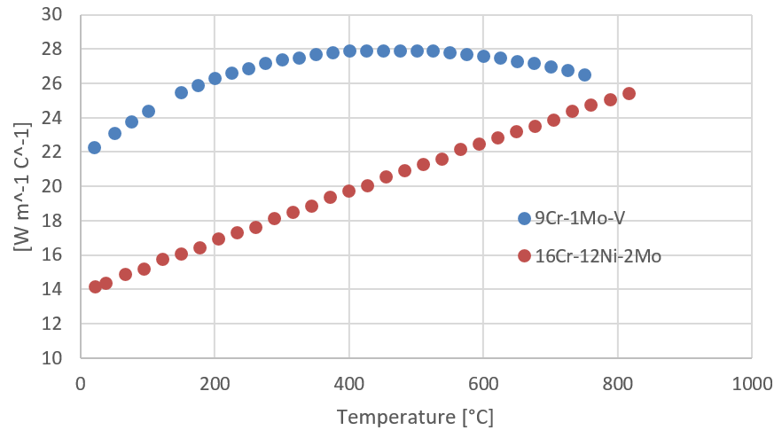
Example 3: welded seat and pup
First simulation: transient thermal analysis of welding deposit
The input data for simulation were provided by our Welding Procedure Specification in according to ASME IX.
For seat-body weld:
Type of weld procedure = GTAW
Filler metal = 316LSi
Size of filler metal = 2,4 [mm]
Travel speed range = 100 – 120 [m/min]
For body-pup weld:
Type of weld procedure = GTAW
Filler metal = 9Cr-Mo-V-N
Size of filler metal = 2,4 [mm]
Travel speed range = 80 - 100 [m/min]
Figure 16: thermal conductivity according ASME II Part.D

Slide 16
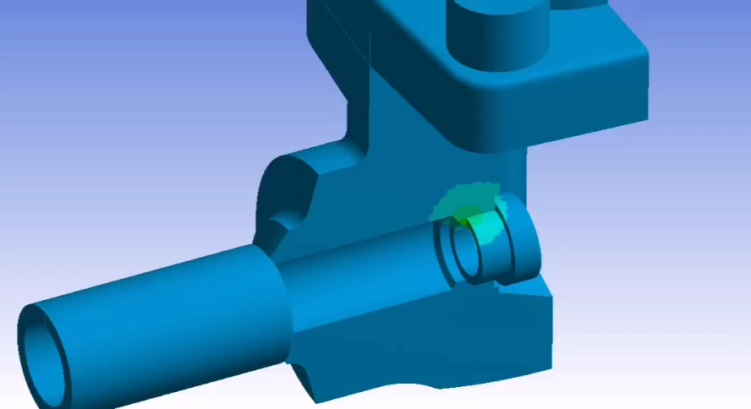
Example 3: welded seat and pup
In order to achieve a realistic analysis, we checked the results with other data provided by our welding engineer:
- Interpass temperature
80 °C max for 16Cr-12Ni-2Mo
300 C° max for 9Cr-1Mo-V.
It is the temperature reached by the body close to the weld deposit; this temperature is monitored throughout the process and can’t exceed a defined threshold temperature related to the material.
- Average time required to complete the weld, based on operator's experience.
A transient thermal analysis has been performed: step by step, with defined time, we added to the model the “bricks” of weld with their thermal load
First simulation: transient thermal analysis of welding deposit
Video 1: Evolution of temperature during the welding process

Slide 17
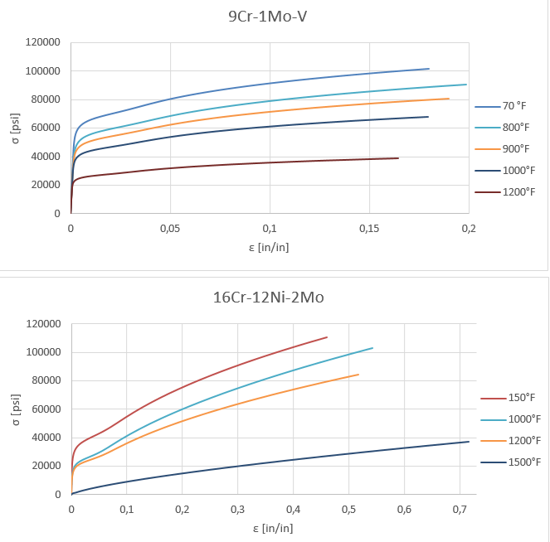
Example 3: welded seat and pup
Second simulation: elastic-plastic analysis of
welding deposit
The purpose of this analysis was to import the trend of the temperatures obtained in the previous simulation, and evaluate the possible presence of structural plastic deformations and residual stresses.
In order to have the most realistic evaluation of the phenomena, we choose to include plasticization and strain hardening in materials properties.
We added step by step the “bricks” of weld with their thermal load; the different coefficient of thermal expansion between seat and body and the thermal distortion due to welding contraction will induce stress and plastic strain
Figure 17: true stress/strain curves
according ASME II Part.D

Slide 18
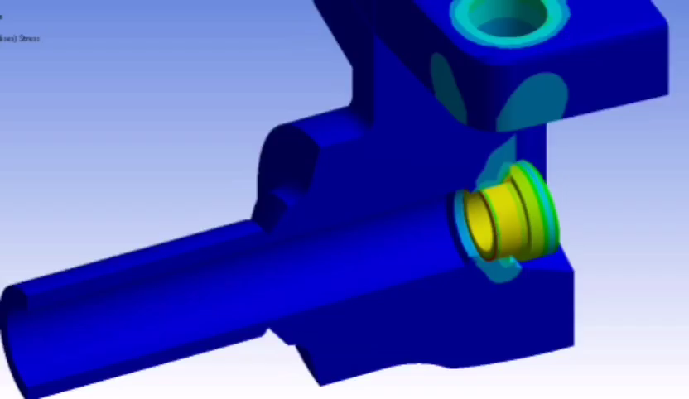
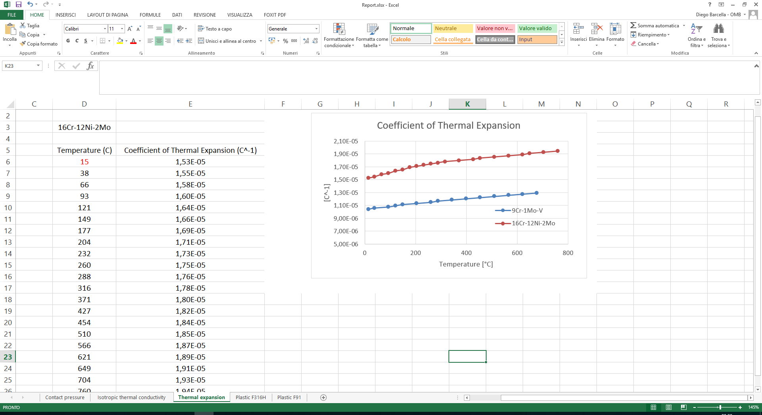
Example 3: welded seat and pup
Second simulation: elastic-plastic analysis of welding deposit
Figure 18: thermal expansion according ASME II Part.D
Video 2: Evolution of residual stress during the welding process

Slide 19
Example 3: welded seat and pup
Third simulation: local failure assessment
Model is fully verified according ASME VIII Div.2 Part.5; it is clear that, comparing the results of the two simulations, the contribute of residual plastic strain due to welding process is significant, and can’t be ignored, especially if we want to verify not only the resistance of the pressure vessel, but also its functionality
Figure 19: evaluation of protection against local failure of 9Cr-1Mo-V, usage factor

Slide 20
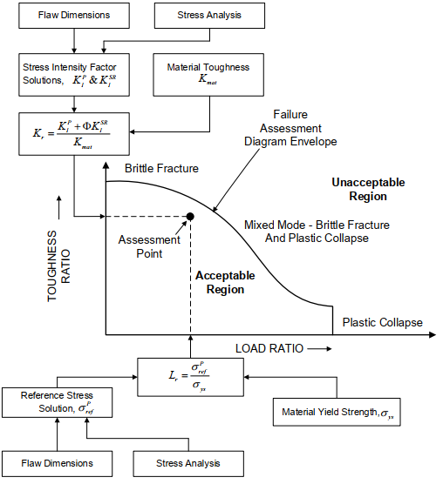
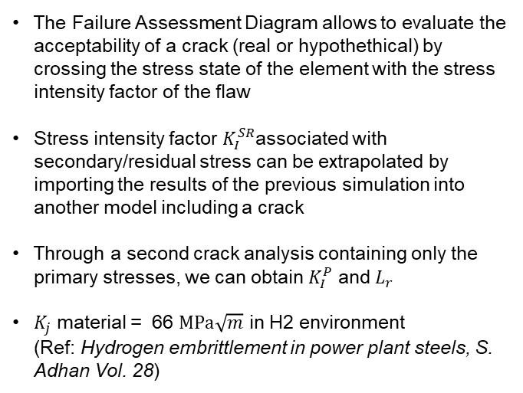
Example 3: welded seat and pup
Fourth simulation: API 579 – FAD assessment
The Failure Assessment Diagram allows to evaluate the acceptability of a crack (real or hypothethical) by crossing the stress state of the element with the stress intensity factor of the flaw
Stress intensity factor $K_{I}^{SR}$associated with secondary/residual stress can be extrapolated by importing the results of the previous simulation into another model including a crack
Through a second crack analysis containing only the primary stresses, we can obtain $K_{I}^{P}$ and $L_{r}$
$K_{j}$ material = 66 $MPa\sqrt{m}$ in H2 environment (Ref: Hydrogen embrittlement in power plant steels, S. Adhan Vol. 28)

Slide 21
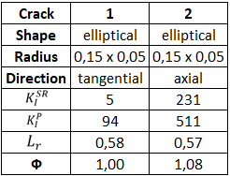
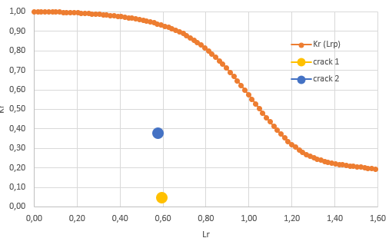
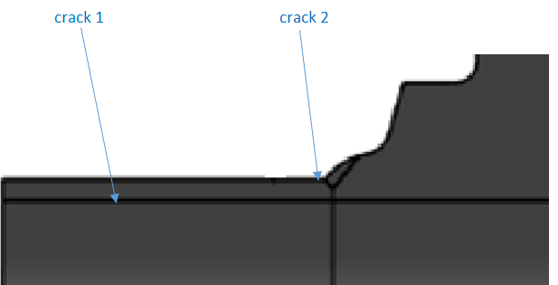
Example 3: welded seat and pup
Fourth simulation: API 579 – FAD assessment
Figure 20: Crack assessment verified, within the acceptable region

Slide 22
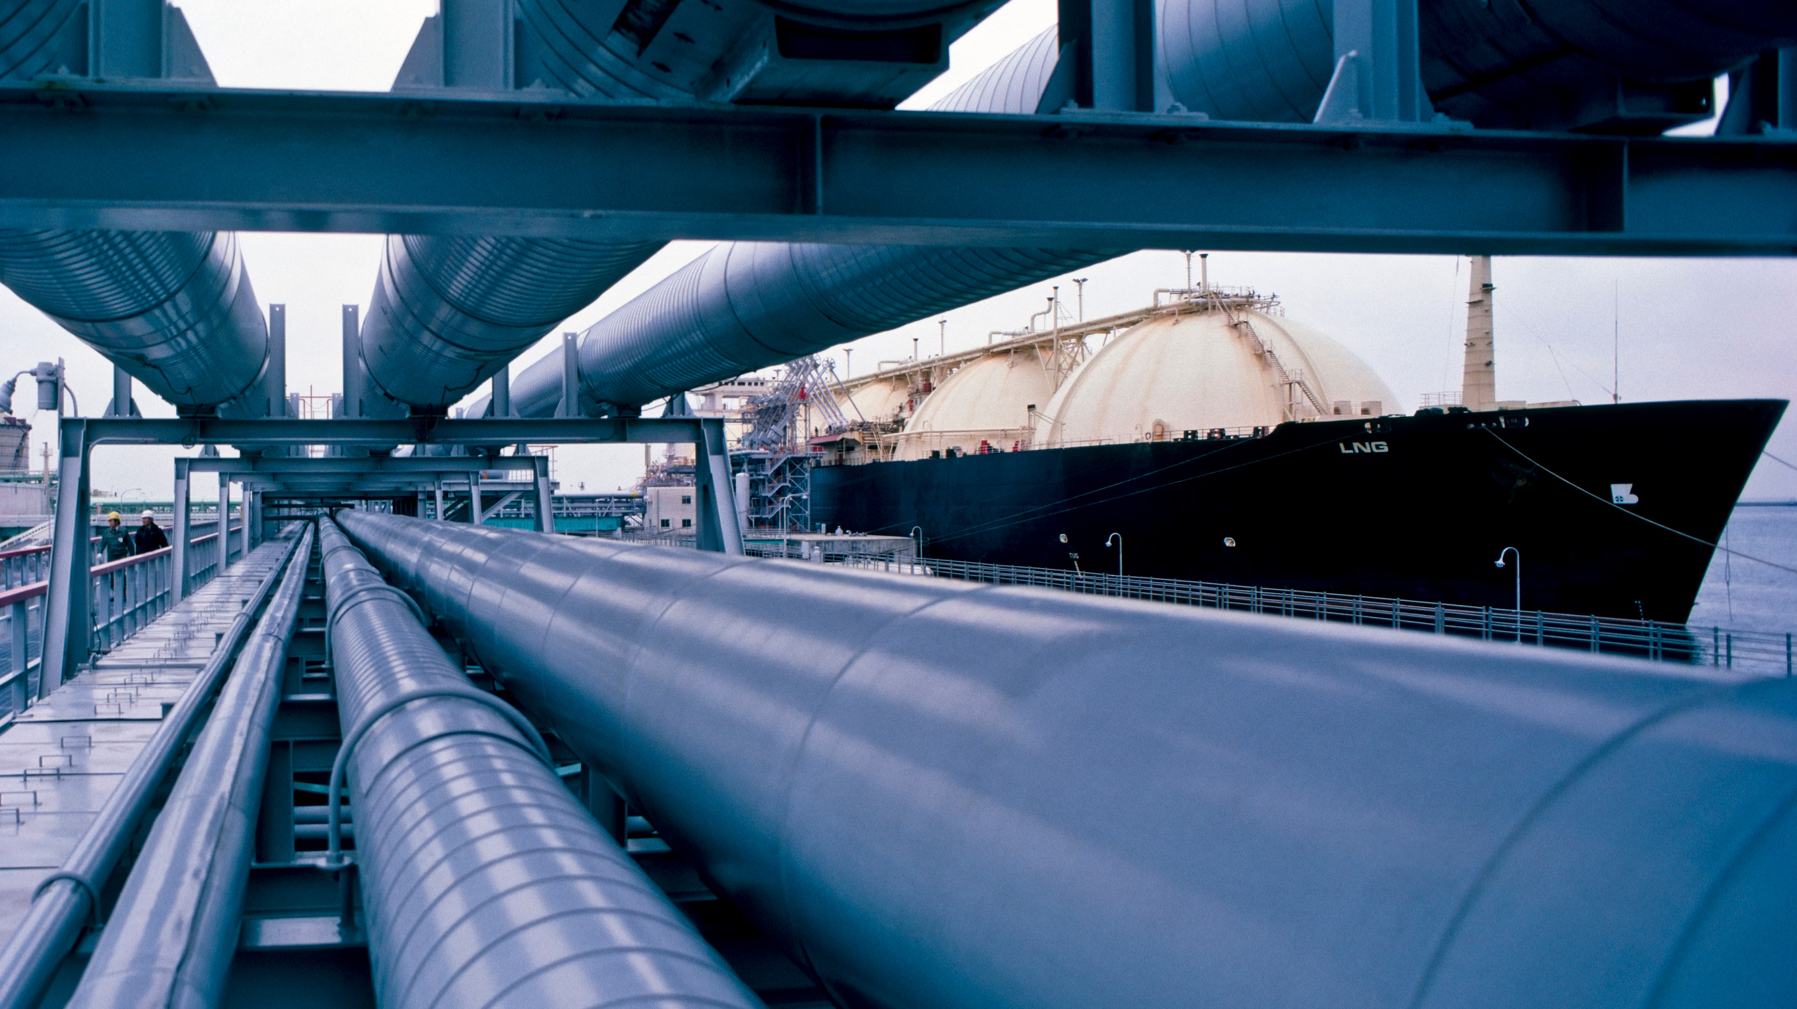


The presence of H2 in process fluids inevitably leads to a deterioration of the properties of steels, especially in the presence of high temperatures or accelerators such as H2S.
Currently the international specifications commonly used in valve design do not take these phenomena into consideration: ignoring them could be very dangerous
It would be useful to combine the standard design methodologies with dedicated design-by-analysis verifications.
Furthermore increasing collaboration between valve manufacturers and end users could lead to a standardization of all that data relating to the behavior of the materials in hydrogen environment, as for example the threshold fracture toughness
ORGANIZERS
CONFERENCE ORGANIZERS

Slide 23
References
[1] ASME BPVC VIII-2
[2] ASME BPVC II-D
[3] ASME BPVC III-1
[4] ASME BPVC IX
[5] API 579
[6] NASA/TM-2016–218602,
[7] Hydrogen embrittlement in power plant steels, S. Adhan
[8] Validation for hydrogen-assisted cracking of duplex stainless steel, University of Galway
[9] TWI Ltd
[10] Sandia National Laboratories
[11] DNVGL-RP-F112
Special thanks for the support received from
Michele Camposaragna – Enginsoft SPA
Vito Boriolo – Enginsoft SPA

Slide 24
Thanks
ORGANIZING SECRETARIAT
Ph. +39 035 3230904
e-mail info@industrialvalvesummit.com
CONFERENCE ORGANIZERS
Ph. +39 3474908420
e-mail segreteria@valvecampus.com
www.industrialvalvesummit.com
www.valvecampus.com

