Slide 1
Smart Valve: a concept that enables a new level of valve reliability
CONFERENCE
ORGANIZERS

Slide 2
Smart Valve:
a concept that enables a new level of valve reliability
Lorenzo Rossano | ATV Electronic Engineering Manager

Slide 3
The Oil&Gas plant
Operate an Oil&Gas plant means dealing with:
Massive CAPEX and high OPEX
Safe and continuous operation
Minimize unplanned shutdown/maintenance
Minimize unpredicted/uncontrolled events to prevent catastrophic scenarios

Slide 4
The market requirements
The global Oil&Gas market is demanding higher safety and reliable technological systems to:
Provide a new set for the highest assets integrity assessment
Valve life extension based on field data
Minimize downtime operational costs & risks
Minimize OPEX with optimal management of maintenance
Data sharing with the organisations
Maximize predictability also with the use of AI

Slide 5
Failure modes of valves

Slide 6
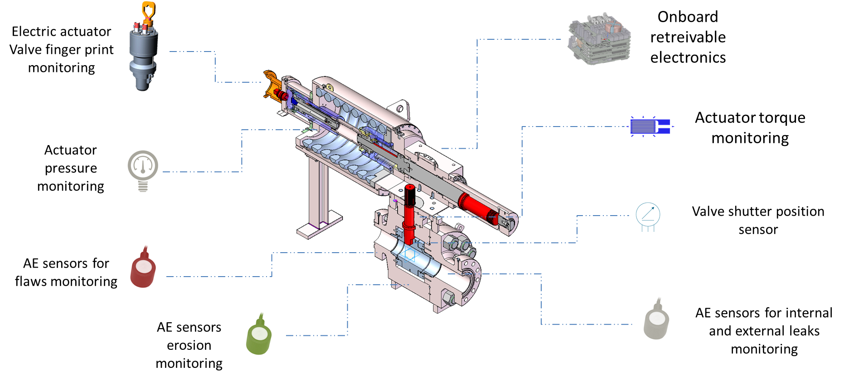
The Smart Valve System

Slide 7
The Smart Valve features
PRODUCT FEATURES – VALVE AND SENSORS
The sensor suite specifically optimized for each type and configuration of the valve
Reliance where possible on not-intrusive sensors
Sensors designed to be auto-recalibrated
PRODUCT FEATURES – ON-BOARD ELECTRONICS
Compact on-board data acquisition and communication electronics
Powered with solar panels, batteries or wired
Data acquisition with local processing, recording and basic diagnostic and predictive functions
Communication of the valve health status
Possibility to perform diagnostic tests

Slide 8
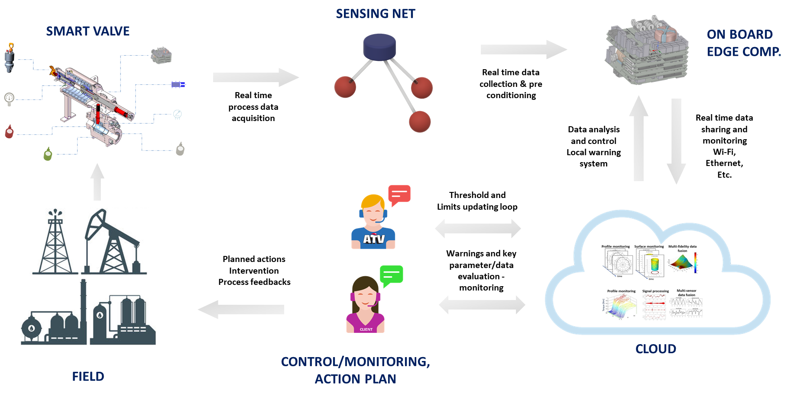
The solution model

Slide 9
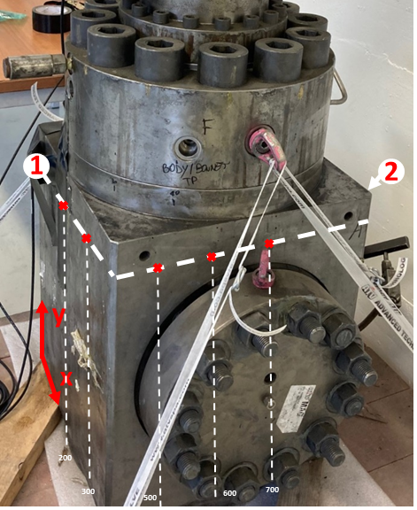
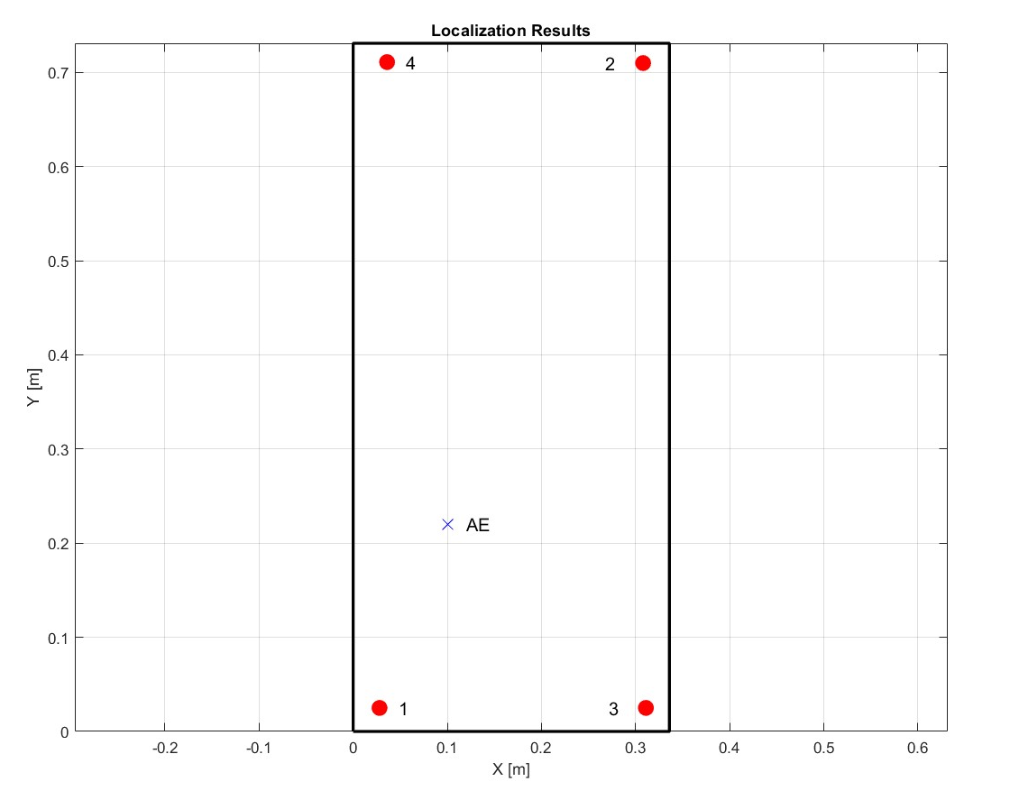
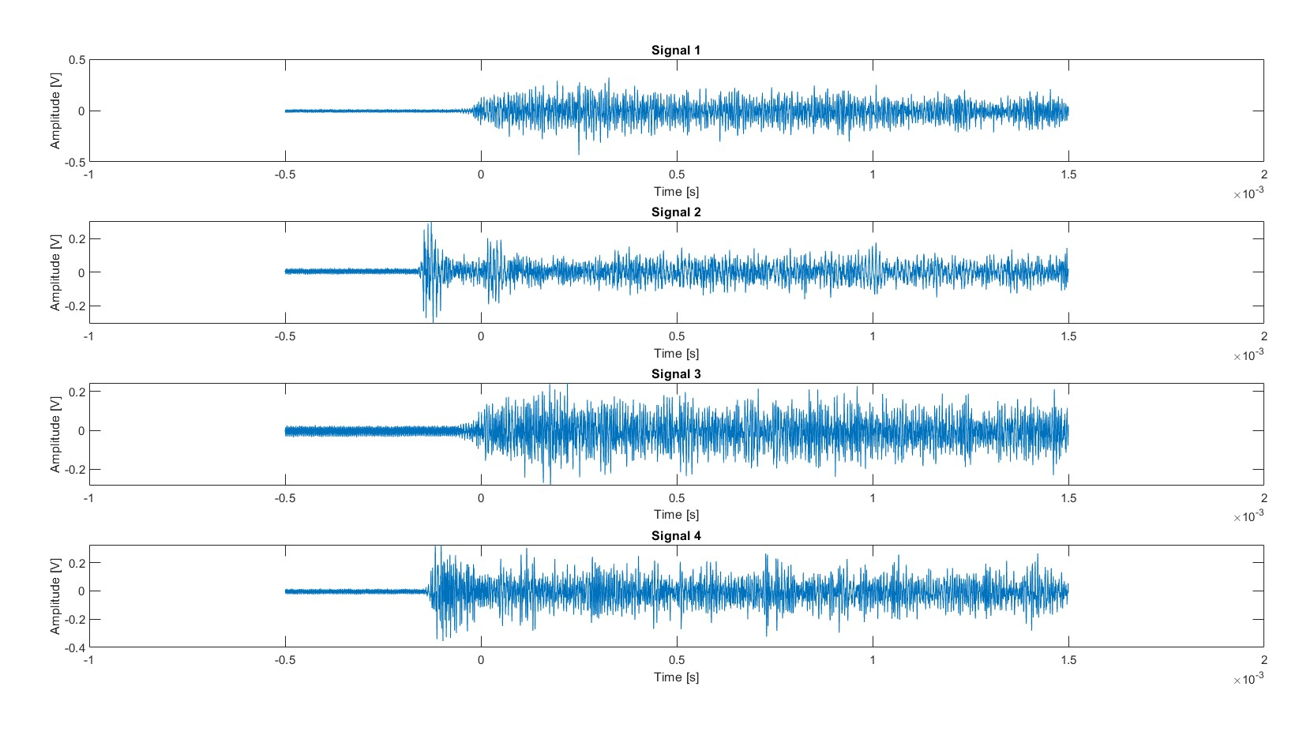
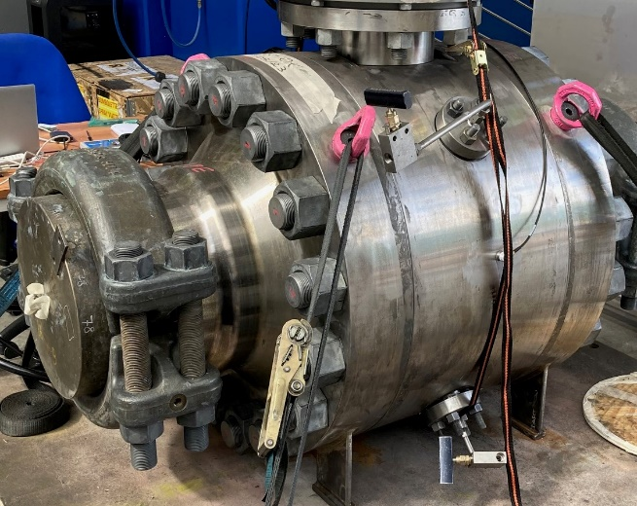
Acoustic Emission test

Slide 10
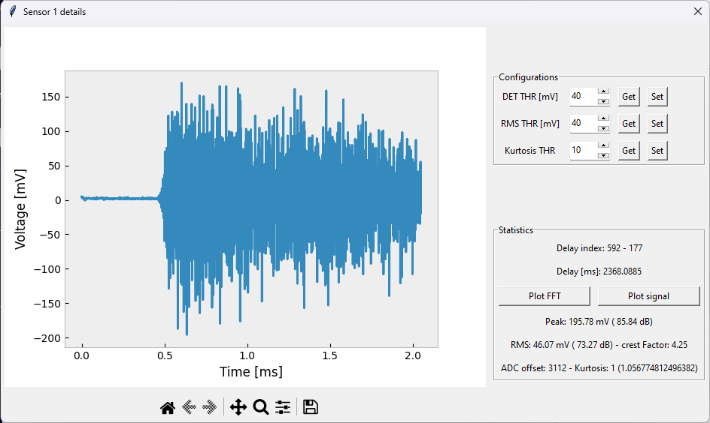
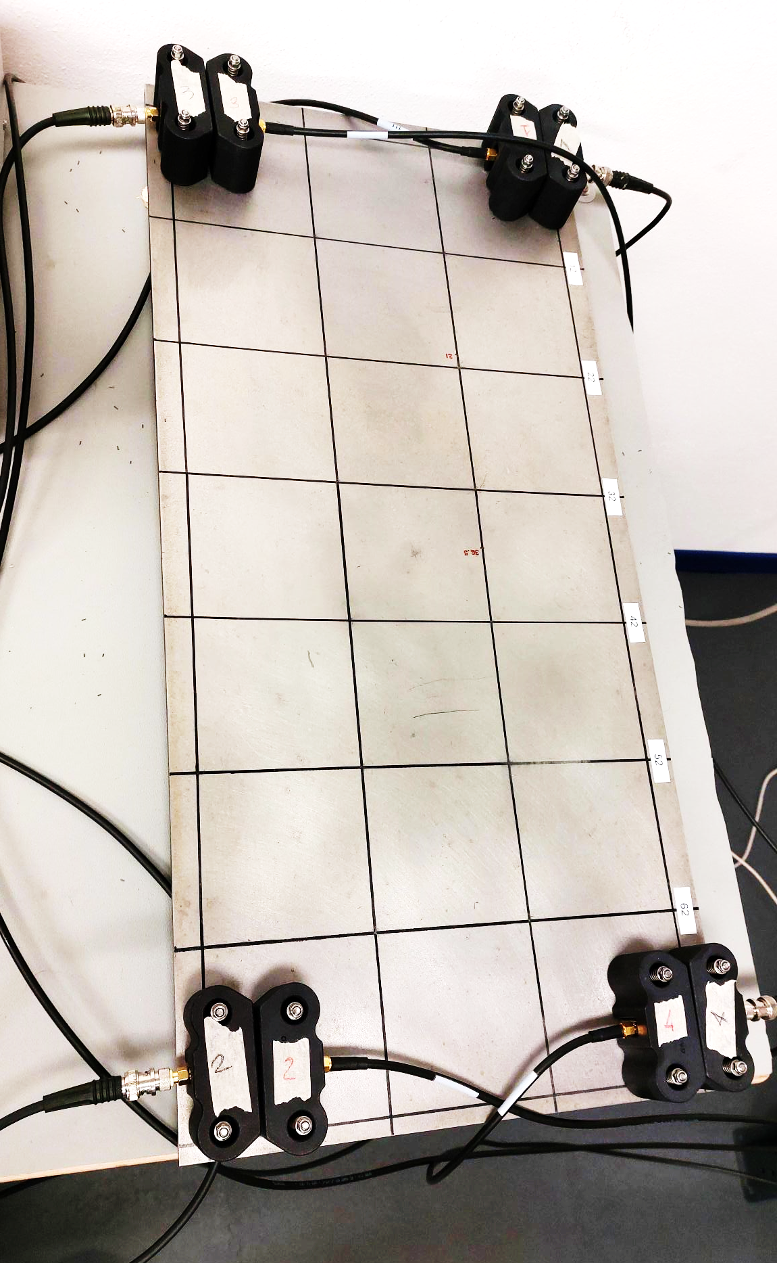
Acoustic Emission test

Slide 11
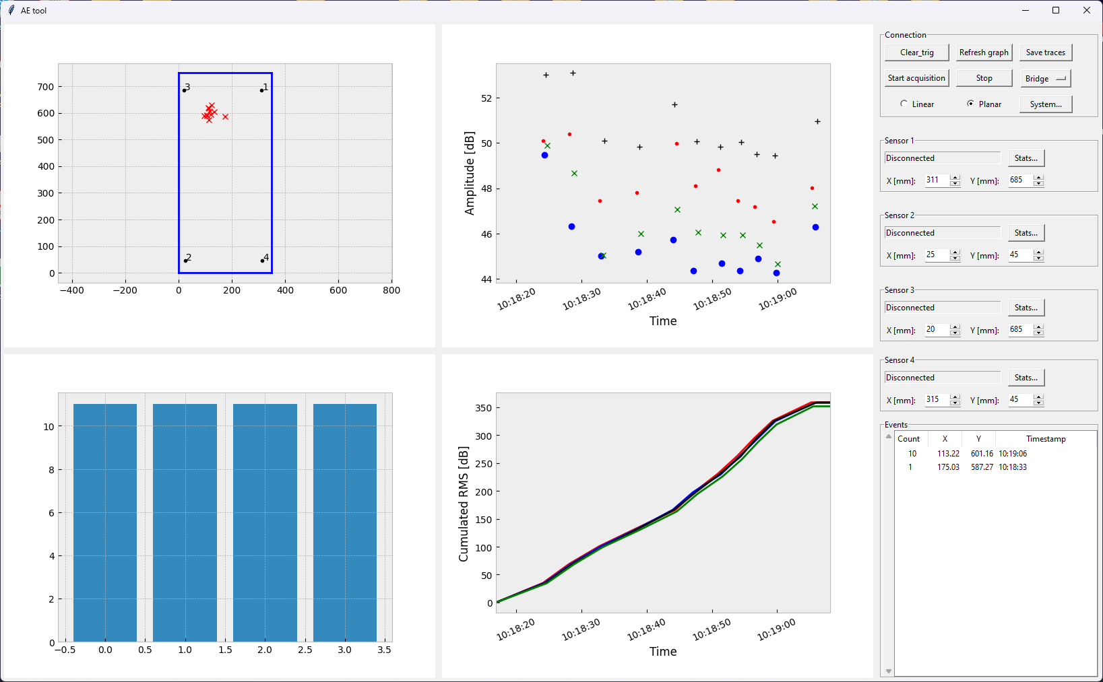
Acoustic Emission test

Slide 12
The solution benefits
VALVE BENEFITS
Functionality & working life confirmation and extension
Enhanced planning of maintenance
PROCESS BENEFITS
Real-time assets health status monitoring
parameters acquisition
Unpredicted and uncontrolled events prevention
Extended production time in safe conditions

Slide 13
Development Plan

Slide 14
Thanks
ORGANIZING SECRETARIAT
Ph. +39 035 3230904
e-mail info@industrialvalvesummit.com
CONFERENCE ORGANIZERS
Ph. +39 3474908420
e-mail segreteria@valvecampus.com
www.industrialvalvesummit.com
www.valvecampus.com

