Slide 1
Actuators are not commodities: Understanding API 6DX 2nd Edition
CONFERENCE
ORGANIZERS

Slide 2
Actuators are not commodities
API 6DX 2nd Edition: Standard for Actuators and Mounting Kits for Valves, main changes and impacts for manufacturers, engineering contractors, and operators
Giulio Zani | Managing Director and Founder PRO CONTROL SRL
Collaborators:
Francesco Agnelli | Quality Assurance Manager
Gianfranco Fulgoni | Technical Manager
Mauro Cazzarini | Product Manager

Slide 3
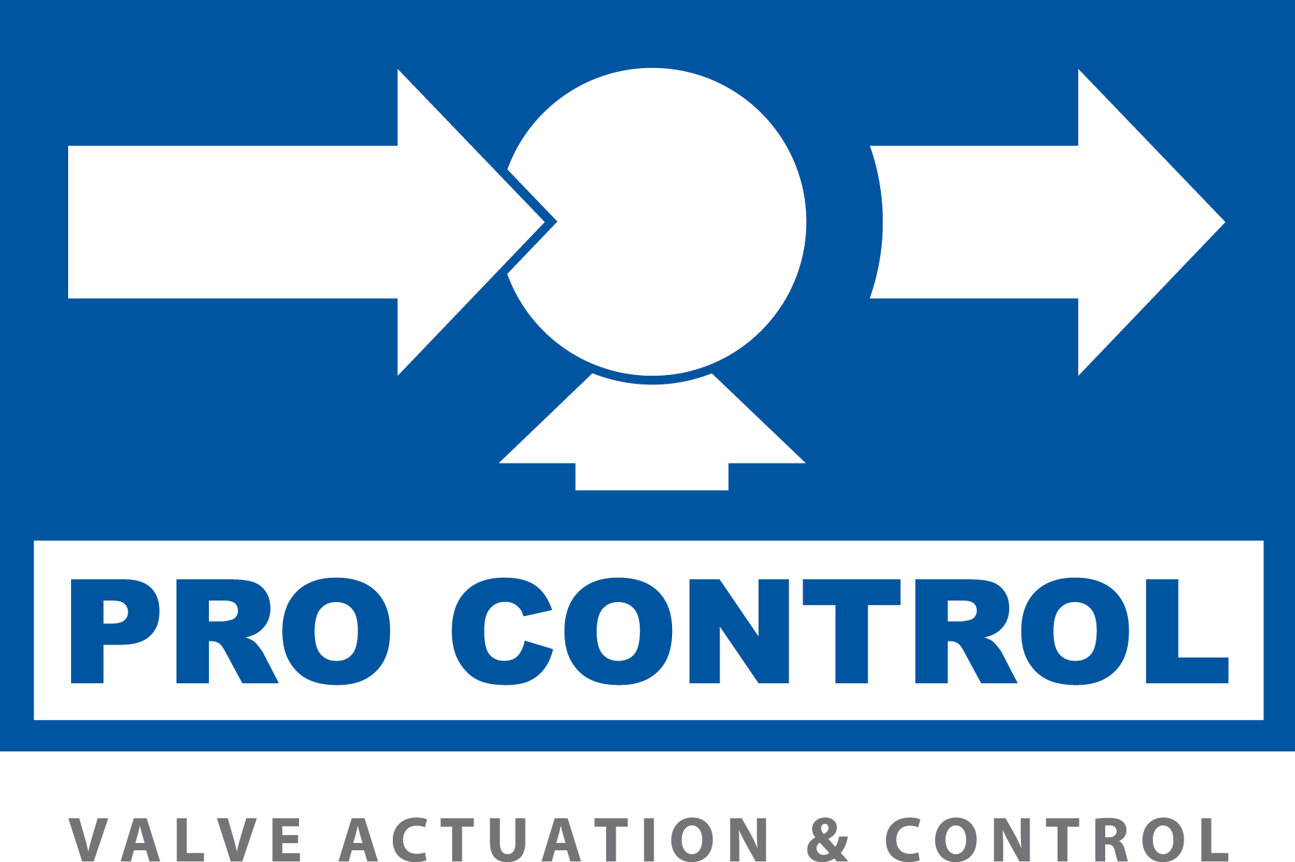
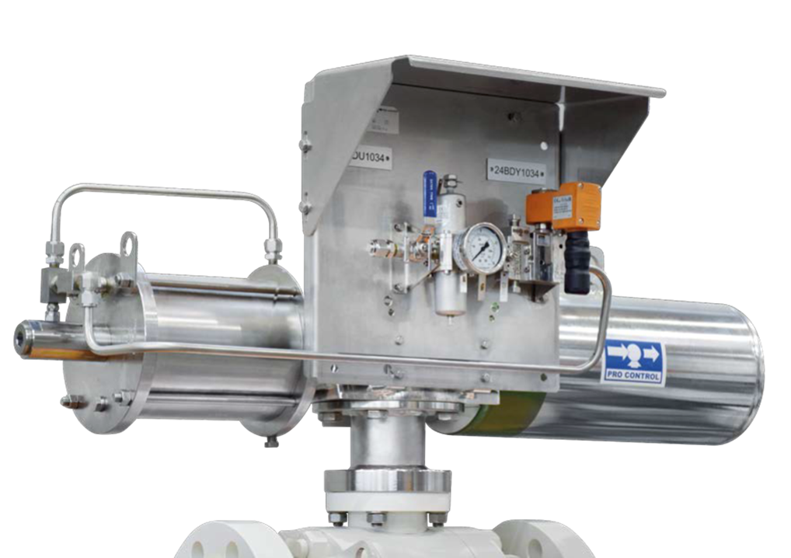
Overview of API 6DX 2nd Edition
PURPOSE AND APPLICABILITY
Purpose: Enhance safety, quality, and operational efficiency of actuated valves.
Scope: API 6DX 2nd Edition governs the requirements for the design, manufacturing, and testing of actuators in conjunction with API 6D valve standards -unless otherwise specified by the customer- and it applies to all industrial applications including oil, gas, chemical, petrochemical, and more.
Actuator Types: Linear and quarter-turn actuators
Power Sources: Pneumatic (compressed air), Hydraulic (pressurized oil), Direct Gas, Gas Over Oil (using accumulated tanks to pressurize fluid inside the cylinder)
Why it is so important? The failure of a single component can result in significant operational disruptions and severe safety hazards. It is crucial to maintain continuous and safe operations, preventing downtime, and avoiding safety hazards.

Slide 4
Major Impacts
DESIGN INPUT DATA
There are approximately 25 Critical Parameters that must be considered:
Just to mention the basics….: Actuator type, power supply, service type (e.g., on/off, fail-safe), valve and line mounting positions, minimum and maximum operating pressures, environmental temperatures, specific operational conditions (offshore, onshore, extreme environments), frequency and speed of operation and many others… not just valve torques!
Actuators operate valves: as the industry evolves, the perception of actuators is finally progressing from being perceived as a basic piece of equipment to being recognized as an essential part which is, in fact, at the heart of valve operation. Thus, valve users must consider the overall quality and service provided by actuator manufacturers in the same way as conceived for valves.
Common misperceptions about actuators:
Actuators are often viewed merely as an accessory to a valve.
Critical parameters are often overlooked or underestimated.
With API 6D 25th Edition, actuated valves shall meet stringent API 6DX requirements with a clear focus on mechanical integrity and plant safety.

Slide 5
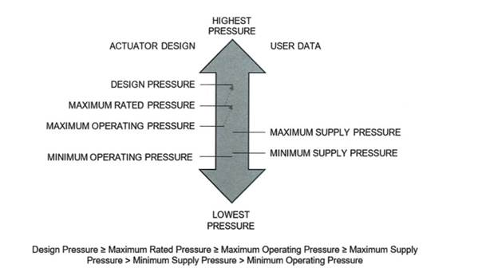
Technical Requirements
ACTUATOR SIZING
Actuators shall be sized in line with the criteria specified in the "Design Basis" section
In the process of sizing actuators, it's imperative to consider both the minimum and maximum supply pressures as the operational pressures. API 6DX does not prescribe a standard supply pressure range; always reference the inquiry specifications for guidance
Unless otherwise outlined in the inquiry specifications, actuator sizing shall as a minimum adhere to the Safety Factor guidelines detailed in relevant Section "Safety Factor," summarized as follows:
ESDV/BDV: a Safety Factor of 1.5 is required for fail strokes, and 1.3 for non-fail strokes.
HIPPS systems necessitate a Safety Factor of 1.5.
All other applications should maintain a minimum Safety Factor of 1.3.
The design torque or thrust should correspond to the output produced under the maximum operating pressure, augmented by a factor of 1.1 as determined by the relief valve's set pressure. To prevent exceeding the Maximum Allowable Stem Torque (MAST) of the valve, a relief valve may be employed, which is not intended to limit the Maximum Operating Pressure (MOP) of the actuator.

Slide 6
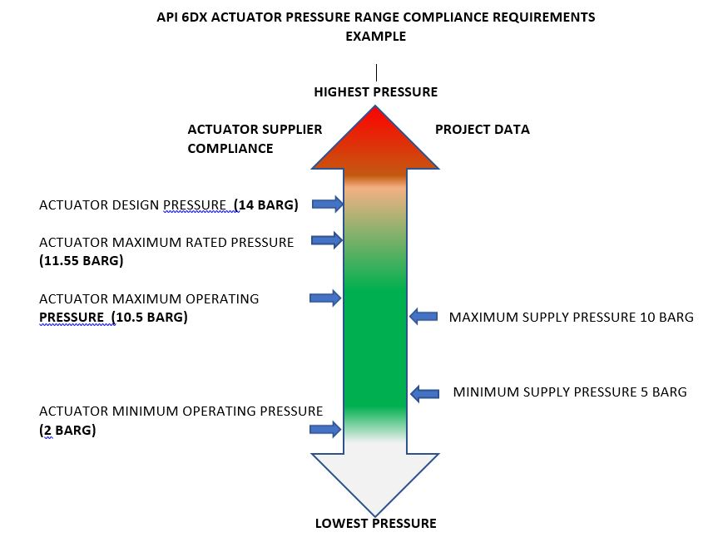
Technical Requirements

Slide 7
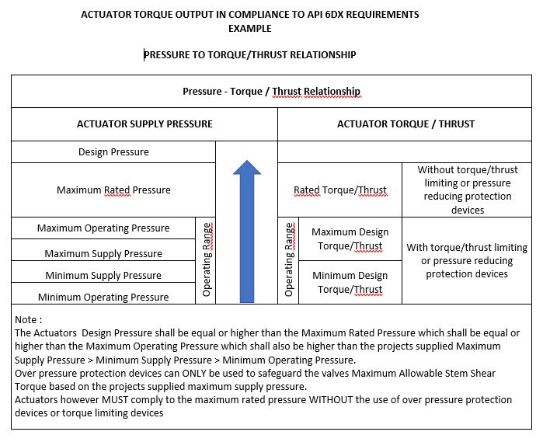
Technical
Requirements
Operating Range
Operating Range

Slide 8
Quality Control and Testing
TEST PROTOCOLS
Comprehensive testing for mechanical integrity including pressure tests and functional assessments.
TESTING PROTOCOLS: Shell Pressure tests, piston seal tests, and functional tests to ensure mechanical integrity and performance.
IDENTIFICATION REQUIREMENTS: Each actuator must feature a permanently affixed tag displaying manufacturer details, model, serial number, maximum allowable and operational pressures, and the year of manufacture. Tags must be visible and securely attached, made of durable materials like 316 stainless steel to ensure legibility and longevity.
DOCUMENTATION REQUIREMENTS: Required comprehensive documentation including torque and thrust output data, electrical and operational schematics, pressure and seal test reports, dimensional drawings, and conformity declarations to API 6DX.

Slide 9
Quality Control and Testing
TEST PROTOCOLS
Dedicated manufacturing process
Evaluation of spring production through type testing
Design specifications for Mounting Kits
Detailed reporting of Visual Examinations
Validation of the Pressure Shell Test to validate cylinders integrity
Assessment of the Piston Seal Integrity to ensure no leaks at operational pressures
Verification of 100% of the actuators’ output torque via a dedicated test bench
Precise product marking and identification
Provision of material certificates for all pressure-retaining components and springs, compliant with EN10204 3.1, alongside a comprehensive paint report
Actuator manufacturers are required to provide a design validation as well as a declaration of conformity for every actuator supplied.

Slide 10
Quality Control and Testing
DOCUMENTATION
It is crucial for actuators to be supplied with comprehensive final documentation, ensuring that all actuators meet both the regulatory standards and specific customer needs enhancing transparency:
Torque/thrust indications for each actuator.
Electrical and operational schematics for each actuator model/configuration.
Cylinder pressure test reports and piston seal integrity for each actuator.
Hazardous area certification for each actuator.
General dimensional drawings for each actuator model/configuration.
A summary declaration of conformity to API 6DX standards for the purpose of supply.
Instructions for the safe removal of the spring container.
This structured documentation process is critical for verifying that actuators are safe, compliant, and ready for operation, aligning with both API 6DX standards and contractual obligations.

Slide 11

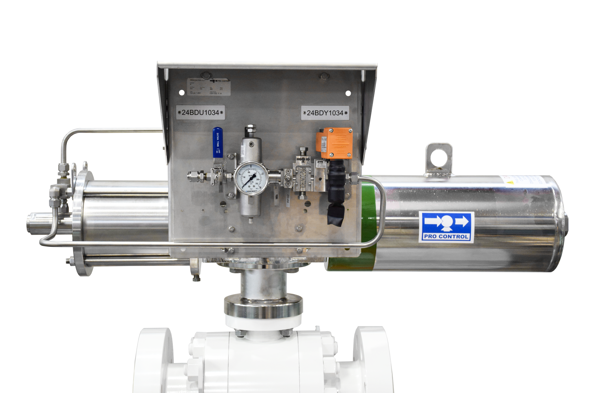


LIFECYCLE COSTS: Total ownership costs beyond the initial purchase price.
SUSTAINABILITY AND EFFICIENCY: The improved design contributes to longer equipment lifespan and reduced maintenance requirements.
Consider what really matters!
Best value for money.
Long-term Benefits & Cost Efficiency
ORGANIZERS
CONFERENCE ORGANIZERS

Slide 12

PRO CONTROL S.R.L.
Località Sforzesca,
29014 Castell’Arquato, Piacenza, Italia
Ph.: +39 (0)523 893025
e-mail giuliozani@procontrolsrl.com
Any question?
ORGANIZERS
CONFERENCE ORGANIZERS

Slide 13
Thanks
ORGANIZING SECRETARIAT
Ph. +39 035 3230904
e-mail info@industrialvalvesummit.com
CONFERENCE ORGANIZERS
Ph. +39 3474908420
e-mail segreteria@valvecampus.com
www.industrialvalvesummit.com
www.valvecampus.com

