Slide 1
Assessing behaviour of thermoplastic & metal materials for critical valve sealing applications in the 2050 Net-Zero context
CONFERENCE
ORGANIZERS

Slide 2
Assessing behaviour of thermoplastic & metal materials for critical valve sealing applications in the 2050 Net-Zero context
Filip Rousseau | R&D Group Leader

Slide 3
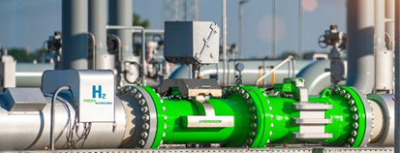
AGENDA
Intro Omniseal Solutions
The Importance of Limiting Hydrogen Leaks
Evaluation of Hydrogen Compatibility
CO₂ Material Certification
NH₃ Material Certification

Slide 4
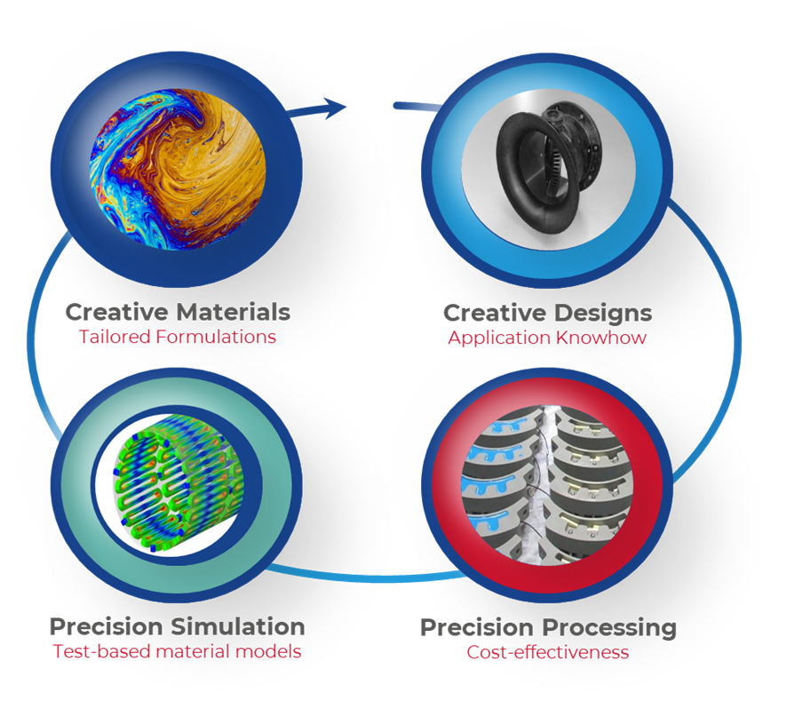
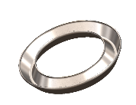
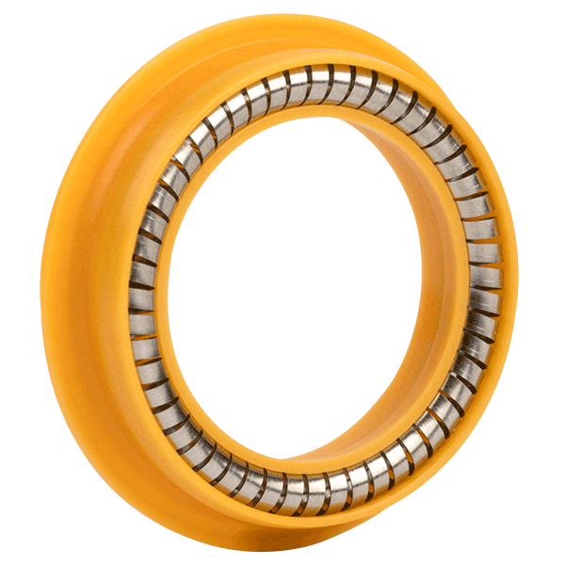
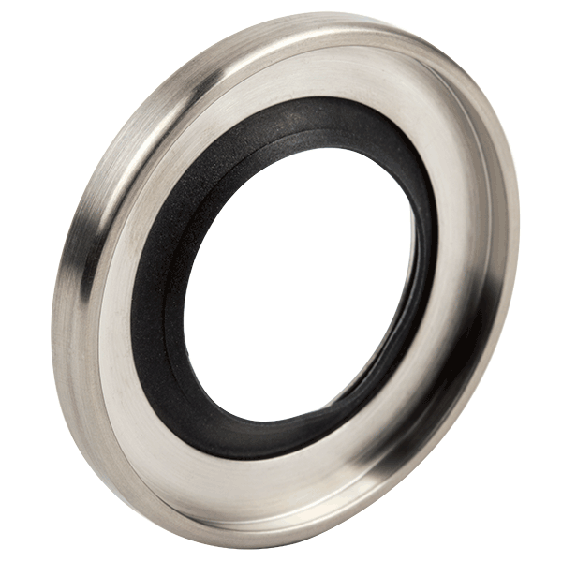
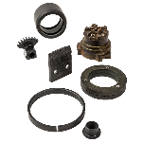
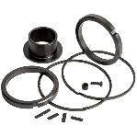
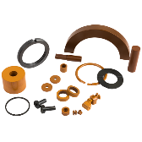
Our Unique Approach for Problem Solving
Our customers rely on the passion, expertise and diversity to overcome their toughest sealing challenges
They value our unique, reliable and innovative solutions, enhanced by physical & numerical testing and customized services
Experienced, problem-solving engineers that create collaborative partnerships with customers
OMNISEAL® SPRING-ENERGIZED SEALS
OMNISEAL® ROTARY LIP SEALS
OMNISEAL® METAL SEALS
Partnership with test labs to assess material properties
From analysis to application testing, our R&D teams support all testing efforts
RULON® FLUOROPOLYMERS
MELDIN® HT THERMOPLASTICS & POLYIMIDES
HYCOMP™ COMPOSITES

Slide 5
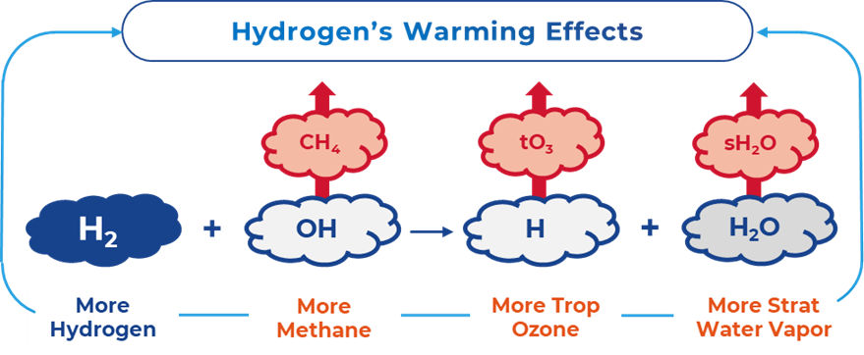
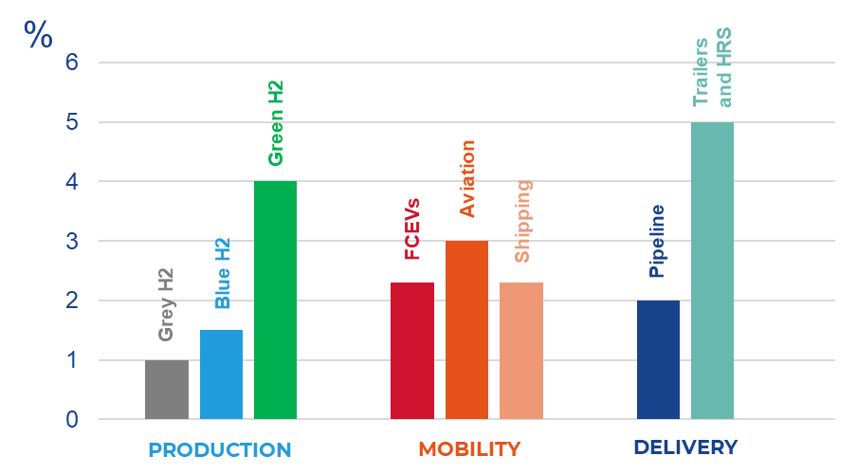
From Different Researches, Hydrogen Emissions could Have a Significant Impact on Global Warming
the importance of limiting hydrogen leaks to the atmosphere
Hydrogen leakage by sectors - 2050 scenario
Key Findings & Recommendations
Poor H2 leakage detection and monitoring
Improve understanding of leakage sources in existing H2 infrastructure
Expand support for R&D programs on H2 leakage detection, prevention, and mitigation
Source: Hydrogen Leakage: A Potential Risk for the Hydrogen Economy, Center on Global Energy Policy, Columbia SIPA – July 5, 2022

Slide 6
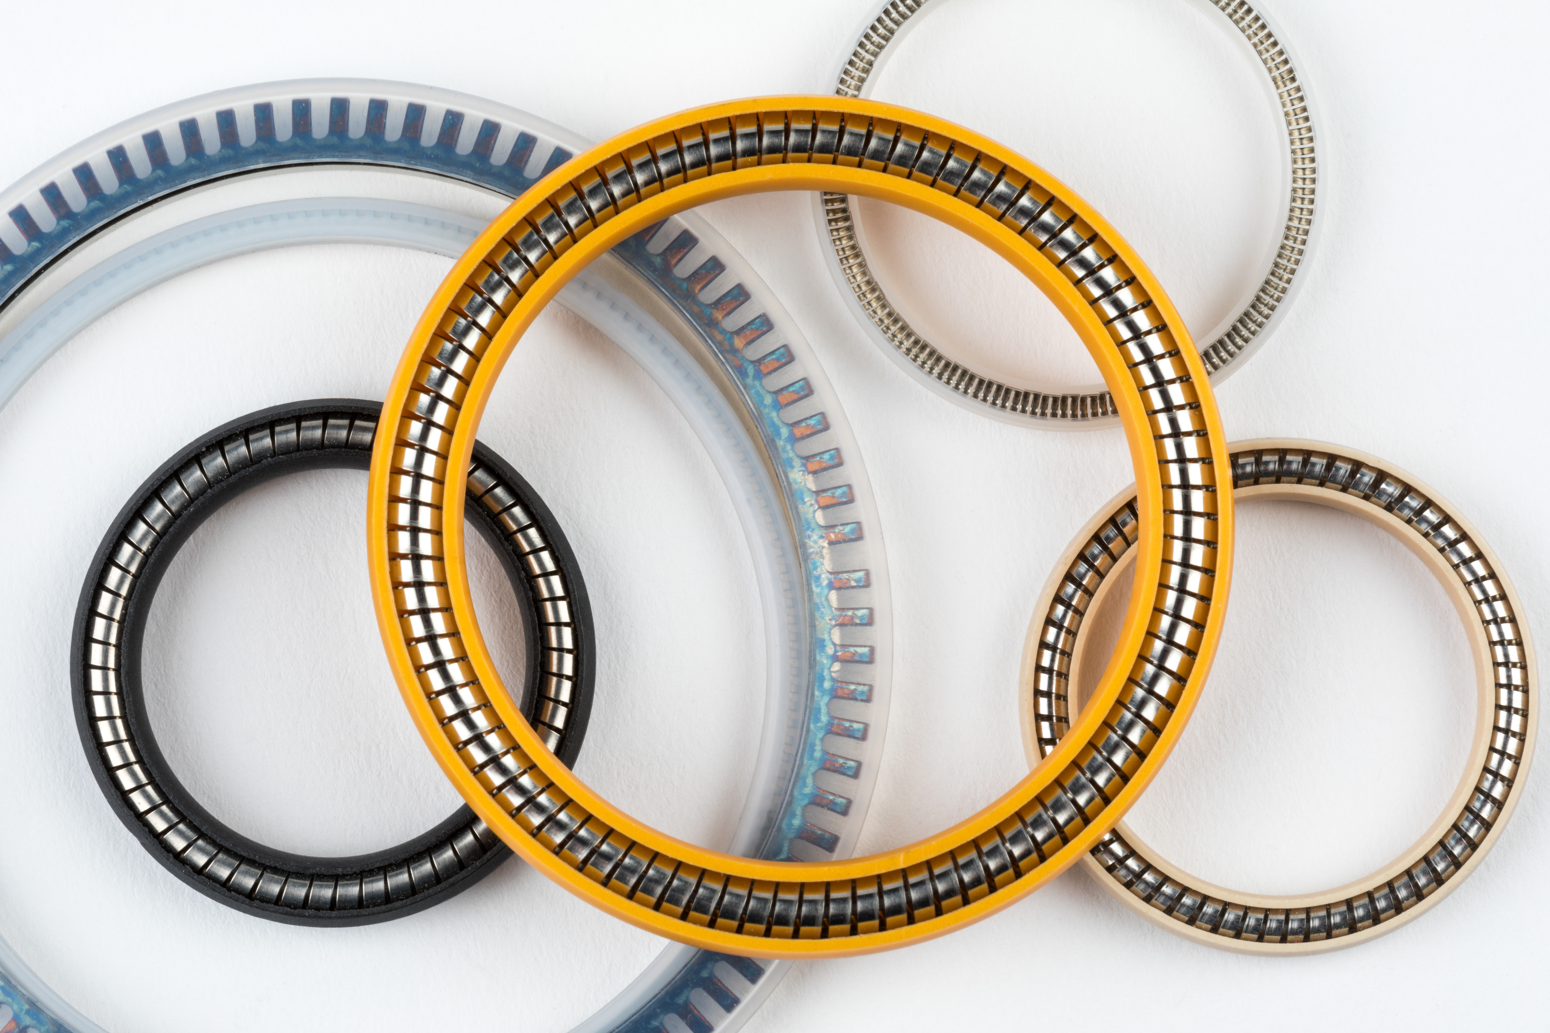
Evaluation of Hydrogen Compatibility through External Material Testing Campaigns
We partner with external test labs to generate data on most critical material properties
Application-based Testing
Most of tests in Industry do not utilize Hydrogen as a test media, or even no Technical Specification exist yet
H2 / LH2 valves
OMNISEAL® SPRING-ENERGIZED SEALS
OMNISEAL® METAL SEALS
H2 Compressors
Aging in high pressure H2
Aging in high pressure H2
RGD in high pressure H2
Thermal behavior in high pressure H2
Fatigue in high H2 pressures (<1500 bar) & temperatures (-253°C to +600°C )
H2/LH2 refueling solutions
Mechanical Properties in high pressure H2
Lifetime assessment in extreme H2 conditions
Permeation in high pressure H2
Mechanical Properties in H2/LH2
LH2 reciprocating pumps
Tribological Properties in high pressure H2
Material Characterization after H2 exposure

Slide 7
Transport Properties of Hydrogen in Polymers
Permeability
(Φ)
Diffusivity
(D)
Solubility
(S)
How fast H₂ moves inside material (cm²/s)?
How much H₂ can be contained inside a material?
Note: High solubility of hydrogen in polymers = high concentration of gas within material = increased chain mobility =
reduction of Tg and reduced mechanical strength: Plasticization => Diffusion
Under hydrostatic high pressure, opposing effects on diffusion in polymers:
Compression, due to imposed hydrostatic pressure: diffusion
Swelling, due to increased hydrogen solubility under high pressure, diffusion
Effect of temperature changes: e.g. Large pressure gradients during refueling operation, and consumption of the fuel: up to 200 °C in some compressors: affecting H₂ transport properties in polymer

Slide 8
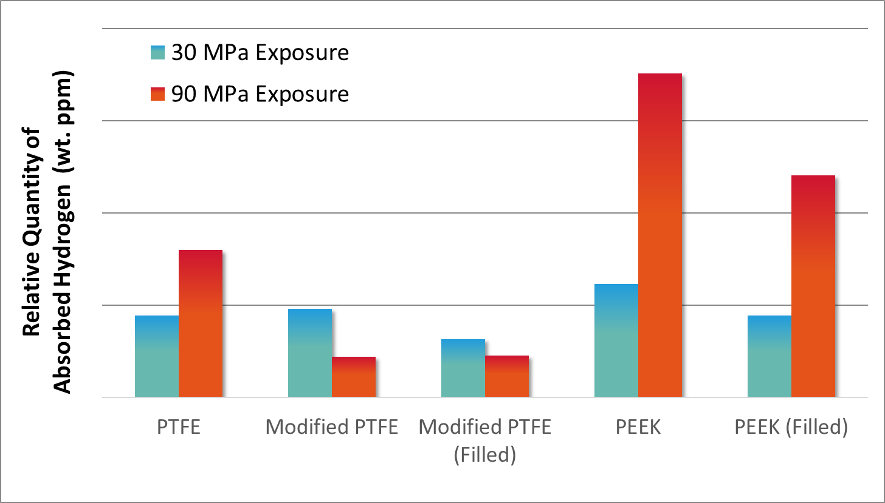
Hydrogen Absorption of PTFE and PEEK upon Exposure to High Pressure (24hours, 30°C)
PEEK absorbs a higher content of hydrogen, compared to PTFE or modified PTFE.
At higher pressure, hydrogen uptake of modified PTFE decreases, as opposed to PTFE or PEEK, and is lower than PTFE.
With addition of appropriate fillers, the overall hydrogen uptake can be decreased, which could be more significant at higher pressure.

Slide 9
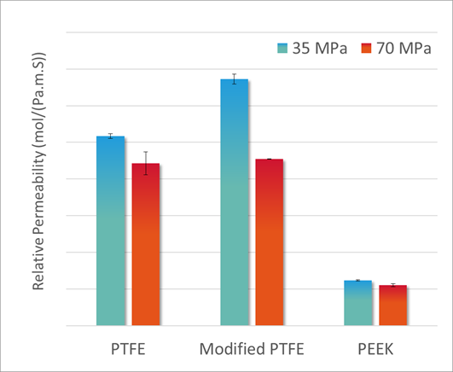
Steady State Hydrogen Permeation of PTFE and PEEK at 80 °C / High Pressure
$$\text{P}\text{ermeation} \text{set} \text{up} \text{used} \text{for} \text{measurements} \text{of} \text{high}\text{−}\text{pressure} \text{hydrogen} \text{permeation} \text{in} \text{polymers}$$
Source: image from CSA/ANSI CHMC 2:19 (page 21)
$$\text{Permeability} \text{Coefficient} :$$
$\frac{molar flow \left(\frac{mol}{s}\right) × thickness (m)}{sample surface \left(m^{2}\right)×Pressure gradient (Pa)}$
PEEK has lower hydrogen permeability compared to PTFE or modified PTFE
Permeation of hydrogen through PTFE, modified PTFE and PEEK decreases with increase in hydrogen pressure.
At 30 MPa, the modified PTFE showed higher permeation to hydrogen, compared to PTFE.
A higher permeability tends to favor the resistance to rapid gas decompression (RGD). However, mechanical and thermo-mechanical properties should be also considered to better evaluate the final performance.

Slide 10
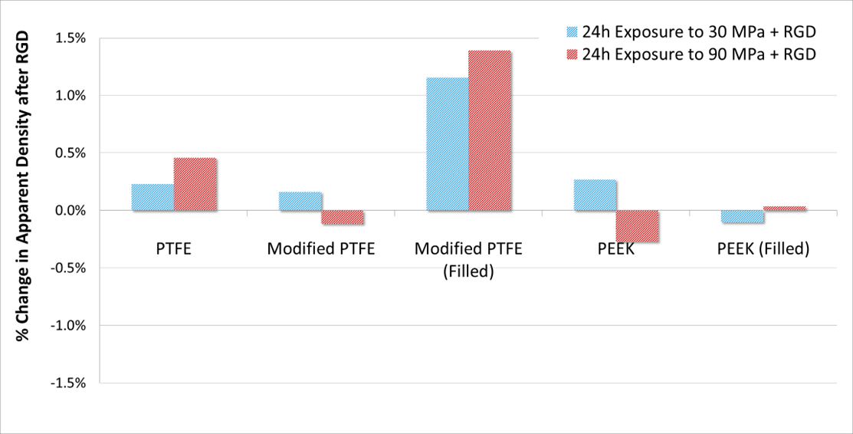
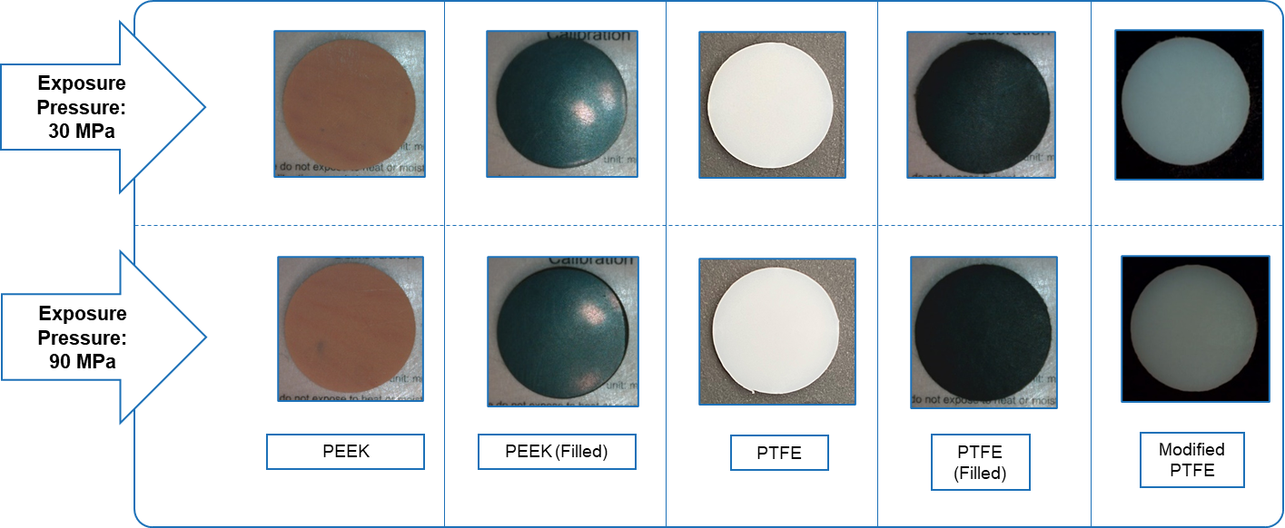
Change in Density, upon exposure to High Pressure Hydrogen and RGD (~6 MPa/min)
A significant change in density of a polymer after rapid gas decompression can indicate presence of voids or defects in the polymer.
Change in density of PEEK, PTFE and modified PTFE upon RGD from up to 90 MPa is minimal (less than 1.5%).
None of the test specimens showed visible change in structure after RGD from 90 MPa or 30 MPa hydrogen.

Slide 11
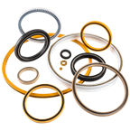
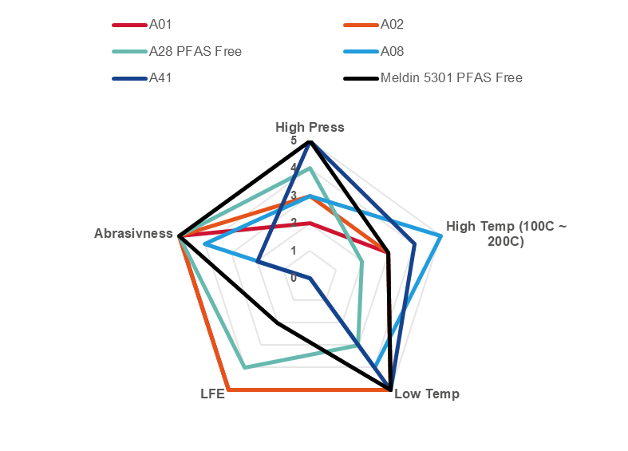
Ranking of Lip Seal Jacket Materials for Hydrogen Pipeline Valves
OMNISEAL® SPRING-ENERGIZED SEALS
Omniseal Solutions™ proprietary materials | Seat Seals | Stem Seals | Static Seals | PFAS Free
A01 | 2 | 2 | 3
A02 | 3 | 3 | 3
A28 | 2 | 2 | 2 | X
A08 | 1 | 2 | 3
A41 | 1 | 3 | 1
Meldin® 5301 | 2 | 1 | 2 | X
0: not recommended / 3-5: recommended

Slide 12
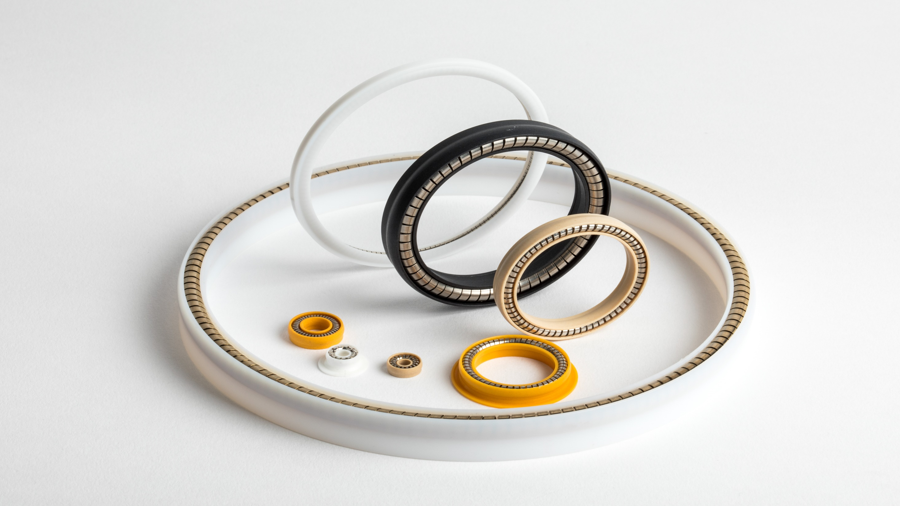
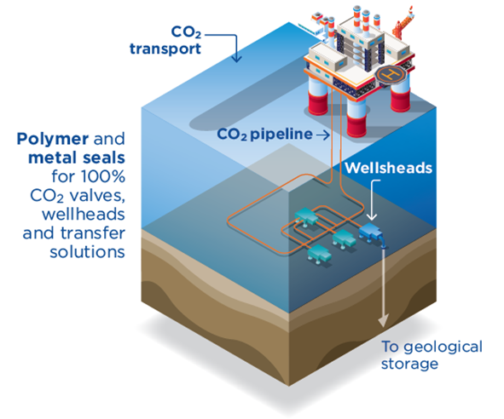
Our 100% CO₂ Third-Party Materials Certification for CCUS
CO2 Offshore Transport & Storage
CO₂ is considered non-corrosive in dry condition, however presence of « impurities » (water, H2S, MEG) could affect metal and polymers
Elastomers are susceptible to swelling and changes in physical properties due to absorption of dense phase of CO 2
CO₂ will have a limited impact on multiple physical properties of PTFE based materials (creep resistance, crystallinity, sorption, swelling
OMNISEAL® SPRING-ENERGIZED SEALS
Test conditions in compliance with the pass/fail criteria of Norsok M-710 Ed.3:
100% CO2 (liquid & super-critical)
345 bar
-46 / RT / 97°C / 127°C
In Blue Hydrogen process, CO₂ produced with Steam Methane Reforming is captured and stored to reduce emissions
CO₂ is compressed for onshore (pipelines, trucks, rail) or offshore (ships) transport and geological storage
Ship transportation of liquid CO₂ can be an alternative option for many regions of the world
All materials passed successfully :
Proprietary Custom PTFE A02, A10, A16, A19, A21
Proprietary Custom FEP A20
Proprietary Ekonol-filled A08
Proprietary Custom UHMW-PE A09
Proprietary Custom PEEK Meldin® 5301

Slide 13
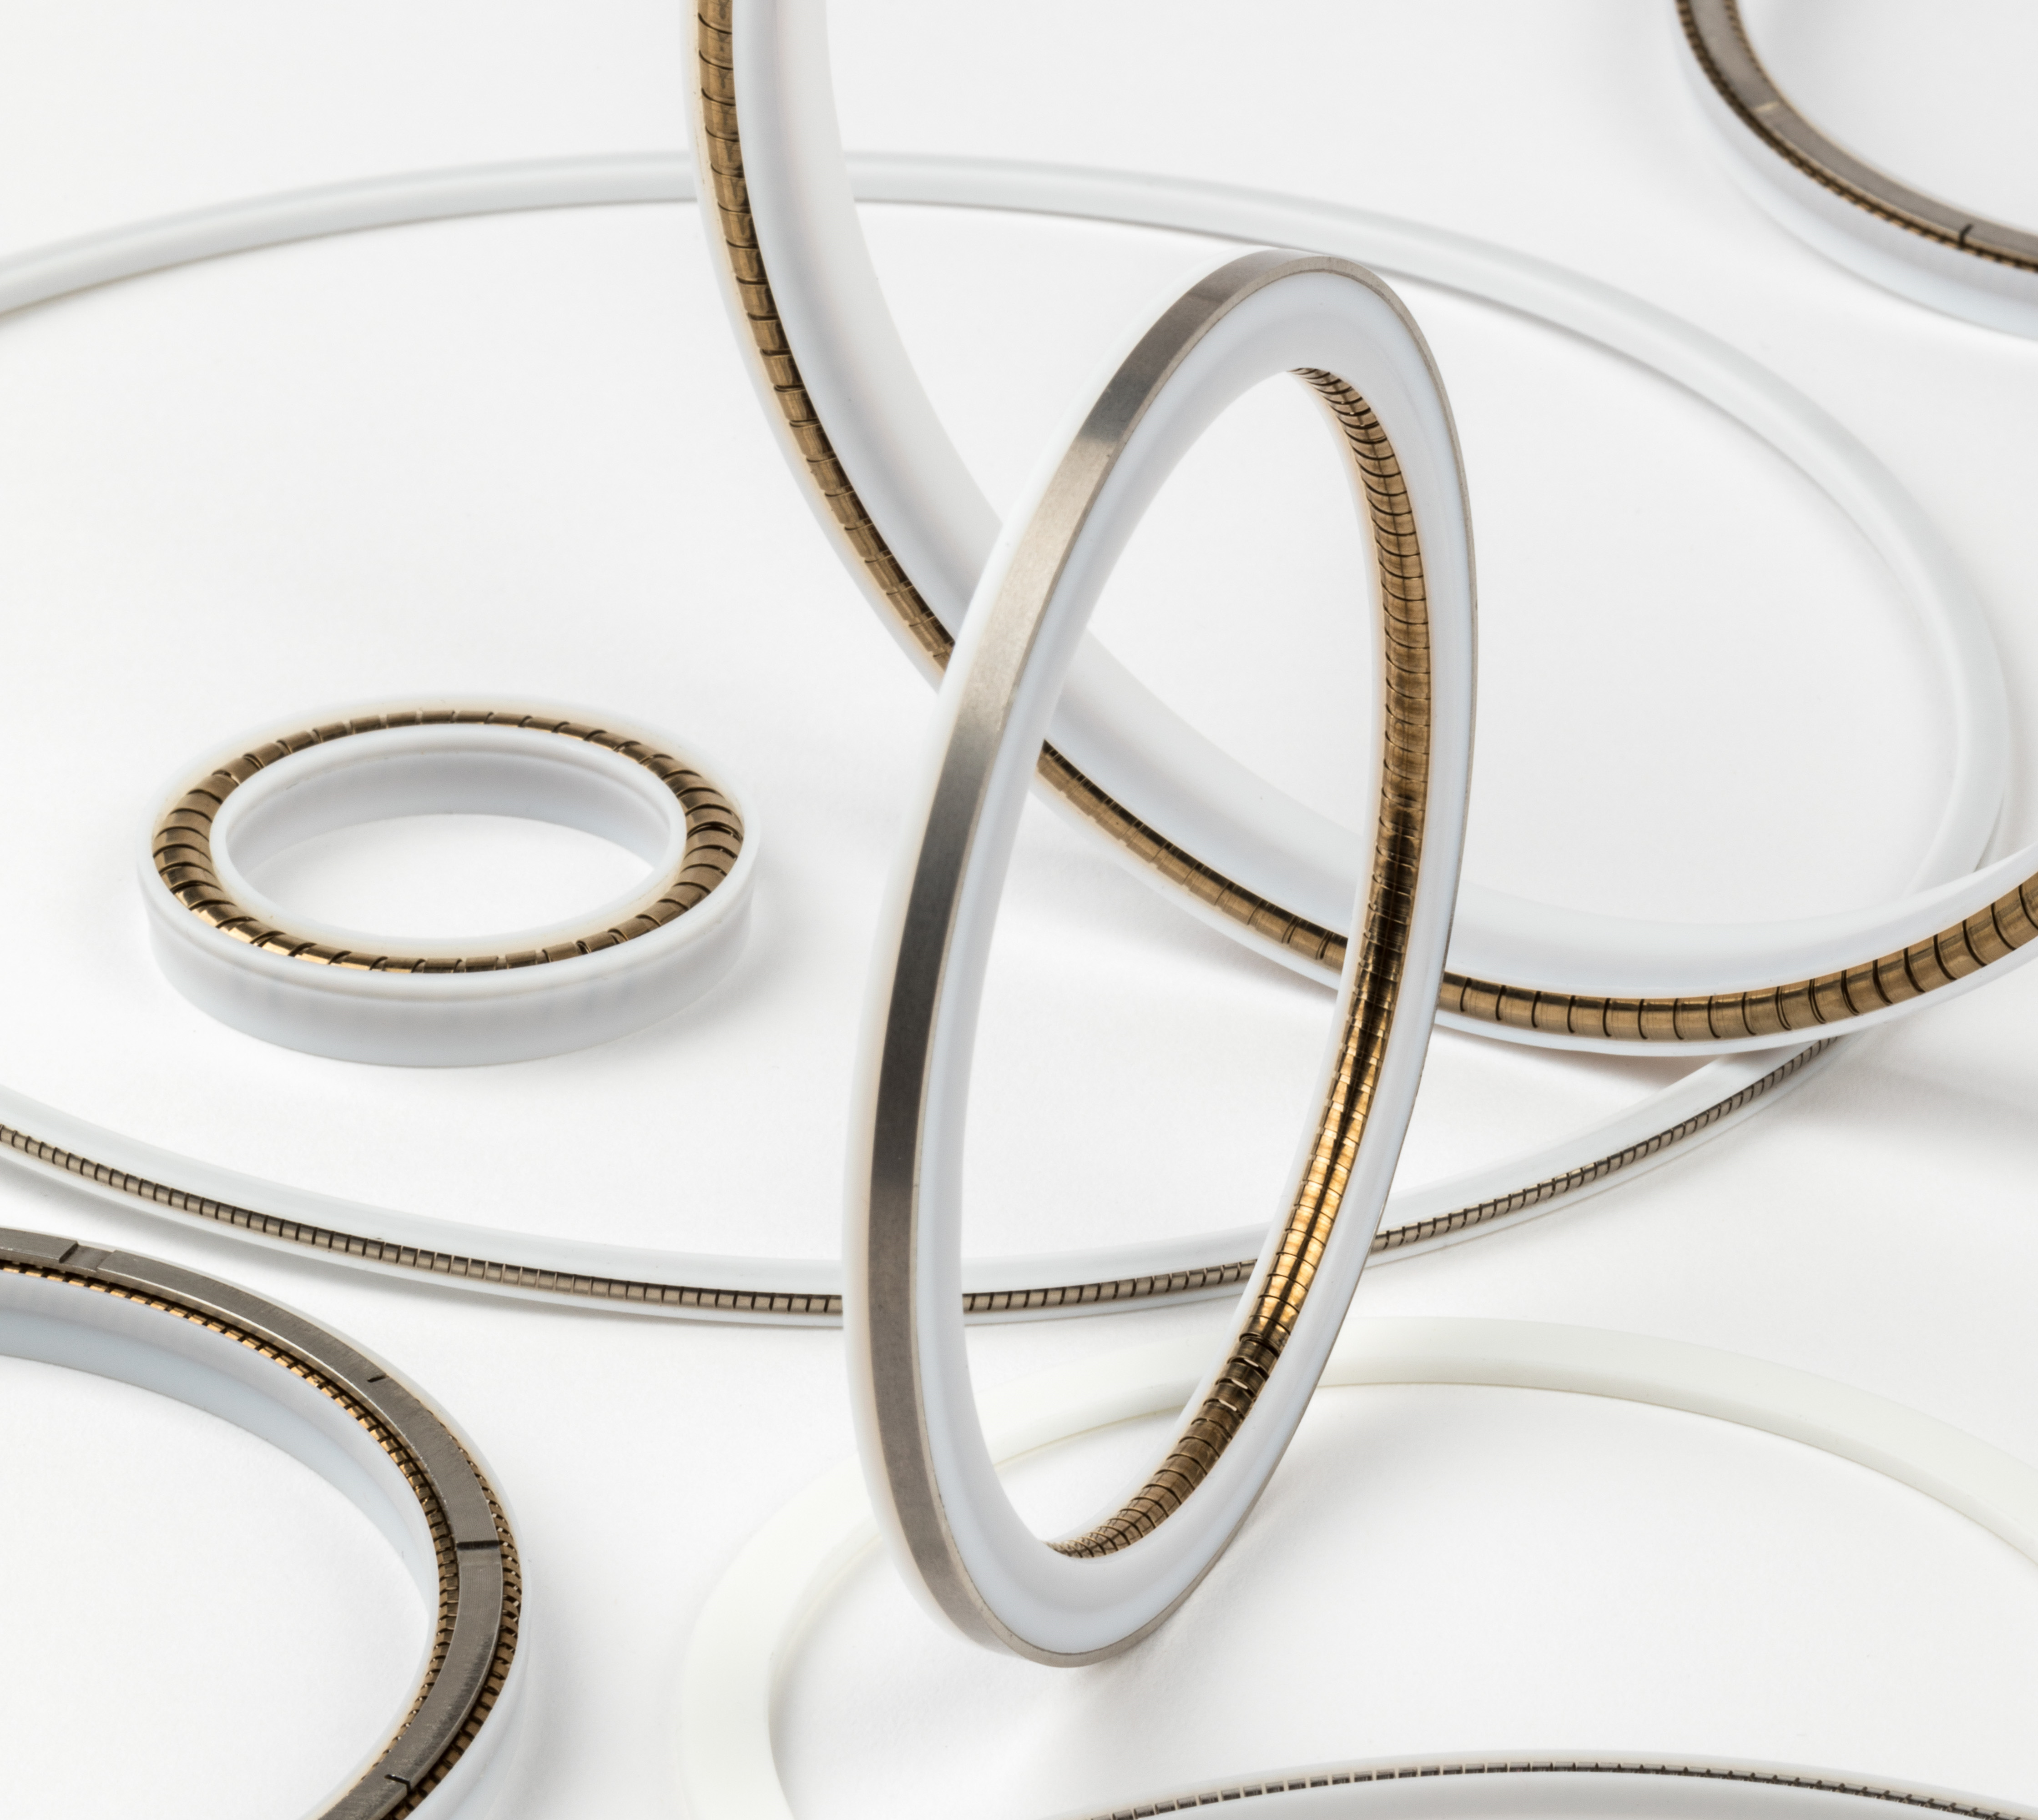
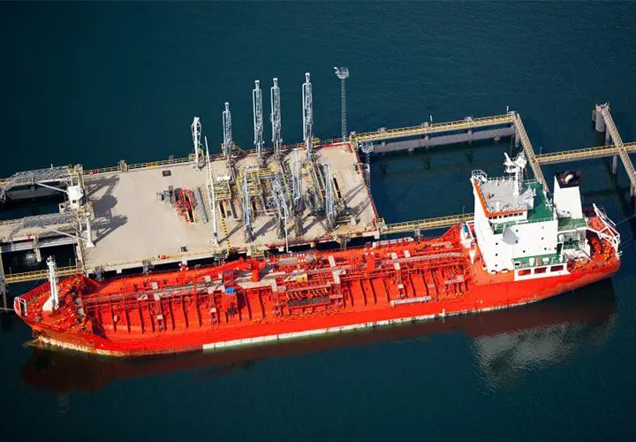
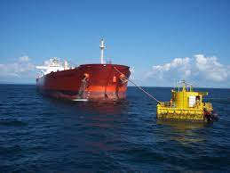
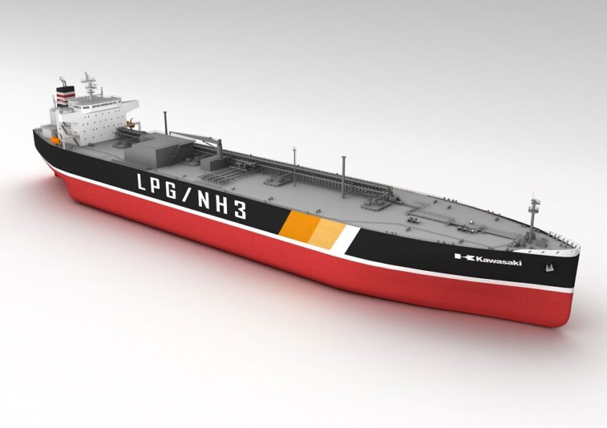
Our 100% NH₃ third-party materials certification
Ammonia safe cargo transfer
Test conditions in compliance with the pass/fail criteria of Norsok M-710 Ed.3:
100% CO2 (liquid, gas & super-critical)
Patm, 9 bar, 60 bar
-46 / RT / 82°C
OMNISEAL® SPRING-ENERGIZED SEALS
Ship-to-shore Transfer
Jetty-less Transfer
Ammonia Cargo
Ammonia shipping represents today 15-20 MTPA of the 180-200 MTPA worldwide ammonia production/use
Ammonia shipping at -33°C / low pressure
Ammonia shipping to increase x20 between today and 2050 projections
Omniseal Solutions™ proprietary materials | Description
A02 | Modified PTFE
A16 | Lubricated organic PTFE
A19 | Lubricated organic PTFE
A21 | Lubricated organic PTFE
A09 | Formulated UHMW-PE
A27 | Lubricated Glass Filled PTFE
Meldin® 5301 | PEEK
NH3 volumes | Today (low) | 2050 (low) | Ratio | Today (high) | 2050 (high) | Ratio
Production MTPA | 150 | 450 | 3 | 200 | 600 | 3
Local consumption MTPA | 135 | 150 | 1.11 | 180 | 200 | 1.11
Shipping MTPA | 15 | 300 | 20 | 20 | 400 | 20

Slide 14
Thanks
ORGANIZING SECRETARIAT
Ph. +39 035 3230904
e-mail info@industrialvalvesummit.com
CONFERENCE ORGANIZERS
Ph. +39 3474908420
e-mail segreteria@valvecampus.com
www.industrialvalvesummit.com
www.valvecampus.com

