Slide 1
API 623, 2nd Edition
CONFERENCE
ORGANIZERS

Slide 2
API 623, 2nd Edition
Highlights of change, and how we got here
Ron Merrick, PE | Retired Valve Specialist, Fluor
Yogesh Jangra | Fluor India
Ashley Casteel, PE | Fluor Houston

Slide 3
Background of Valve Standards
For engineers who worked in the mid-20th century, process piping relied on only three different types of valve, the gate, globe and check.
Industry standards for these products evolved slowly, driven by industries who needed reliability and interchangeablity.
The API Refining Division developed standards for valves they used most:
API 600 (1949) for gate valves,
API 602 (early 1960s) for small-size gate valves,
API 594 (early 1970s) for double-disc check valves.

Slide 4
Background of Valve Standards
During this time, there never had been a standard for globe valves.
One possible reason for the lack of a globe valve standard was that, in a 2010 survey, we* found that globe valves were only 9% of all steel GG&C purchases.
Another possible reason was that the function of manual globe valves had been steadily displaced, starting in the 1950s, by globe-style and other designs of automatic control valves, which were operated from a central control room or, increasingly, by distributed control systems, instead of by hand.
* Internal survey of Fluor project purchases worldwide.

Slide 5
Background on globe valve failures
After globe valves became relegated to light to moderate throttling, mostly just bypasses around control valves,
It became common practice to choose the valve size based on ‘rule of thumb’, with little regard for actual flowrate. In many cases this was same as the line size.
This often resulted in valves with usual flowrates only at the very bottom of their range, leading to high flowrates at small percentage-open, leading to vibration, leakage and fires, especially in flashing services.

Slide 6
Background on globe valve failures
An incident in 2007 in a US refinery unit dramatically illustrated this.
During startup of a crude vacuum unit that we designed for a US refinery,
Numerous globe valves were exhibiting serious vibration.
The vibration sometimes caused packing leaks, in high temperature hydrocarbons, which caused flash fires.

Slide 7
Background on globe valve failures
As part of the investigation into these failures, we asked valve specialists from other operating companies,
Many said it was common knowledge (folk wisdom) that
globe valves always vibrate
and make noise
and have stem leaks.
Some owners had guidelines on sizing of globe valves
Some owners had limits on maximum allowable ΔP.

Slide 8
Background on globe valve failures
We analyzed all the globe valves in this startup unit and determined –
API 602 globe valves did not exhibit this problem (relatively stiffer)
The problem occurred almost entirely in flashing services
Was more severe with high ΔP
High vibration, with one or two turns open, was sometimes accompanied by packing leaks, and usually flash fires (services above autoignition temps)
We quickly ruled out poor valve design or manufacturing

Slide 9
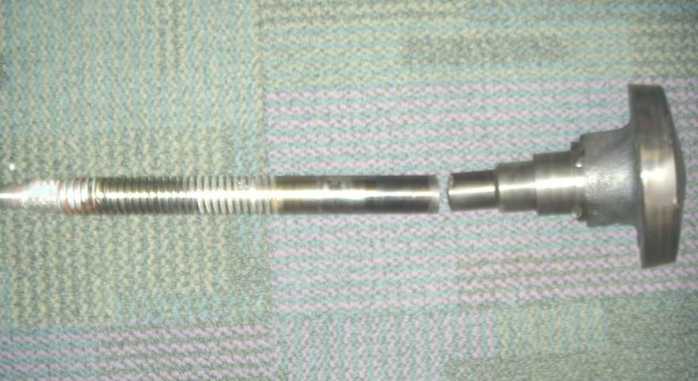
Background on globe valve failures
Later, we found some catastrophic failures, likely caused by vibration.
Not the same refinery
where the original
problem occurred.
Photo courtesy Terry Blackard

Slide 10
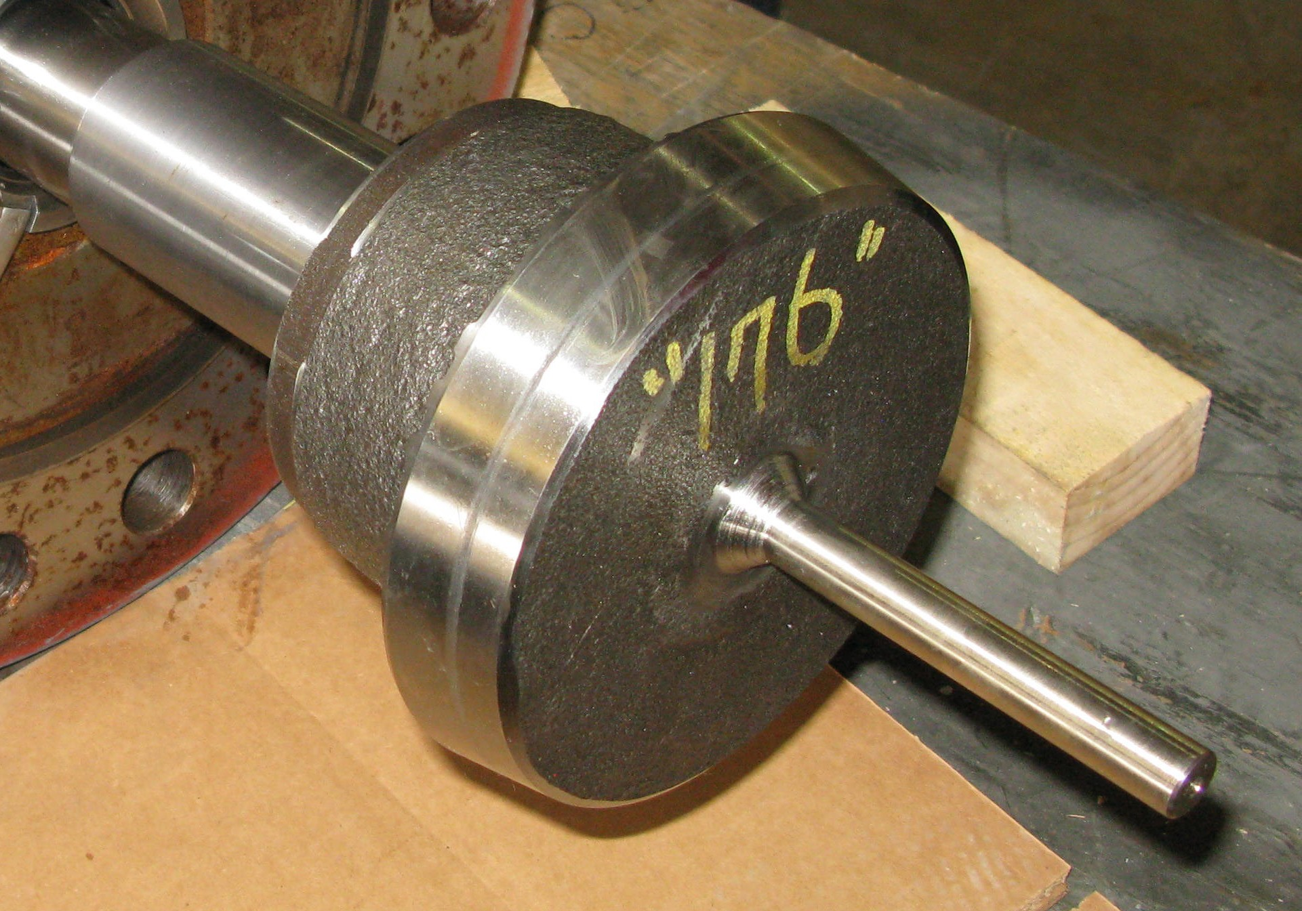
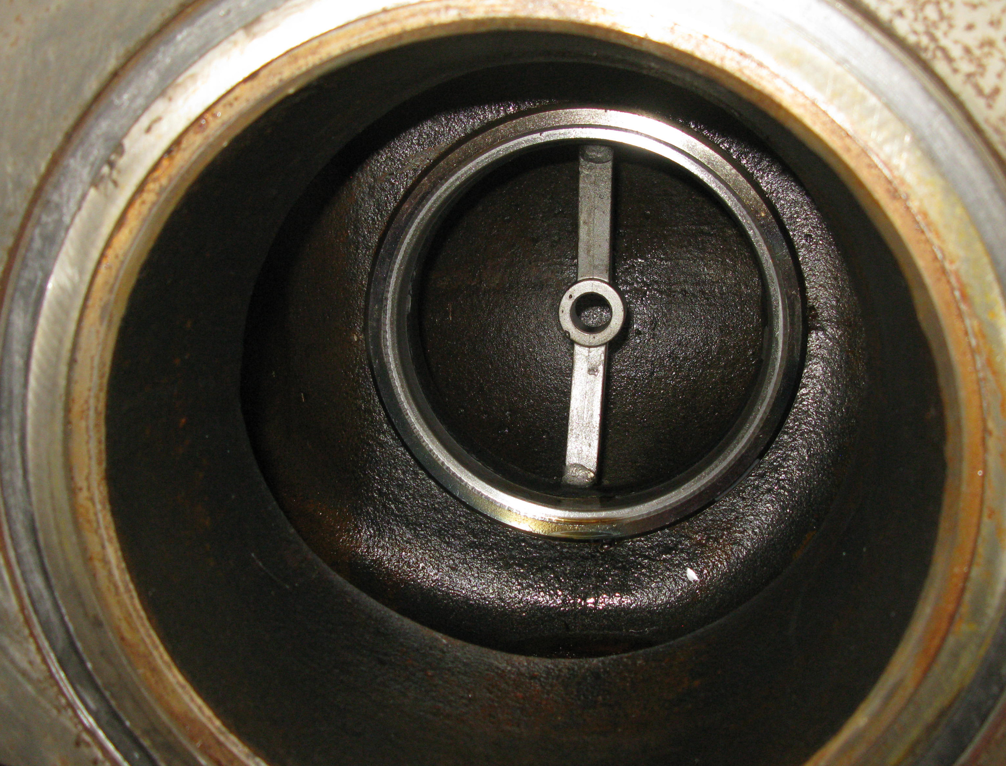
Search for solutions to vibration
Several solutions were tried. One was a guide directly on the disc.
It was well known that this approach reduced disc vibration.

Slide 11
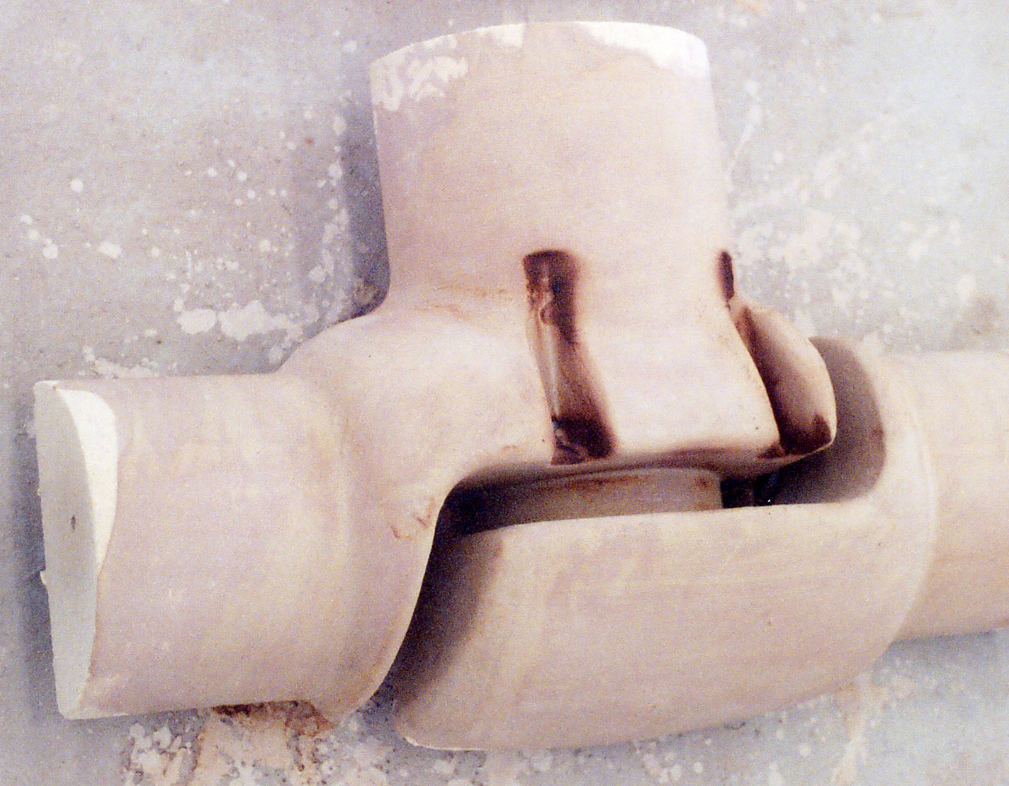
Search for solutions to vibration
Another approach was body guides.
Example of body guides (shown here in a mold core for clarity).

Slide 12
Finally, an API standard
Based in this incident and other failures, in 2009 the API agreed to develop a new standard on globe valves
Design rules were based on API 600 (gate) and BS 1873 (globe)
Main difference is that globe valve stems are in column loading
Also globe valve stems are under side loading due to flow
The committee approved a calculation method for stem loading
Calculations showed that stems of many existing globe valve designs were inadequate for column loading.
Further, many BS 1873 minimum diameters were inadequate.

Slide 13
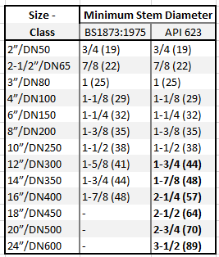
Comparison with BS 1873 stem diameters
In some cases, our calculations showed a greater required stem diameter than in the last 1975 edition of BS 1873.
BOLD = greater diameter based on 20 ksi stem strength (F6/410 stem material). 20 ksi ≈ 138 mPa
Results from ASME Class 150:

Slide 14
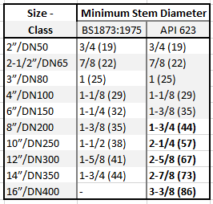
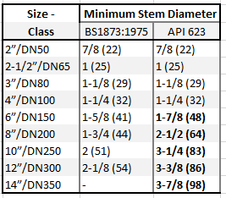
Comparison with BS 1873 stem diameters
In some cases, our calculations showed a greater required stem diameter than in the last 1975 edition of BS 1873.
Class 300 Class 600

Slide 15
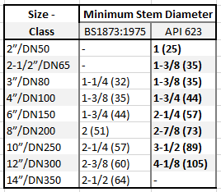
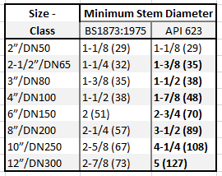
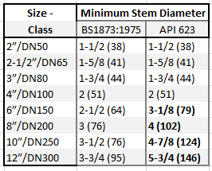
Comparison with BS 1873 stem diameters
In some cases, our calculations showed a greater required stem diameter than in the last 1975 edition of BS 1873.
Class 900 Class 1500 Class 2500

Slide 16
What changed in 2nd edition?

Slide 17
What changed in 2nd edition?
We should begin by addressing the elephant in the room….

Slide 18
Changes in 2nd Edition
The single most important change in API 623 --
Requiring the disc to be fully guided throughout its entire travel
Clause 5.3 “The disc shall be body guided throughout its full range of travel to provide disc stability and avoid vibration”
This disallows guiding the disc solely through the stem, with an unsupported moment are from the packing bush down to the disc.
Some designs of high-pressure globe valve had used a fully-guided disc since at least the 1960s.
This change was already applied in the 1st edition, but only applicable to class 900 and higher.

Slide 19
Changes in body guide design
As a practical matter, making this change in the 1st Edition served two functions –
The problems of vibration and damage are most severe in higher-pressure, and higher-pressure-drop, valves
For end users, this change would demonstrate the effectiveness of the change, its potential for success in reducing vibration and mis-operation.
For manufacturers, this change allowed an opportunity for redesign of portions of the product line and gain experience with the design.

Slide 20
Other changes
Other minor changes occurred in the standard –
Clause 1 – Specifically including pressure seal bonnets in scope.
Clause 2 – Adding reference to API 602 (ISO 15761 equivalent) for small globe valves, and reference to API 624, the new standard on testing packing sets for fugitive emissions.
Clause 4 – Adding reference to ASME B31.3 for guidance on low temperatures. This is a new reference which will be repeated on all other API valve standards.

Slide 21
Other changes (continued)
Clause 5 – Added carbon equivalent equation. This is another new provision which will be added to all other API valve standards.
Clause 5.4.4 – Improved wording on requirement for retention of packing eyebolts during repacking operation.
Clause 5.8.1 – Statement emphasizing the consideration of stem strength and design details. This is for the case of using lower strength stem materials such as 304 stainless or Monel.
Clause 8.2 – Specifically requiring body-mounted arrow showing flow direction.
Annex B – Improved typical configuration and parts callout drawings.

Slide 22
How do you check drawings for these guides?
On a typical GA drawing, the presence of the disc guides might be hard to see.
Of course, the drawing should state compliance to API 623 2nd Edition.
The following slides will show what to look for.

Slide 23
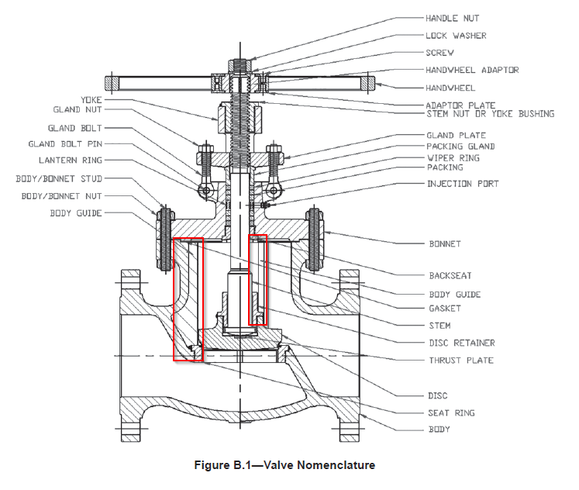
Figures showing new body guide design

Slide 24
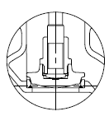
How do you check drawings for these guides?
Typically, there are three guides.
They are normally located 120 degrees apart, around the seat circumference.
One is normally located on the left-right
centerline of the valve, above the seat
ring and toward the inlet end.
The other two are arranged 60
degrees left and right of center,
toward the downstream end.

Slide 25
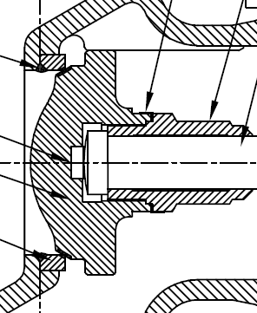
How do you check drawings for these guides?
Another, more subtle, indicator is to look at the periphery of the disc.
Presence of a vertical, flat, circular edge to the disc is an indicator of disc guides. Conversely, presence of a rounded or sloped disc edge is an indicator of lack of disc guides.

Slide 26
What will happen going forward?
Recent research has indicated a trend toward changes in Cv (Kv) values of newer valve designs equipped with these full guides.
Published Cv (Kv) values of some newer globe valve designs are lower than previously published values of older designs.
This is not a bad thing.
Since globe valves have historically tended to be over-sized in comparison to flowrate, this could tend to reduce the effects of over-sizing, as would be the case if a line-size valve is used instead of a valve that is one or two sizes smaller.

Slide 27
New designs going forward
We invite your feedback into the performance of these new-design globe valves with the fully-guided disc.
With this new standard, we expect to see fewer incidents of disc chatter (noise, vibration, cavitation)
We expect to see fewer incidents of severe vibration leading to stem leakage and potential fires.
Feedback from user experience is the single most important way that standards are upgraded and changed to meet changing conditions.

Slide 28
Thanks
ORGANIZING SECRETARIAT
Ph. +39 035 3230904
e-mail info@industrialvalvesummit.com
CONFERENCE ORGANIZERS
Ph. +39 3474908420
e-mail segreteria@valvecampus.com
www.industrialvalvesummit.com
www.valvecampus.com

