Slide 1
Low E Valves – 20 Years in the Making
CONFERENCE
ORGANIZERS

Slide 2
Low E Valves – 20 Years in the Making
Paul Heald | VP Product Engineering, Specialties & China Operations - BONNEY FORGE
Rodney Roth | NIPPON PILLAR

Slide 3
Chronological History of Low E
1990 – Clean Air Act of 1990
1991 – Petroleum Environmental research Forum - Low Emissions Valve Packings - Plant Evaluations (sponsored by Exxon)
1993 – Release of early Low E valve packing products (RM Graphaseal)
1997 – MSS-SP Project 93-17 Valve Fugitive Emission Measurement and Classification
1998 - Akzo Nobel Packing Test developed to evaluate potential Low E packing materials
1999 – ANSI/ISA 93.00.01 Standard Method for the Evaluation of External Leakage of Manual and Automated Valves
2000 – Chevron/Texaco Valve Test Developed to Qualify Valves and Packing
2006 – First Edition of API 622 Released with Leakage up to 500 ppm(Testing allowed in a valve or a fixture)
2006 – First Edition of ISO 15848 -1 Released

Slide 4
Chronological History of Low E
2007 – First Low E Consent Decree Lodged Against 2 Chemical Plants
2009 – First Low E Consent Decree Lodged Against a Refinery
2010 – FCI 91-2010 Standard Qualification for Control Valve Stem Seals
2011 – Second Edition of API 622 Released with 100 ppm threshold with Excursion to 500 ppm Allowed (testing only allowed in the fixture)
2014 – First Edition of API 624 Released with No Leakage Allowed Above 100 ppm
2016 – First Edition of API 641 Released with No leakage Allowed Above 100 ppm
2018 – Third Edition of API 622 Released with Pass/Fail Added with Leakage Above 100 ppm
2022 – API 622 High Temperature Addendum Released

Slide 5
Clean Air Act of 1990
Changed the game for valve and packing performance requirements
Led to the creation of many of the early Low E packing products developed
Created the need for Valve and Packing Testing

Slide 6
PERF Testing
Sponsored by Exxon
Backed by Other Companies (ARCO, Texaco, Gulf, Fina etc.)
6” Gate Valve mounted Vertically

Slide 7
Chevron/Texaco Test
Created need for standardized testing
Helped drive changes to API 622 Second Edition

Slide 8
Low E Consent Decrees
Low E Consent Decree language states less than 100 ppm or less leakage
Written definition for Low E valves
Written definition for Low E packing
Drive discussions within API to update 622 and eventually create 624 & 641

Slide 9
ISO 15848-1
Testing of Stem Seals in the valve
First Edition only allowed Helium
Second Edition allows testing with Helium or Methane to align with EPA language
The stem seals tested are only approved for the valve brand they are tested in

Slide 10
API 624
Creates Easy path for Users to Purchase Low E Valves as a standard
Covers API 600, 602, 603 and 623
New Edition has High Temperature testing added
Aligned with Consent Decree definitions written by the EPA

Slide 11
API 641
Creates Easy path for Users to Purchase Low E Valves as a standard
Covers API 599, 608 and 609
Aligned with Consent Decree definitions written by the EPA

Slide 12
API 622 Third Edition
Aligned with Consent Decree definitions written by the EPA
Allows for easy evaluation of packing because the test is performed in a fixture
Required for testing to API 624
Required for portions of API 641 testing
High Temperature testing addendum added

Slide 13
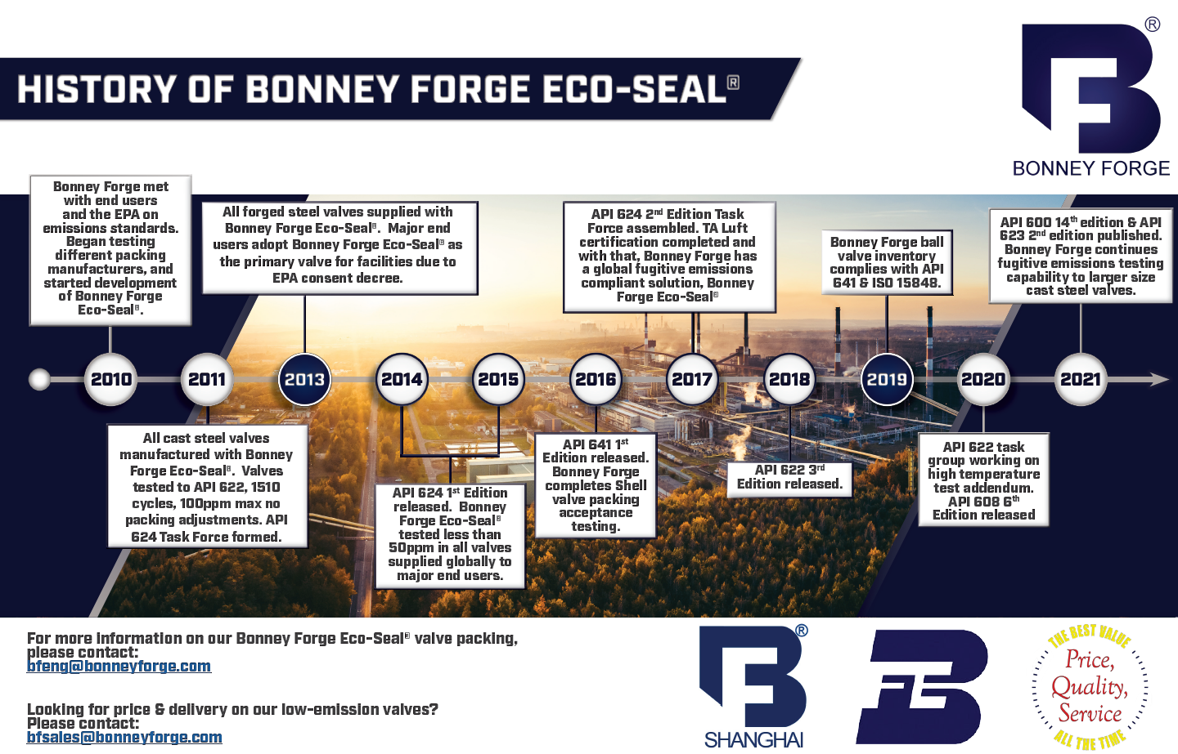

Slide 14
Thanks
ORGANIZING SECRETARIAT
Ph. +39 035 3230904
e-mail info@industrialvalvesummit.com
CONFERENCE ORGANIZERS
Ph. +39 3474908420
e-mail segreteria@valvecampus.com
www.industrialvalvesummit.com
www.valvecampus.com

