Slide 1
Valves for CCUS applications:
challenges and solutions for on-off and control valves
Speaker:
Marco Sparisci, Technical Director DAFRAM S.p.A.
Co-Authors:
Paolo Perroni, Technical Product Manager, DAFRAM S.p.A.
Andrea Borgognoni, Technical Project Manager, DAFRAM S.p.A.
CONFERENCE
ORGANIZERS
Notes:
Thank you Ron and welcome to every one and thank you for attending this Session.
My name is Marco Sparisci and I am Technical Director in DAFRAM Company. I have 15 years experience in the valve industry and I have been coordinating R&D activities and product development for severe applications. In particular I have been involved in valve development for different hydrogen applications. I am part of API 6D Committe who recently finalized requirements for hydrogen service. My Collegues and myself are in contact with End Users and Research Institutes with tasks and Projects related to Energy Transition and Carbon Capture and Utilisation in particular.

Slide 2

Outline
Background
Challanges:
  Background
  Piping equipment & Valves
Solutions
  Materials & Design
  Validation & Testing
  Monitoring
Case Study
© Copyright DAFRAM S.p.A.. All rights reserved.

Slide 3
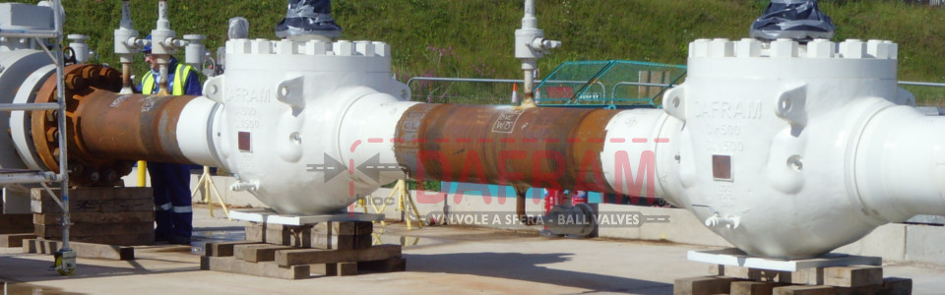
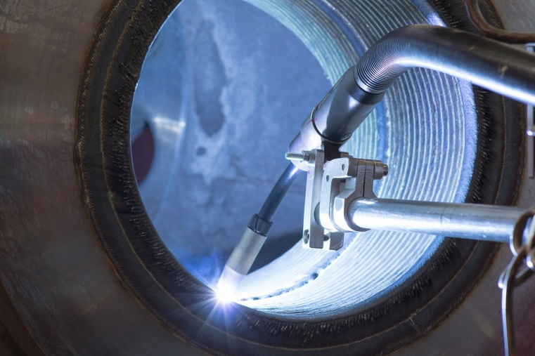
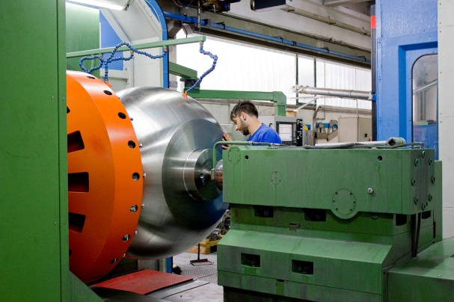

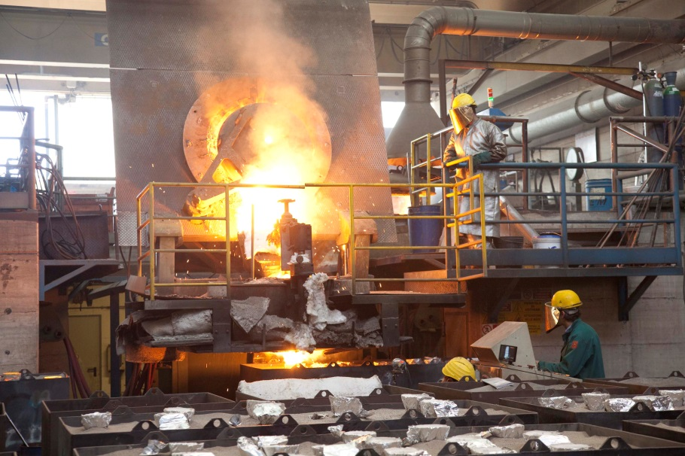
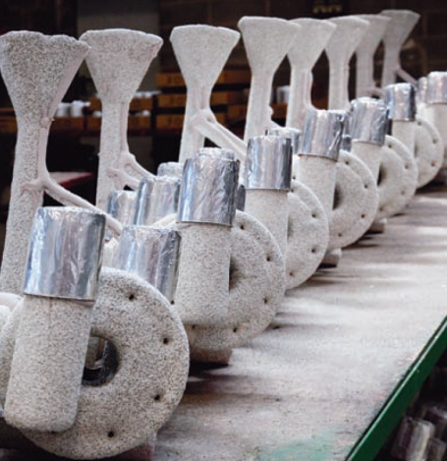

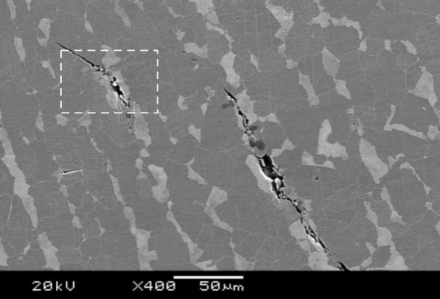
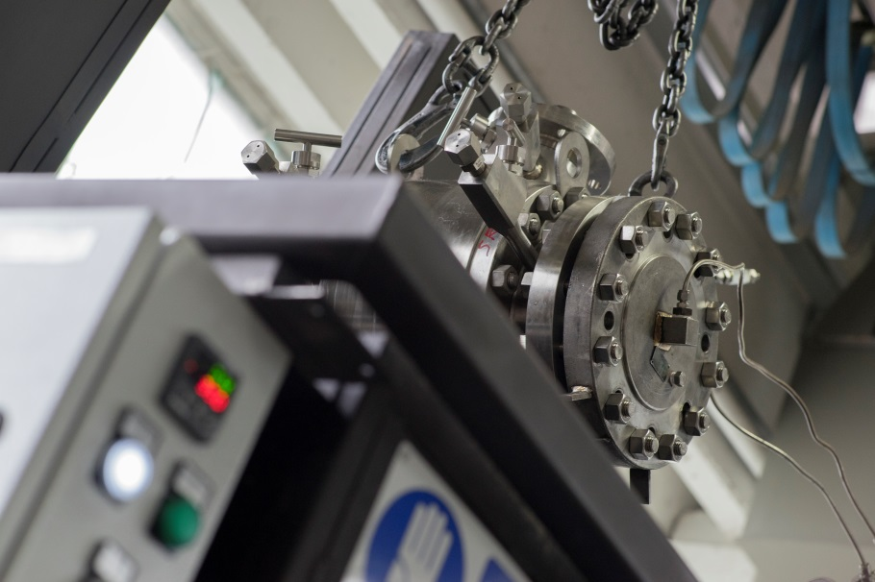
Introduction
Founded in 1956
based in Urbisaglia (MC) - Italy
BALL VALVES:
½” up to 60” (DN15 to DN1500)
Class 150 up to 15000 (16 to 1035 bar)
APPLICATIONS:
Oil&Gas (Upstream, Midstream, Downstream)
Chemical & Pharmaceutical Industries
Power generation
© Copyright DAFRAM S.p.A.. All rights reserved.

Slide 4
Background
CO2 impact on climate change
CO2 emissions sources
CO2 demand
Need for strategies of CO2 capture, transportation, storage and utilisation
© Copyright DAFRAM S.p.A.. All rights reserved.

Slide 5
Background
CO2 Capture
CO2 storage
CO2 transportation
CO2 utilisation
Recent improvements for typologies and efficiency of CCUS technologies
© Copyright DAFRAM S.p.A.. All rights reserved.

Slide 6
Applications & Conditions
CO2 capture
Post/Pre combustion: warm gas up to 350-600°C, low pressure (solid sorbents)
Membrane separation: moderate temperature, high DP
Oxy-fuel combustion: O2 handling, up to 2000°C
Amine process: amine handling, high DP, T up to 200°C
Presence of contaminants to be considered
© Copyright DAFRAM S.p.A.. All rights reserved.

Slide 7
Applications & Conditions
CO2 transportation
Pipeline: dense phase
Pipeline: gas phase
Ship/Rail/Truck: moderate cryogenic
Presence of contaminants to be considered
© Copyright DAFRAM S.p.A.. All rights reserved.

Slide 8
Applications & Conditions
CO2 storage
Injection: dense phase, high pressure (similar to EOR)
Injection: liquid (pilot Prj)
P/T of injection as per site conditions
Flow assurance for injection
© Copyright DAFRAM S.p.A.. All rights reserved.

Slide 9
Applications & Conditions
CO2 utilisation
Traditional processes: chemical industry (fertilizer), Oil&Gas (EOR), Food&Beverage
Innovative Processes: integration EGR-LNG, Methanol production
Presence of other chemicals
Requirements by FDA standards
Developments to follow
© Copyright DAFRAM S.p.A.. All rights reserved.

Slide 10
Challenges for piping equipment
Pressure range:
typical moderate, up to class 2500 for injection or membrane separation/capture
Temperature range:
Ambient temperature for pipeline transportation;
Moderate cryogenic for ship transportation & utilisation;
High temperature for gas combustion;
Chemicals in the mix; Transition of state
© Copyright DAFRAM S.p.A.. All rights reserved.

Slide 11
Challenges for piping equipment
Corrosion of metallic materials: impurities, water
Limits of dehydratation, purification technologies
Elements in CO₂ stream
H₂0
Ar
N₂
O₂
SO₂
Components in CO2 stream from post-combustion and before compression
© Copyright DAFRAM S.p.A.. All rights reserved.

Slide 12
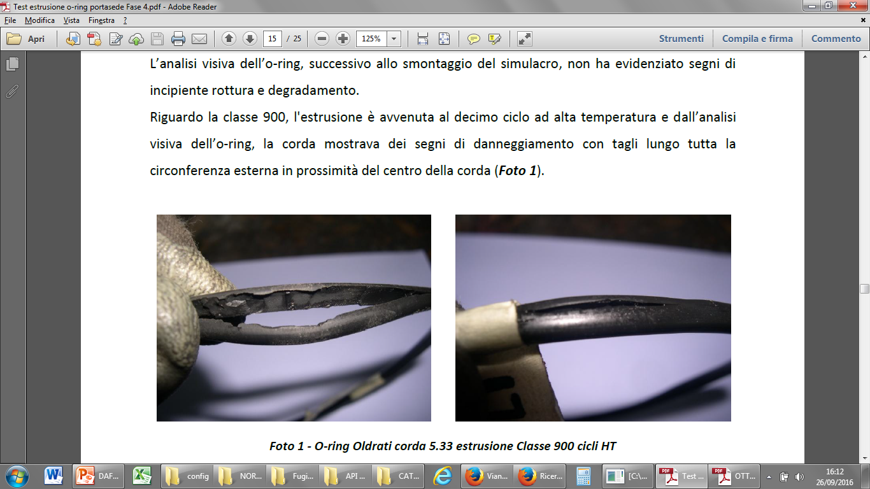
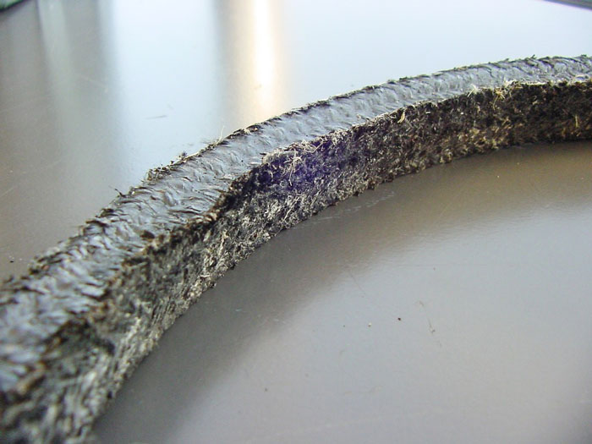
Challenges for piping equipment
Interaction with soft materials:
Service temperature (low), swelling & RGD, solvation capability & aging, contamination
Dafram RGD O-Ring test - P-T cycles in mock-up
© Copyright DAFRAM S.p.A.. All rights reserved.
Gasket used for validation tests

Slide 13
Challenges for piping equipment
Ductile Fracture propagation
Sensible to type/qty of impurities, CO2 state and fluid temperature
© Copyright DAFRAM S.p.A.. All rights reserved.

Slide 14
Challenges for piping equipment
Variations of process conditions
Precipitations, formations
© Copyright DAFRAM S.p.A.. All rights reserved.

Slide 15
Challenges for piping equipment
Cryogenic service
Moderate cryogenic conditions: control of toughness of metals, shrinkage of soft materials, functional requirements (e.g. loading/unloading systems)
© Copyright DAFRAM S.p.A.. All rights reserved.

Slide 16
Challenges for valves
Corrosion of metal parts
Seals and bush effectiveness
High pressure (e.g. CO2 well injection)
High temperature (e.g. CO2 capture)
Cryogenic performance (CO2 liquid)
Long-lasting suitable performance
© Copyright DAFRAM S.p.A.. All rights reserved.

Slide 17
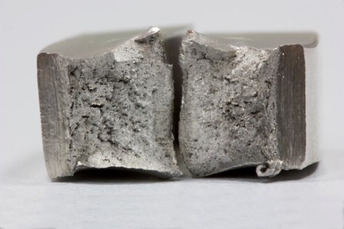
Solutions
Selection of metallic materials (ref. corrosion phenomena, toughness, etc.)
Well established guideline for corrosion resistance:
Carbon/Low-alloyed steel: limited free H2O
Duplex-SuperDuplex & Martensitic: limited H2S
Austenitic/Nickel based alloys: suitable, LT-HT
© Copyright DAFRAM S.p.A.. All rights reserved.

Slide 18
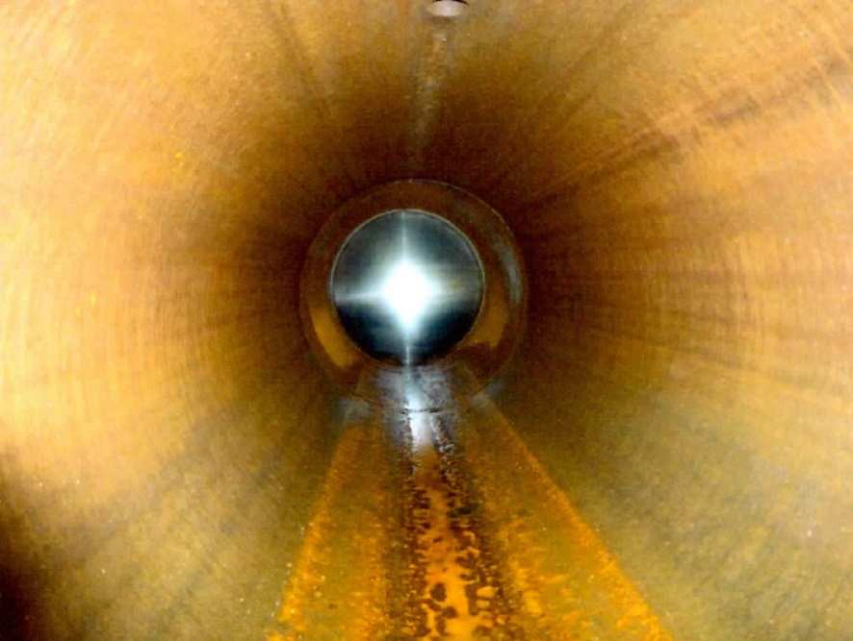
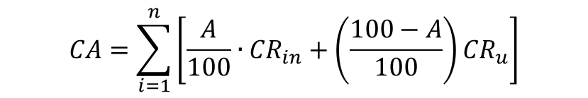
Solutions
Corrosion resistance strategy
Corrosion Allowance approach
$$CA=\sum_{i=1}^{n}{\left[\frac{A}{100}∙{CR}_{in}+\left(\frac{100−A}{100}\right){CR}_{u}\right]}$$
CA = Corrosion Allowance [mm]
A = availability of corrosion control [%]
N = number periods with constant conditions
CR_{in} = corrosion rate with corrosion control [mm/year]
CR_{u} = corrosion rate without corrosion control [mm/year]
© Copyright DAFRAM S.p.A.. All rights reserved.

Slide 19
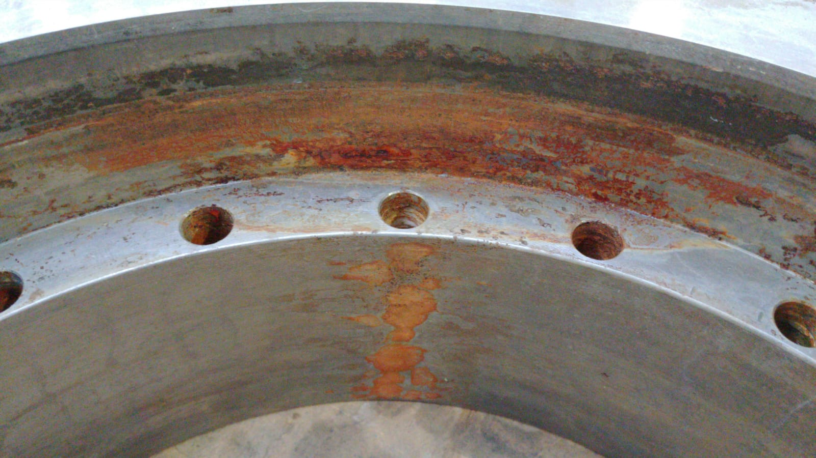
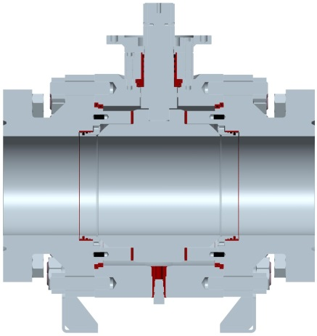
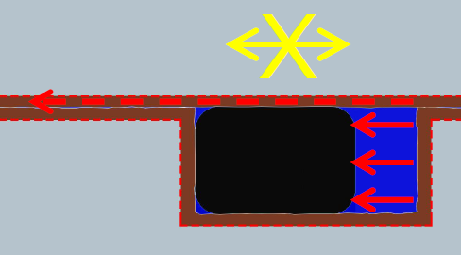
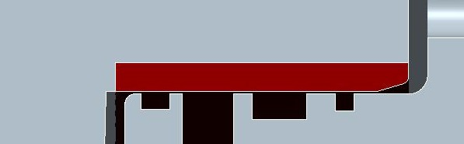
Solutions
Corrosion resistance strategy
Corrosion Resistant Alloy application
© Copyright DAFRAM S.p.A.. All rights reserved.

Slide 20
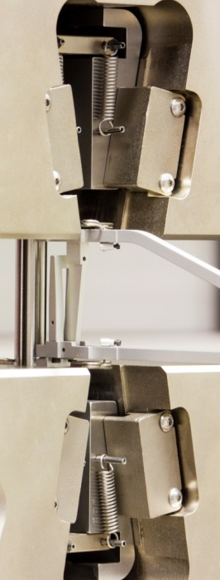
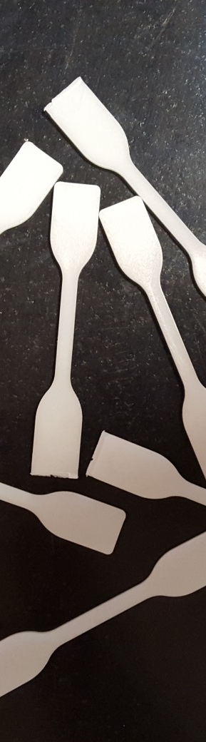

Solutions
Seals selection:
Limits and compound selection of elastomeric seals
Limits and selection of thermoplastic seals
Bush design and materials:
Avoid corrosion
Avoid permeation/entrapment within layers
UNICAM School of Science and Technology
© Copyright DAFRAM S.p.A.. All rights reserved.

Slide 21
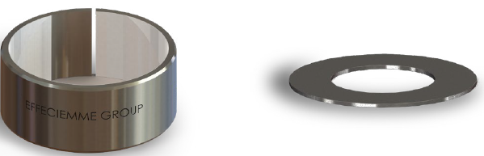
Solutions
Developed guidelines for
Selection of gasket materials & compounds
Selection of bush typologies and materials
Self lubricant bearings. Courtesy of Effeciemme
© Copyright DAFRAM S.p.A.. All rights reserved.

Slide 22
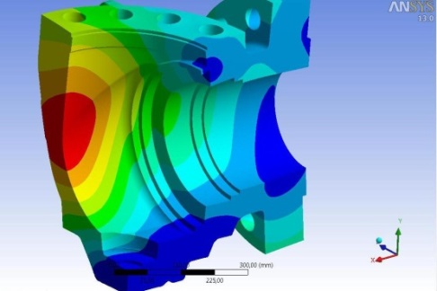
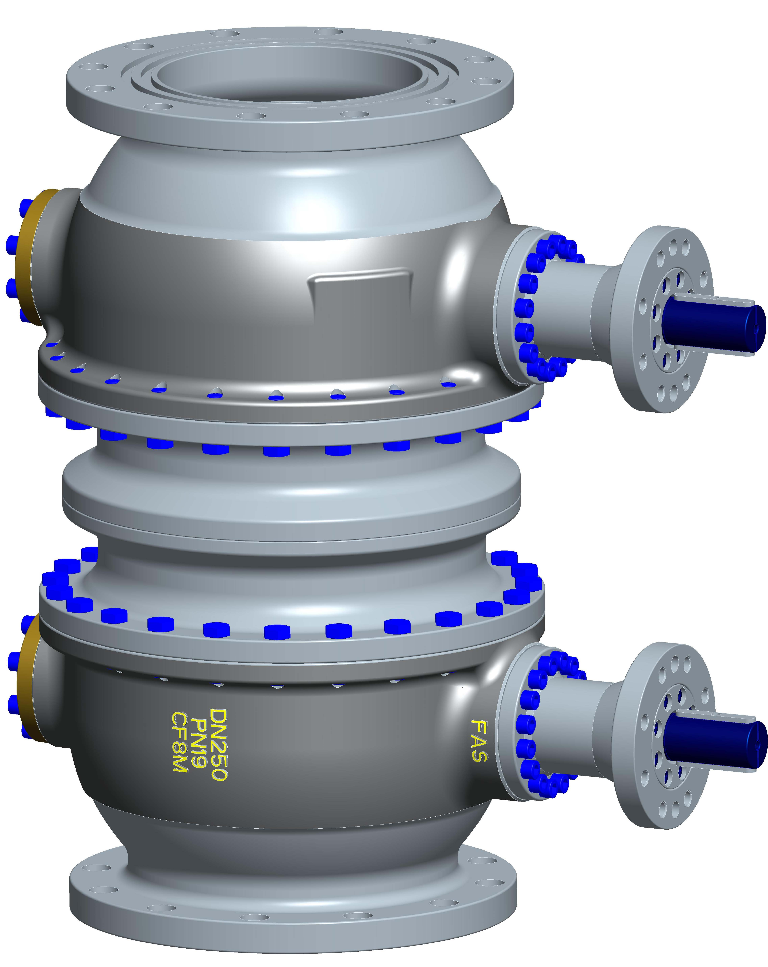
Solutions
Dedicated design:
Robust construction for P/T range
Minimizing leak paths
Cavity relief & Isolation Philosophy
Cryogenic / High temperature service
Customized for ERS – Loading arms
Non-linear FEA for stress evaluation, DAFRAM Technical Dept.
© Copyright DAFRAM S.p.A.. All rights reserved.
DAFRAM customized valves for ERS Loading Arms

Slide 23
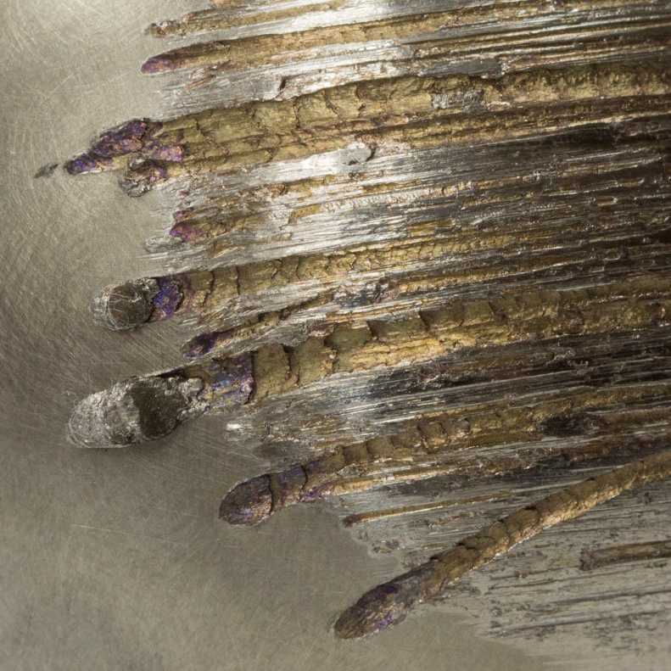
Solutions
Dedicated design: Flow control
Dedicated trim design for the application
(e.g. anti-surge, capture/separation, injection)
Quick response
Wear resistance (injection, solid formations)
Anti-plug trim (injection, solid formations)
DAFRAM sizing tool for control valves
© Copyright DAFRAM S.p.A.. All rights reserved.
DAFRAM test on wear resistant coatings

Slide 24
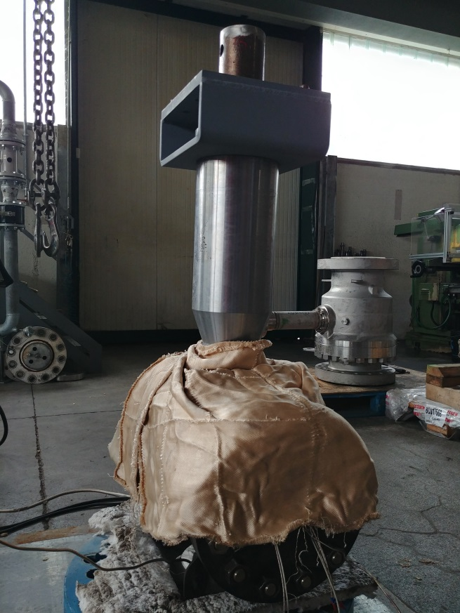
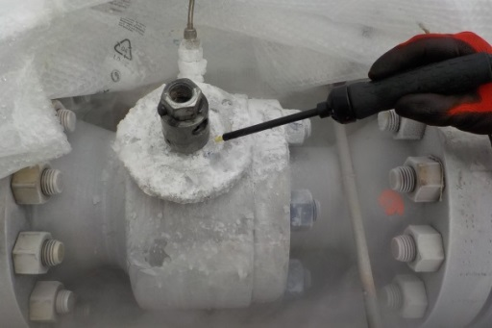
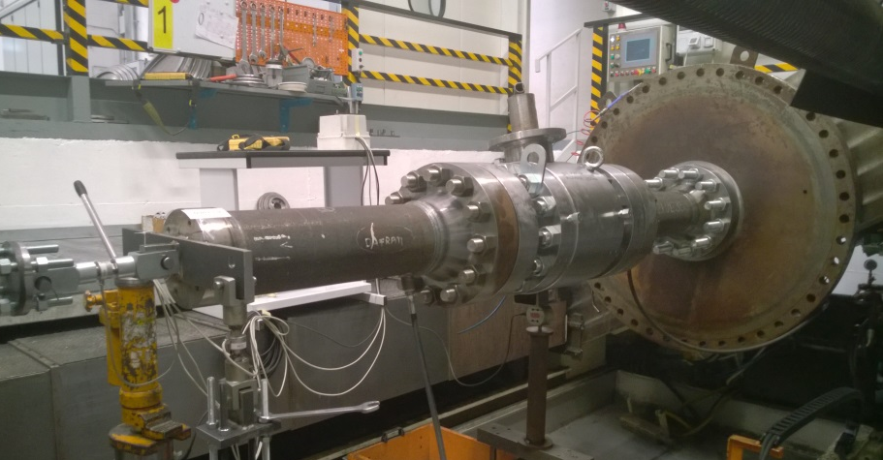
Solutions
Validation tests: FE-TAT, PR2, Pressure-Temperature cycles, etc. , external loads
Functional Tests: extensive pneumatic tests, FET, cavity relief
FE validation test at DAFRAM Testing Dept.
External load test at DAFRAM bench
© Copyright DAFRAM S.p.A.. All rights reserved.
Heating for validation test

Slide 25
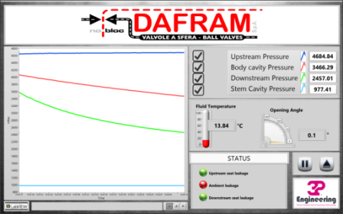
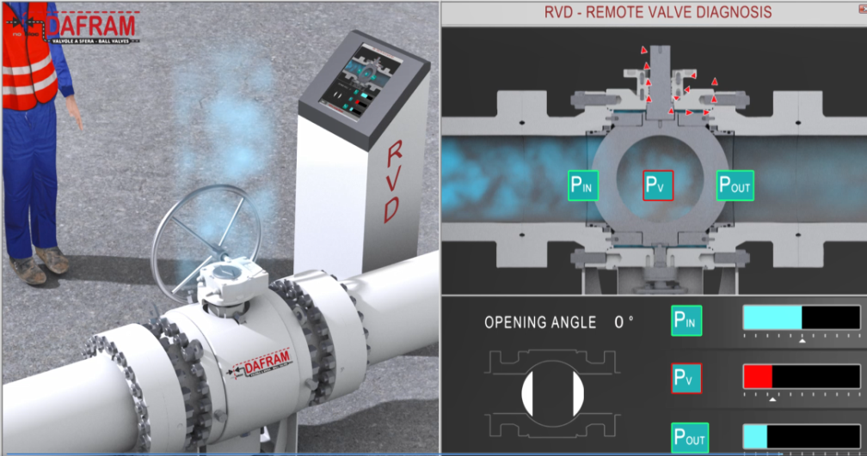
Solutions
Long-lasting performance of new equipment:
Design, materials, Validation & Testing
Monitoring by RVD - Remote Valve Diagnosis
Real time analysis by proprietary algorithm
Extremely sensitive leak detection system
Enhanced safety for the plant/system
© Copyright DAFRAM S.p.A.. All rights reserved.
DAFRAM and 3P Proprietary RVD System

Slide 26
Solutions
Long-lasting performance of new equipment: Design, materials, Testing, Monitoring
Assessment of existing equipment & valves for CCUS:
Assessment of actual corrosion of metals
Replacement of soft seals (if possible)
Limitation of P levels not always decisive (i.e. pipelines)
Final risk evaluation vs regulations
© Copyright DAFRAM S.p.A.. All rights reserved.

Slide 27
Case Study Project
UAE first project for CC (steel factory site), transportation & injection (2015)
Trunnion mounted ball valve 2’’ to 8’’, class 2500 and API 10000
Application: CO2 Dense phase, ESD & HIPPS valves
Design conditions ESD: -49° to 150°C, up to 420 bar
Design conditions HIPPS: -50° to 120°C, up to 494 bar
Applicable spec.: Shell Mesc & Shell DEP, Company & Project spec.
Reference standards: API 6FA, Nace MR0175, ISO 15848
© Copyright DAFRAM S.p.A.. All rights reserved.

Slide 28
Case Study
Design requirements:
Side-entry or Top-entry
Stem extension (min. design temp. -50°C)
Soft or metal seated, self-relieving, DBB
Solids entrapment protection: springs & cavity protection
Grease injection system for trunnion bushes, stem & seat
Vent & drain: RTJ flanged to body
© Copyright DAFRAM S.p.A.. All rights reserved.

Slide 29
Case Study
Material selection:
CS (3mm c.a.) + Overlay Inc625 on sealing areas
Springs in Inc718
Peek inserts, Lip-seals, V-pack (Norsok M-710 tested)
Auxiliary HNBR (FKM not allowed), graphite fire-safe
Bushes Inc625+Ptfe (bronze not allowed)
© Copyright DAFRAM S.p.A.. All rights reserved.

Slide 30
Case Study
Testing requirements:
Seat gas testing (ref. API 6D, 6A PSL3G)
Fugitive emission class A(HS), Mesc 77/312
Functional Testing (including HIPPS)
© Copyright DAFRAM S.p.A.. All rights reserved.
Notes:
Fugitive Emission production testing, validation test not required

Slide 31
Conclusions
CCUS related processes and handling imply peculiar aspects for performance requirements, interactions with materials and design of valves
Remarkable data and technical background
Research on materials shall be carried out for innovative CCUS applications
Mfrs know-how is crucial to meet performance and durability in demanding conditions
End Users & Mfrs cooperation is beneficial to develop fit-for-application cost-effective set of requirements
© Copyright DAFRAM S.p.A.. All rights reserved.

Slide 32
Thank you for your attention!
Come and visit us: Hall A Booth A152
Contacts:
Marco Sparisci, m.sparisci@dafram.it
For technical-commercial information: info@dafram.it
© Copyright DAFRAM S.p.A.. All rights reserved.

